Slide 1

Developing Art & Design Experiential Learning Outcomes: Navigating the Complex Terrain of Experiential Learning in Studio-based Education
Learning Outcomes Symposium
11 October 2018
Susan Ferguson
Cary DiPietro
OCAD University

Slide 2
Presentation Overview
Background and Key Debates at OCAD U
Community Engagement Process and Experiential Learning Model
Experiential Learning Framework
Questions and Discussion

Slide 3
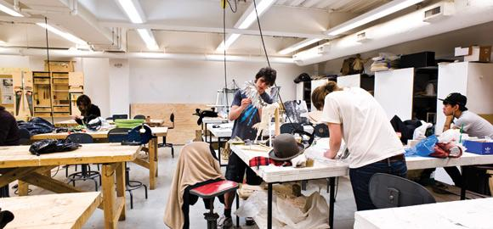
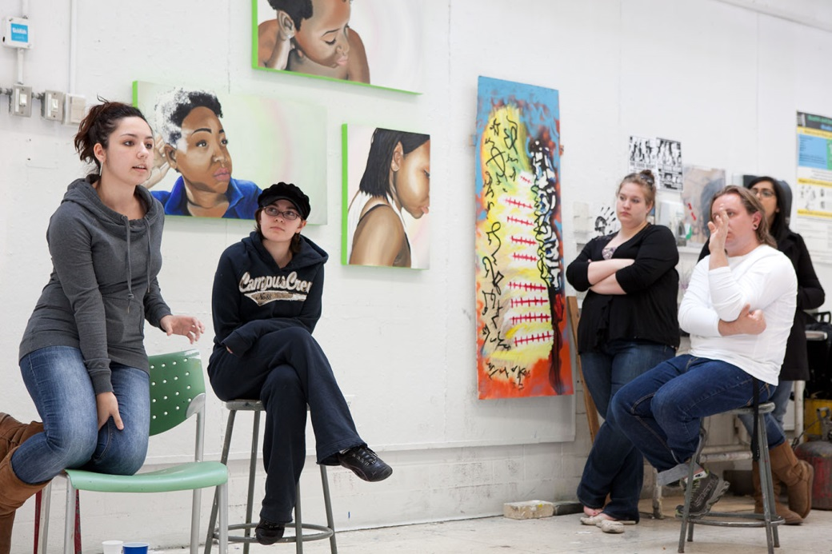
Studio Education as Experiential Education?
Above: OCAD U Website asset. Left: Christina Gapic. No title. OCAD U Painting Critique. 2012.
Notes:
OCAD University is Canada’s largest art and design university. We offer undergraduate programs across three Faculties – Art, Design and LAS – in disciplines such as Drawing and Painting, Photography, Sculpture and Installation, Graphic Design, Environmental Design and Advertising.
OCAD U is a predominantly studio-based learning environment. What is studio education?
Strong emphasis on making, active learning, learning by doing, peer critique and collaborative projects.
Also a strong culture of valuing faculty professional practice (compared to the emphasis on research and publication at comprehensive universities).
And so, when we first began talking about experiential learning at OCAD U, and the desire to provide more opportunities to ground student learning in real-world contexts, there was a strong feeling among many faculty that a studio-based education is inherently experiential – that is, there is already a strong integration of theory and practice, strong relationships with community and industry and a strong emphasis on learning by doing.
The discourse of studio education as experiential education became both the dominant one, and the inevitable one.

Slide 4
Student Perspective
Notes:
Student data tells a somewhat different story about the extent to which our programs have addressed experiential learning, however...
There is ample evidence that while OCAD U offers a deeply engaging learning experience, what students expect are more opportunities to translate their learning experience to employment and more opportunities to develop the skills necessary to succeed in the workforce, including self-employment.
The 2017 National Survey of Student Engagement (NSSE) results demonstrate that OCAD University respondents are less likely than their Ontario counterparts to indicate that their experience at university contributed to acquiring job- or work-related knowledge and skills.

Slide 5
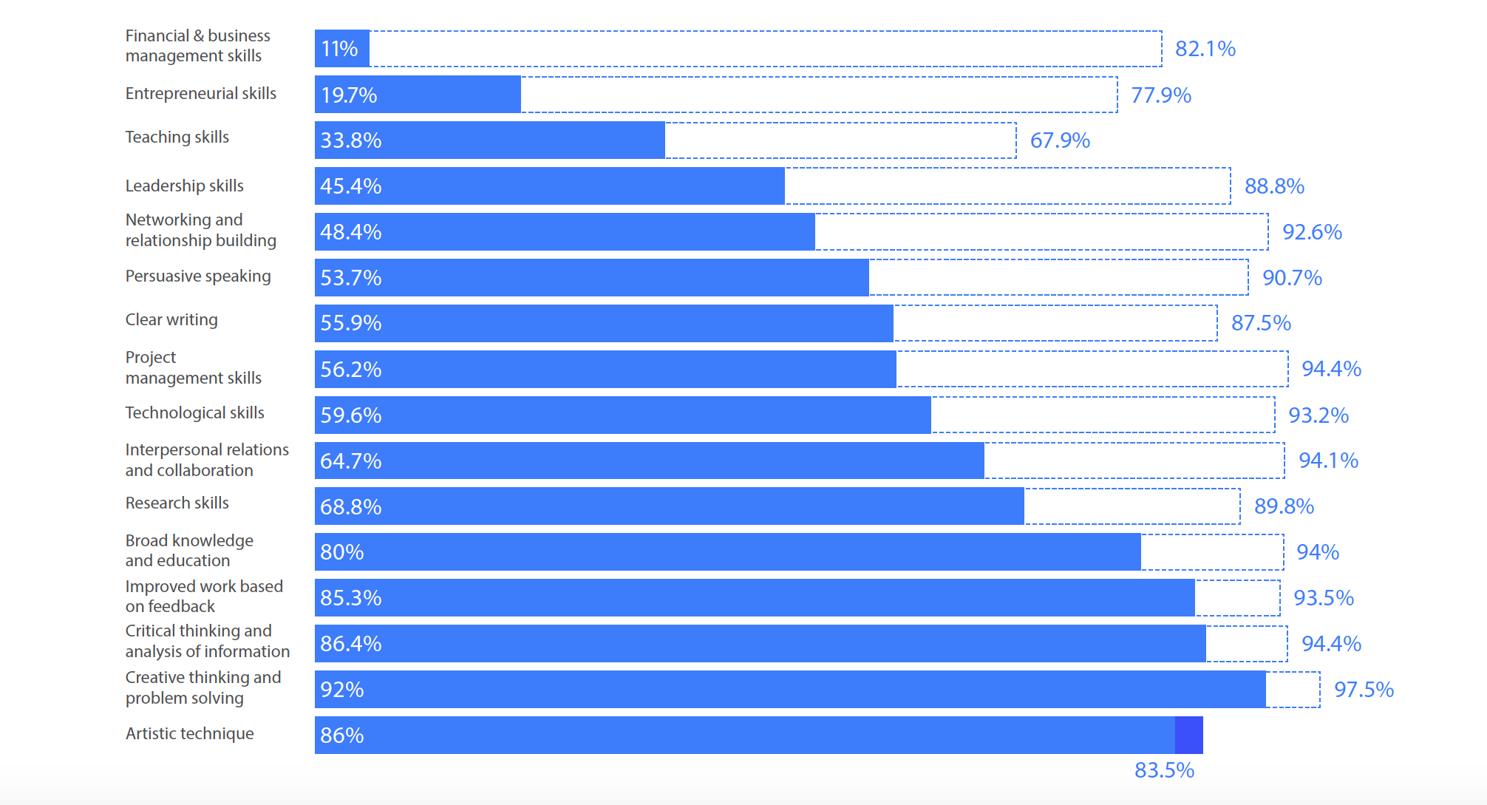
Student Perspective
SNAAP 2015:
How much did OCAD U help you acquire or develop each of the following skills and abilities? (% very much)
How important are the following to perform effectively in your profession or work life? (% very important)
Notes:
While surveys of OCAD U graduates show promising employment rates, data from the Strategic National Arts Alumni (SNAAP) survey points to the challenges of translating an art or design degree to employment.
When asked how OCAD U helped them acquire the skills and abilities important to their professional or work life, the gaps are most prominent in the areas of financial & business management, entrepreneurial, leadership and networking, and relationship-building.

Slide 6
Task Force on Experiential and Work-Integrated Learning
...The task force is responsible for developing a comprehensive Experiential and Work-Integrated Learning Strategy at OCAD University, including recommendations for key models, activities and associated timelines and resources that will enable OCAD U to grow self-sustaining curricular and co-curricular experiential education and work-integrated learning opportunities that build on existing programs and offerings.
Notes:
In Fall 2017, the Provost struck a Task Force on Experiential and Work-Integrated Learning. Task Force composed of faculty, staff and students. Still underway.
Our mandate was to develop a coordinated strategy to scale up experiential learning at the university and respond to Ministry priorities in this area.
Entering this process, we knew a few things –
We needed a scalable model
We needed to improve the visibility and accessibility of EL opportunities for a very diverse student body
We needed better, more transparent mechanisms for alumni and partner engagement
Perhaps most importantly, though, we knew that the debates around EL at OCAD U have been very complex.
And so, an underlying goal was to focus the conversation and move the university community through a structured process of community consultation and consensus-building to develop a shared understanding about how to fulfill our various accountabilities in this area – to the Ministry, to students, and to our faculty.
There was an implicit understanding that we needed to find a way to at once acknowledge the fact that experiential learning activities are already woven throughout the OCAD U curriculum while at the same time move the conversation forward and develop a strategy for expanding and making more visible and intentional experiential learning opportunities for our students.

Slide 7
Task Force Process
Environmental Scan
Consultation with Faculties
Informal audit of EL in the curriculum
Community Engagement and Visioning
Collaborative design methodology
“Big Day” produced a proposed model
Consultation with Faculties
Community Engagement and Visioning
Development of EL Framework
Notes:
This emphasis on dialogue and consensus-building is reflected in the process we used to guide the work.
Iterative process, through which the proposed model for EL was refined and clarified.
Collaborative design methodology
Hired a Master’s student with extensive professional experience in organizational development to lead us through a design thinking process
Project became part of her Master’s research
Began with problem identification (by Task Force)
Broadened out to include large group of community stakeholders - ”Big Day” – to generate vision for EL at the university
Narrowed back to the Task Force to future proof and refine the proposed approach

Slide 8
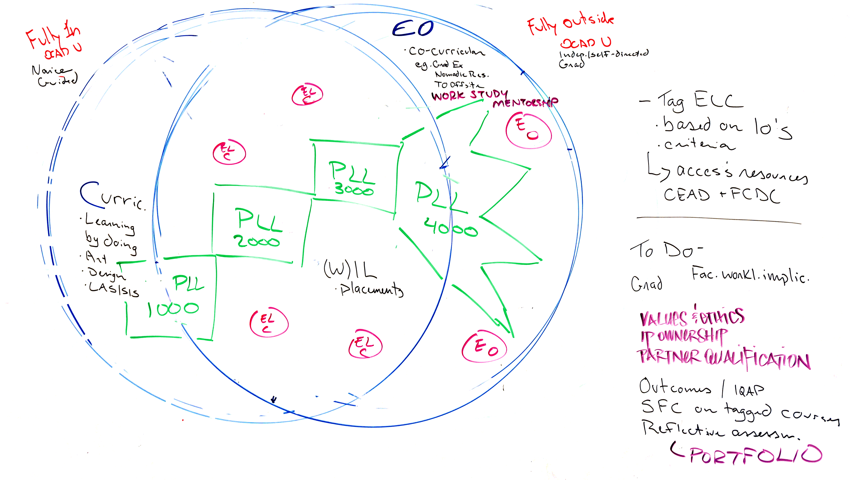
Notes:
Visioning day and follow up sessions resulted in an overall model or approach, as well as some questions or tensions (that I’ll share later).
Consultation process helped clarify model.
This is how we began...

Slide 9
Curriculum:
Learning by Doing (Art, Design, LASSIS)
Co-Curricular:
Eg., Nomadic Residencies,
TODO Offsite
Work Study
Mentorship
Experiential Opportunities
Notes:
The proposed model emerged from our current state...
Lots of learning by doing.
Lots of co-curricular opportunities.
Limited integration of connection between these two areas.

Slide 10
Fully Inside OCAD U
Fully Outside OCAD U
EXPERIENTIAL LEARNING OPPORTUNITIES
(AKA PODS --> PROFESSIONAL LEARNING LABS)
CURRICULUM
EXPERIENTIAL OPPORTUNITIES
Notes:
It was decided, though the design thinking process, that our goal was to enlarge the sweet spot in the middle where curriculum and co-curriculum meet.
This space in the middle went through various incarnations – community of practice, learning labs, etc. – but what remained consistent was that they were to be grounded in students’ programs and supported by teaching resources and co-curricular opportunities in very intentional ways.

Slide 11
PROFESSIONAL LEARNING LABS
FEATURES:
Tightly couple curriculum and co-curriculum
Connected to existing courses where possible
Explicit and clear to students
Engage alumni, trusted partners
Diverse, flexible (built to engage a wide range of students)
Evaluated through reflection, portfolio & documentation
PLL 4000 (or capstone?)
Specialized, self-directed opportunities
PLL 3000:
Sample opps: exhibitions, sales, contracts, commissions
PLL 2000:
Sample opps: shadowing, charrettes, short projects, mentoring
PLL 1000: Connections & Discovery
Sample opps: site visits, portfolio development, resume
Facilitators/mentors for 1st year PLLs
EXISTING OPPORTUNITIES:
Placement courses
Etc. continue to exist
Notes:
The proposed model was to be staged across year levels, resulting in more specialized and self-directed opportunities by 4th year.
There was also strong interest in a peer component.

Slide 12
Curriculum
Co-Curriculum
Program-specific
Interdisciplinary
For credit, graded
Not for credit
Competing notions of experiential learning
Notes:
Tensions that emerged throughout our consultation process...
A more complex cluster of tensions emerged (and continue to resonate) in relation to a set of competing notions of experiential learning noted earlier, ranging between experiential learning as a discrete set of employability skills that can be measured in employment outcomes and experiential learning as a studio-based, hands-on, materials-based practice.
To resolve these tensions into a shared strategy, we decided on a curricular approach that is for-credit and program-specific, but flexible, and one that seeks to integrate and align work-integrated learning with our strengths in theory, practice and community engagement.

Slide 13
EXPERIENTIAL LEARNING DESIGNATED COURSES
IDENTIFIED BY PROGRAM
COURSE-LEVEL EL ACTIVITIES TIED TO PROGRAM-LEVEL LEARNING OUTCOMES IN FRAMEWORK
RESOURCES TO SUPPORT LEARNING OUTCOMES
EXPERIENTIAL LEARNING COMMUNITIES
CONNECTIONS
PEER-LED
SELF-DIRECTED
ACCOUNTABLE
EXPERIENTIAL LEARNING
OPPORTUNITIES
PROJECTS
SHADOWING
PLACEMENTS
STUDENTS SUPPORTED BY CENTRE FOR EMERGING ARTISTS & DESIGNERS
FACULTY SUPPORTED BY FACULTY & CURRICULUM DEVELOPMENT CENTRE
Notes:
Ultimately, this is where we landed: An approach that, assuming it is approved by Senate, designates or tags EL courses in each program at the second, third and fourth year levels.
This approach accomplishes a few important things:
It acknowledges that EL is already present in the curriculum and acknowledges faculty expertise
At the same time, it provides a means through which to identify places where EL activities are authentic, intentional and assessed – and meet Ministry criteria
It makes EL transparent to students
It meets students where they already are – in courses – and enhances access to co-curricular by drawing co-curricular opportunities and expertise closer to curriculum
Now over to Cary, who will walk us through the development of our EL Framework to support the recognition and integration of transparent, intentional EL opportunities within the curriculum...

Slide 14
Proposed Model: Key Features
Tightly couple curriculum and co-curriculum
Aligned with program learning outcomes and OCAD U’s UDLEs
Explicit and clear to students
Inclusive and accessible to our diverse student body
Provide a transparent mechanism for engaging partners, alumni, collaborators
Intentional assessment of student learning from experiential activities

Slide 15
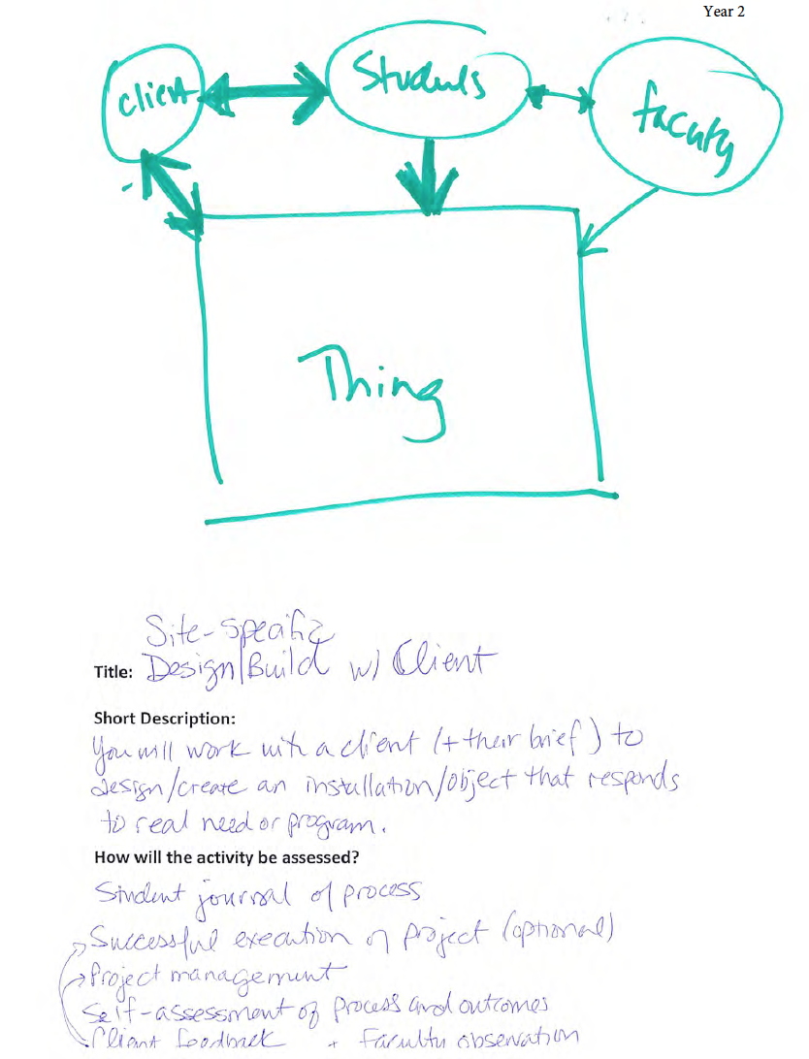
EL Visioning Session
Work in pairs to brainstorm EL activities
Work within the Ministry’s guiding principles and context of program
Include assessment
Map it to year level
Notes:
Once we identified the need for a framework as part of the overall EL strategy, a second workshop was undertaken to engage faculty for their knowledge and experience and generate material we could use for the framework, which we knew needed to include both learning outcomes and model activities.
I’m going to discuss in some length the methodology we used for the workshop to highlight some of the strategies that were used to navigate the relationship between experiential learning and studio-based pedagogy, before we look closely at the resulting learning outcomes.
Conventional wisdom would argue for a so-called “backwards design” or constructive alignment approach in which we would begin by identifying what students should be able to do after completing successful EL activities and then fill in the example activities with a clear focus on the learning outcomes. In this case, however, we decided to take a different approach because of the tensions Susan noted revolving around competing notions of experiential learning. That is to say, we were concerned that, by asking faculty to engage in a way of thinking abstractly about EL as both learning that would enhance students’ employability through authentic, work-integrated experiences and activities fully aligned and embedded within program curriculum might bring us back to the same conversations we’d been having.
So we chose instead to ask our faculty participants to begin by brainstorming EL activities, thinking creatively and innovatively, but within the Ministry’s guiding principles.

Slide 16
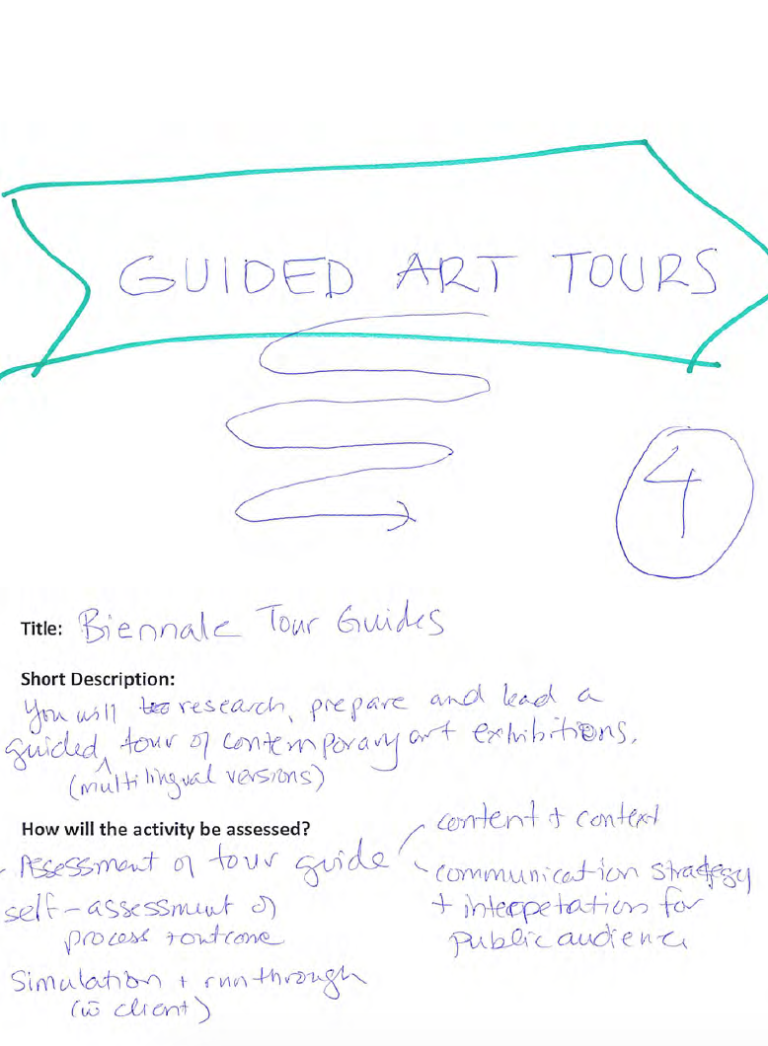
EL Visioning Session
Work in pairs to brainstorm EL activities
Work within the Ministry criteria and context of program
Include assessment
Map it to year level
Notes:
The projects that they developed show how readily the work in which students engage in art and design studio contexts is readily adapted to a more explicit experiential learning situation, such as responding to a site-specific design brief generated not by the course instructor but by a real-world client, or turning a curatorial project on contemporary local art or artworks into a Biennale-style tour.

Slide 17
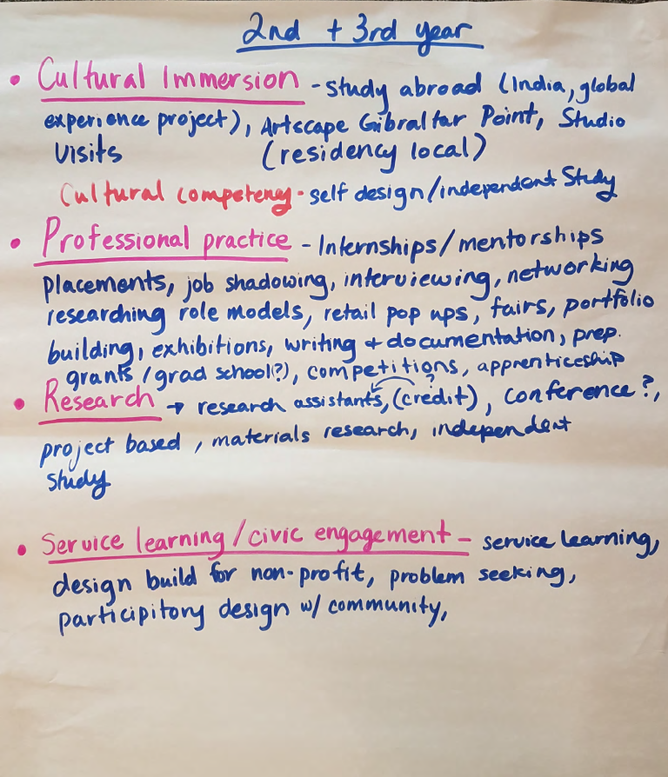
EL Visioning Session
Work in groups to identify three or four model activities at each year level
Notes:
In the second stage of this activity, we then asked the participants to map their model activities to the level of knowledge, skills and attitudes that were being developed, from beginner to intermediate and advanced, such that all examples were mapped across a timeline. Participants were then asked to join groups for each of the different levels, look at the examples posted at their level and generate some broader models for inclusion in the framework.

Slide 18
EL Visioning Session
Thinking of your EL activity, brainstorm specific knowledge, skills and attitudes students will be able to demonstrate by completing the activity
develop + update CV + portfolio
scan field for submission / employment opportunities (identify gaps?)
autonomy of depth / breadth of knowledge – define the qualities that comprise successful individual and group work
conduct a user / client interview – basic open-ended questions, actively listen
communicate with facilitators / offices / resources
communication – reflect in multiple formats (verbal, written, presentation, critique)
methodologies – list the skills / knowledge / resources you require to do this experiential work
limits of knowledge – identify the value of the experiential work
articulate their own contributions to a project outcome
limits of knowledge – develop a proposal of how you would have done the experiential work differently (if given the chance)
evaluate + explore opportunities available
documentation for commission
to be willing to experiment to discover solutions
Notes:
In the second half of the workshop, we finally turned to the development of the learning outcomes, asking participants to think through their activities and models to identify the specific knowledge, skills and attitudes students would be able to demonstrate by completing the activity or set of activities.
At this point, we also provided the six main Degree-Level Expectations as prompts to consider, to see how or whether they would incorporate the language or use it to express the kinds of learning students would engage in.
Participants worked individually to generate these learning outcomes on individual post-it notes and then mapped them to beginner, intermediate and advanced levels.

Slide 19
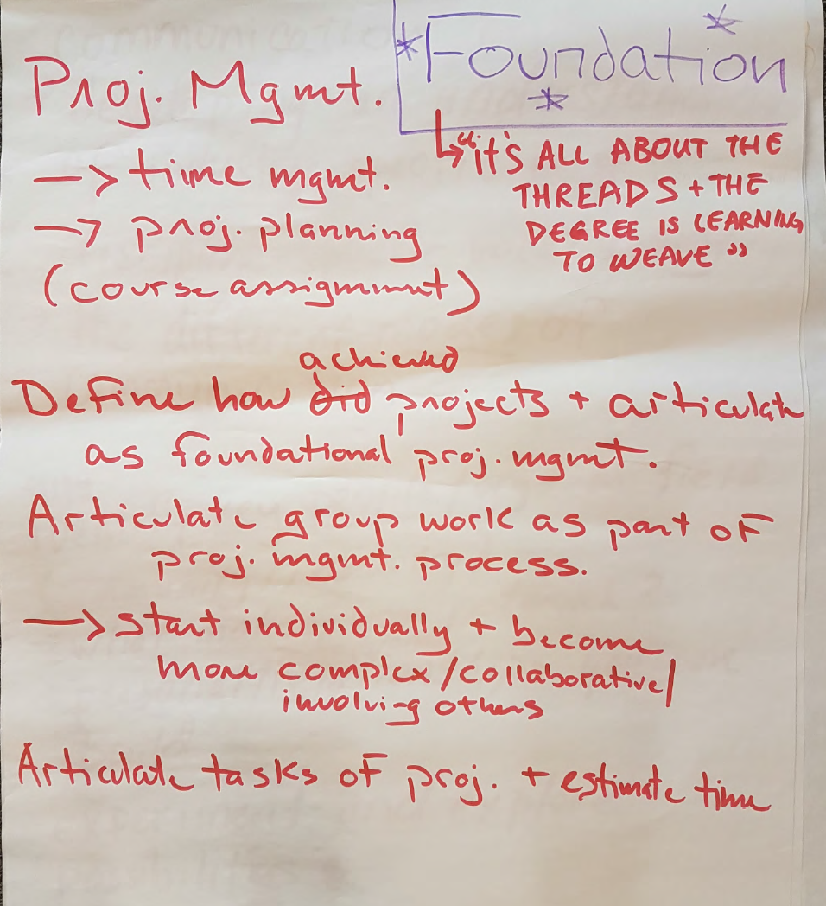
EL Visioning Session
Map learning outcomes to year levels
In original groups, review learning outcomes, revise, organize, synthesize
Notes:
Finally, participants returned to their earlier group of beginner, intermediate or advanced level and were asked to review the learning outcomes, revise, organize and synthesize them with a view to generating some broader thematic categories.
We could see some of the common themes in conversations about EL emerging through the workshop: for example, the importance of project and task management,

Slide 20
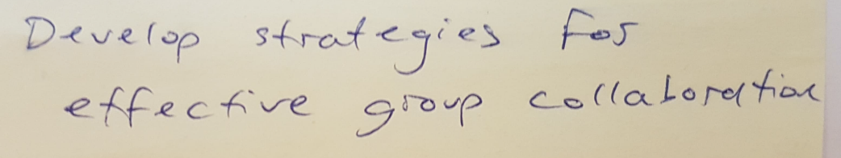
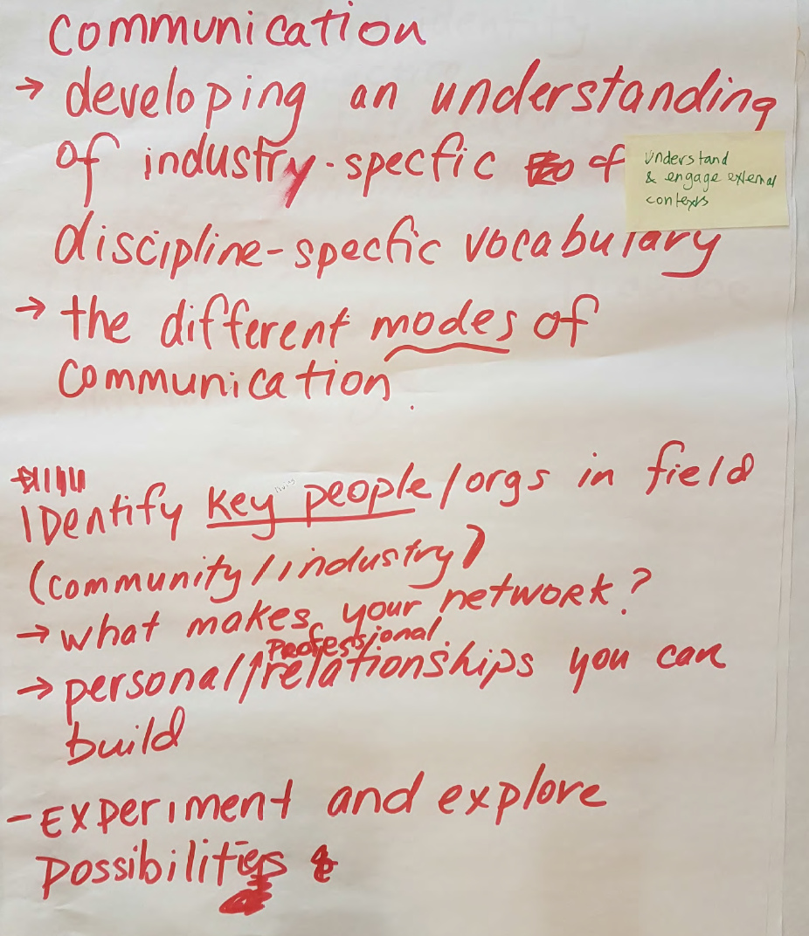
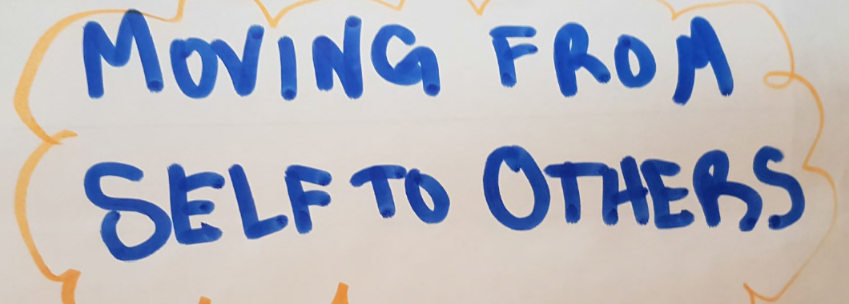
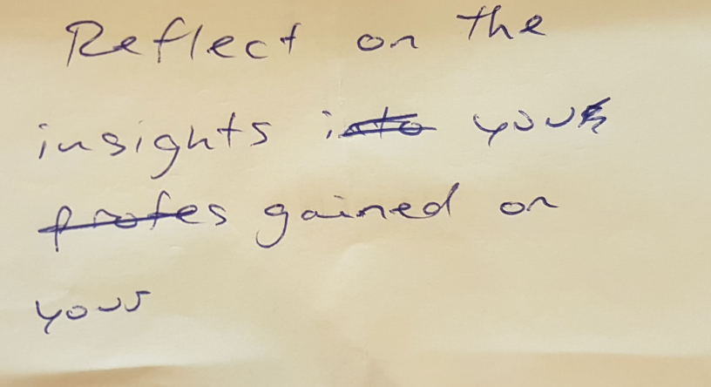
Notes:
… an emphasis on communications skills, interpersonal relations, collaboration with others and team-based work, and the importance of reflection.

Slide 21
EL Framework: Overview
What is Experiential Learning?
How to use this document
Guidelines for Experiential Learning activities
Experiential Learning Outcomes
Experiential Learning Activities
Notes:
We took the material away to draft the Framework, portions of which we’ve distributed.
We worked with a smaller group of faculty from the task force to draft the actual experiential learning outcomes.

Slide 22
EL Framework: Guidelines
The EL activity takes place in a workplace or simulated-workplace such as a studio-based, community service-focused or professional work environment, or the student is engaged in activities that prepare them to be self-employed
Students are exposed to authentic demands and expectations that improve their employability, self-employability, entrepreneurial and interpersonal skills, and that prepare them for participation in diverse professional communities
The EL activity is structured with purposeful and meaningful activities and includes formal student reflection on their experience
Notes:
Aligned closely with the Ministry Guiding Principles for Experiential Learning, adapted to reflect our context and accommodate, in particular, studio-based learning, noting that a large proportion of our students are self-employed artists and designers as well as entrepreneurs who start up small businesses.
Guidelines are intended to guide faculty teams, program chairs, etc., to identify experiential learning opportunities at each year level.

Slide 23
EL Framework: Guidelines
The EL activity is situated within a program’s curriculum and helps students achieve course and program-level learning outcomes
Students’ performance and learning in the EL activity is evaluated as one or more assessed components of a course (e.g., a project)
The EL activity counts towards course credit
In addition, to the above:
Students should have opportunities to engage in EL activities that are accessible and inclusive
EL activities must be compliant with university policies and procedures (e.g., Respectful Work and Learning Environment Policy, Academic and Non-Academic Misconduct Policies, etc.) and employment laws

Slide 24
Experiential Learning Outcomes
Professional Capacity (Depth and Breadth of Knowledge)
Applications of Knowledge (Application of Knowledge)
Methods of Inquiry (Knowledge of Methodologies)
Communication (Communication Skills)
Social Responsibility (Awareness of the Limits of Knowledge)
Autonomy and Growth (Autonomy and Professional Capacity)
Notes:
The themes that emerged through the workshop were organized into categories that are closely aligned with the DLEs; important to see that work-integrated and experiential learning is not exceptional or additive, but helps students to achieve learning in their programs.
Important qualification: we’re not just developing Autonomy and Professional Capacity

Slide 25
Experiential Learning Outcomes
Professional capacity
The knowledge and skills required for work in a professional capacity
Applications of knowledge
The ability to engage critically and analytically with different knowledges in professional contexts, and select from a variety of tools and strategies for organizing and documenting it
Methods of inquiry
The ability to identify goals or problems, propose different methods for undertaking or solving them, and apply acquired knowledge and skills to implement ideas and solutions
Notes:
The alignment of EL outcomes with the DLEs brought into sharper focus the value of EL activities and ways to communicate that value to faculty; for example, we were able to think broadly about information gathering and research, that while there are formalized methods for undertaking investigation and research in academic contexts, the rubric of “research” can be widened to include a variety of work-related activities related to the gathering, analysis, organization and documentation of information, replacing the more instrumental language of “information management” that we commonly find in experiential learning frameworks.
The same can be said for methodological approaches to problem-solving, that is, when learners are required to identify a problem, consider different methods or approaches for solving them, select the most appropriate methods and see them through. Knowledge of methodologies in both academic and work-related environments is both contextually different and contiguous.
The reorientation of “essential” employability skills as continuous with degree-level expectations works to shift perceptions about the instrumentality of work-integrated learning, while also providing a way to align it with program learning and the language to articulate that alignment.
At the same time, it was important to use language that is pragmatic, that can be readily understood in EL situations.

Slide 26
Experiential Learning Outcomes
Communication
The ability to communicate effectively in oral, written and visual forms across a range of personal and professional interactions
Social responsibility
The recognition of how one’s own knowledge, beliefs and attitudes fit within the context of professional work and inform how one builds equitable relationships and contributes to communities
Autonomy and growth
The attitudes and abilities required to work reflectively and independently in professional contexts and continuously advance one’s professional growth and learning
Notes:
The alignment also reflects back on the DLEs, helps us to think more concretely; for example, Awareness of the Limits of Knowledge is sometimes difficult to translate into learning activities and assessments; but it becomes very concrete and pragmatic when seen through the lens of social responsibility.

Slide 27
Experiential Learning Outcomes: Applications of Knowledge
Valuing Indigenous knowledges and experiential learning | Articulate an awareness of the history of colonialism in Canada, situating themselves in relation to it; value a diversity of Indigenous knowledges; engage respectfully with Indigenous practices of making | Recognize the legacy and ongoing practice of colonialism that informs all aspects of work and relationships and be able to articulate aspects of Indigenous history and culture in relation to their own work | Integrate engagement with Indigenous knowledges into their work, with respect for Indigenous cultures and practices of making (e.g., not appropriating); demonstrate reciprocity, accountability and ethics in, and knowledge of protocols for, working with Indigenous communities
Notes:
Things we bring as an institution to the conversation about EL; include priorities and goals from our Academic plan; Indigenous learning is the highest of these priorities and has figured prominently in conversations across the campus
- In thinking about knowledge and its applications in the context of experiential learning activities, we wondered to what extent the framework could be explicit about student engagement with Indigenous knowledges; a conversation with Indigenous colleagues helped us to recognize that Indigenous knowledges are experiential, because of their place in relation to families and communities and on the land; extend the goal for all students engage in experiential learning opportunities such that they all or many have an opportunity to learn on the land; but also, as artists and designers, it’s important that students engage respectfully with Indigenous practices of making and are ethical and accountable in their work with Indigenous communities.

Slide 28
Experiential Learning Outcomes: Applications of Knowledge
Engaging with diverse knowledges | Appreciate the social, historical location of their own knowledge in relation to a diversity of knowledges; acknowledge their own assumptions and biases | Recognize the different ways that knowledge is created; work with different people and communities respectful of the different knowledges they bring | Realize projects or work that integrates or takes into account diverse knowledges; navigate the tensions and conflicts that integration produces
Notes:
Students’ engagement with Indigenous knowledges sits within or alongside a broader conversation about epistemology informed by our institutional experience in working with diverse local and global communities in sustainable design, social innovation and art for social change. The conversation also inflects the question of what it means to “transfer” knowledge and skills from the academy to work environment; what our faculty emphasized was that when students work in service and community-based placements and projects, what they need to learn is that different communities and groups have their own ways of generating knowledge, and that work integration is not only knowledge “transfer”, but also negotiation, being able to recognize one’s own assumptions and biases, integrate or take into account different ways of knowing and being in the world, and navigate the tensions and conflicts such integration produces.

Slide 29
Experiential Learning Outcomes: Social Responsibility
Equitable and inclusive practices
Sustainability
Community engagement
Notes:
Other concerns that reflect that values and academic priorities of our university, and that we don’t always find in conversations about experiential learning, include aspects of social responsibility.

Slide 30
Experiential Learning Outcomes: Autonomy and Growth
Collegiality | Show understanding and empathy in relationships with colleagues | Demonstrate adaptability, flexibility, and perseverance, especially when faced with challenges or conflicts | Model positive leadership, commitment and motivation for colleagues
Notes:
Shifting the focus away from individual traits to support for teams and communities

Slide 31
Susan Ferguson
Director, Faculty & Curriculum Development Centre and Writing & Learning Centre
sferguson@ocadu.ca
Cary DiPietro
Senior Educational Developer, Faculty & Curriculum Development Centre
cdipietro@ocadu.ca

