Slide 1

Personal Growth as an Experiential Learning Outcome
Measuring improvement in student ‘self-efficacy’ and ‘wisdom’
Colin Furness MISt PHD MPH Med (cand.)
Emma Findlay-White Hon. BA MI (cand.)
Faculty of Information, University of Toronto

Slide 2

What is water?

Slide 3

Who am I?
Masters candidate, Faculty of Information, University of Toronto
Employers expect us to be profession-ready
Classes teach us to be work-ready
Work-Integrated Learning (WIL) bridges that gap and helps us successfully transition from school to work
‘Success’ of WIL programs often measured by employment rate, GPA, program satisfaction, and other administrative measures

Slide 4
WORK-INTEGRATED LEARNING
Designed to teach students habits of:
  Self-reflection
  Challenging assumptions
  Adapting to new environments
  Making decisions in ambiguous or unique situations
  Flexibility in the face of uncertainty

Slide 5
Let’s talk about…
Transformative Learning Theory
Social Cognitive Theory
Measuring Learning Outcomes
Self-efficacy
Wisdom

Slide 6
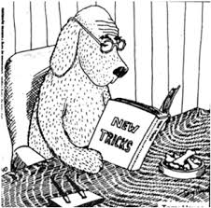
Transformative Learning Theory
Jack Mezirow (1991; 1997; 2000)
Adults do not simply apply old ways of learning to new situations
They acquire new perspectives in order to gain more complete understanding of changing events
Requires context-specific negotiation and re-negotiation of mental models
This iterative sense-making process is crucial to the development of new knowledge and for change to occur

Slide 7
Social Cognitive theory
Social Cognitive Theory (SCT): human functioning is explained by a triadic relationship among behaviour, cognitive, and personal factors
Individuals have varying degrees of control and agency
Self-regulation is a key tenet of
social cognitive theory
Person
Internal Psychological Factors
External
Observable
Factors
Context
Situation
Behaviour
(Bandura: 1986)

Slide 8


self-efficacy and wisdom

Slide 9

What is self-efficacy?
Albert Bandura (1997) defined self-efficacy as an individual’s belief in their abilities to reach goals and overcome obstacles
Self-efficacy is context-specific
Yet, research suggests this is a transferable skill

Slide 10
Leadership self and means efficacy
Dimension | Description
Action Self-Efficacy | Individual’s perceived ability to effectively execute critical actions
Self-Regulation Efficacy | Individual’s perceived ability to: a) think through complex situations, interpret their context, and generate novel and effective solutions to problems b) the ability to motivate oneself to enact those solutions
Means Efficacy | Individual’s perceptions that they can draw upon people, policies and resources in their environment to enhance their performance
Hannah et al (2012)

Slide 11
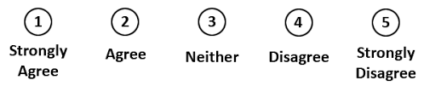
As a leader, I can…
Rely on my peers to help solve problems
Remain steadfast to my core beliefs when I am challenged
Determine what leadership style is needed in each situation
Distinguish the ethical components of problems/dilemmas
Hannah and Avolio (2013)

Slide 12

What Is wisdom?
Monika Ardelt (2004): wisdom is the process of rediscovering deeply held beliefs about our own lives and the lives of others
Wisdom is interpretive knowledge, a paradigm shift in knowing
Through reflection and self-examination, interpretive knowledge leads to a deeper understanding of salient phenomena and events, a transformative experience

Slide 13
Ackoff’s Pyramid
Data
Symbols that represent properties of objects, events, and their environments
Information
Contained in descriptions; inferred from data
Knowledge
Know-how
Makes possible the transformation of information to instructions
Wisdom
Adds value, which requires mental function called judgement. The ethical and aesthetic value that this implies are inherent to the actor and are unique and personal
Wisdom
Knowledge
Information
Data
Ackoff (1989)
Notes:
Minimze (if needed)

Slide 14
Measurements
Dimensions | Definition | Measures
Reflective | Perception of phenomena and events from multiple perspectives | Willingness to look at phenomena from multiple perspectives Evidence of self-examination and reflection
Cognitive | A willingness to comprehend significance of phenomena | Acknowledgement of ambiguity/uncertainty in life Ability to make important decisions despite life’s unpredictability
Affective | Sympathetic and compassionate feelings for others | The presence of positive emotions and behaviour toward others

Slide 15
3-Dimension Wisdom Scale (Ardelt)
Cognitive dimension
A problem has little appeal to me if I don’t think it has a solution
Reflection dimension
I sometimes find it difficult to see things from another’s point of view
Things often go wrong for me by no fault of my own
Affective dimension
Sometimes when people are talking to me, I find myself wishing they would leave
Ardelt (2004)

Slide 16
Operationalization
Pilot project at University of Toronto
We argue that development of self-efficacy and wisdom development can be supported outside of traditional WIL environments
Student government is used as large and accessible project
Research Questions:
  Q1: does student government participation increase SE and/or W?
  Q2: does a conscious approach to developing leadership in one student government increase SE and/or W compared to business-as-usual student governments?

Slide 17
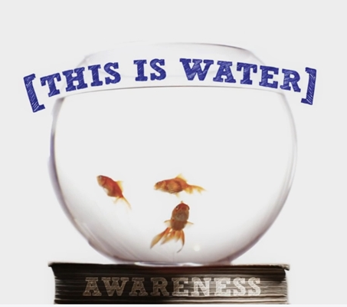
“Learning how to think really means learning how to exercise some control over how and what you think. It means being conscious and aware enough to choose what you pay attention to and to choose how you construct meaning from experience”
-David Foster Wallace, 2005

Slide 18
Works Cited
Ackoff, R. (1989). "From data to wisdom". Journal of applied systems analysis. 16: 3–9.
Ardelt, M. (2004). Wisdom as expert knowledge system: A critical review of a contemporary operationalization of an ancient concept. Human development, 47(5), 257–285.
Ardelt, M. (2003). Empirical assessment of a three-dimensional wisdom scale. Research on aging, 25(3), 275–324.
Bandura, A. (1986). Social foundations of thought and action: A social cognitive theory. Englewood cliffs, NJ: Prentice-Hall.
Bandura, A. (1997). Self-efficacy: the exercise of control. New york, NY, US: W H freeman
Hannah, S. T., Avolio, B. J., Walumbwa, F. O., & Chan, A. (2012). Leader self and means efficacy: A multi-component approach. Organizational behavior and human decision processes, 118(2), 143–161.
Mezirow, J. (1991). Transformative dimensions of adult learning. San francisco, CA: Jossey-Bass.
Mezirow, J. (1997). "Transformative learning: theory to practice". New directions for adult and continuing education, 74, 5–12.
Mezirow, J. (2000). Learning as transformation: critical perspectives on a theory in progress. San Francisco: Jossey Bass.

Slide 19
Thank you
Colin Furness
MISt PHD MPH MEd (cand.)
Faculty of Information,
University of Toronto
colin.furness@utoronto.ca
Emma Findlay-White
Hon. BA MI (cand.)
Faculty of Information,
University of Toronto
emma.findlay.white@mail.utoronto.ca

