Slide 1
A Collaborative Province-Wide Pharmacy Assessment Project – Ontario Pharmacy Patient Care Assessment Tool (OPPCAT)
Annie Lee, Associate Professor, Teaching Stream
Leslie Dan Faculty of Pharmacy, University of Toronto
Henry Halapy, Residency Coordinator, St. Michael’s Hospital & Lecturer, Leslie Dan Faculty of Pharmacy, University of Toronto

Slide 2



Ontario Pharmacy Patient Care Assessment Tool (OPPCAT) - Collaborators
Hospital Pharmacy Residency Forum of Ontario
Annie Lee
University of Toronto
Ken Manson
University of Waterloo
Diana Spizzirri
Ontario College of Pharmacists
Henry Halapy
Hospital Pharmacy Residency

Slide 3
Objectives for this Session:
Describe the collaborative nature of OPPCAT work
Describe the development, implementation and evaluation of OPPCAT

Slide 4
Collaboration
University of Toronto, University of Waterloo, Ontario Hospital Pharmacy Residency Programs and the Ontario College of Pharmacists
At the right time and place
Sharing of ideas and human resources
Notes:
High stakes assessment required a standardized assessment tool
Other Ontario organizations also required tool for experiential practice
Common assessment tool (OPPCAT) developed through collaboration
Ontario Pharmacy Patient Care Assessment Tool (OPPCAT)

Slide 5
Collaboration
Similar goal and outcomes
Common need led to moving forward quickly with less formal collaboration
Working group established as natural evolution
More formality and structure introduced after tool implemented
Notes:
High stakes assessment required a standardized assessment tool
Other Ontario organizations also required tool for experiential practice
Common assessment tool (OPPCAT) developed through collaboration
Ontario Pharmacy Patient Care Assessment Tool (OPPCAT)

Slide 6
OPPCAT Development Timeline
Spring 2014
Initial discussion by residency programs and universities
Fall 2014 Include licensing body
Fall 2015 Version 5 tested with focus groups
May 2016
University of Toronto launch Version 6
July 2016 Hospital residency launch
January 2017
University of Waterloo and Ontario College of Pharmacists launch
January 2017
Satisfaction Survey
January 2018
Data analysis and revision

Slide 7
Implementation in Programs
Hospital Pharmacy Residency Programs
Patient Care Rotations in Ontario
University of Waterloo
Patient Care Rotations in 4th year PharmD and PharmD Bridging Programs
Ontario College of Pharmacists
Practice Assessment of Competence at Entry (PACE)
University of Toronto
Advanced Pharmacy Practice Experience (APPE) in PharmD and PharmD for Pharmacists Programs

Slide 8
University of Toronto - Advanced Pharmacy Practice Experience (APPE)
Full-time PharmD Program (35 weeks)
2 x 5 week institutional
10-week community pharmacy
1 x 5 week other direct patient care
2 x 5 week electives
Direct patient care
Non-direct patient care
PharmD for Pharmacists
20 – 25 weeks direct patient care

Slide 9
APPE Assessment
OPPCAT for direct patient care rotations
Mid-point and final assessment completed in CORE ELMs
Preceptor assessment and student self-assessment
Rotations are individually graded

Slide 10
Expected Level of Performance of Students
Provides guidance for expected level of patient care responsibilities
Specific for institution and community pharmacy practice
Acknowledges patient complexity and care needs
Adaptable to patient care setting
Expectations must be discussed and outlined in learning contract

Slide 11
University of Waterloo - PharmD Experiential Learning
Patient Care Rotations in a “Community of Practice”
3 x 8 week direct patient care rotations in 4th year of program (in 14 regions throughout Ontario)
Week 4 Mid-point – student self-assessment and preceptor assessment
Week 8 Final – student self-assessment and preceptor assessment
Rotations are individually graded

Slide 12
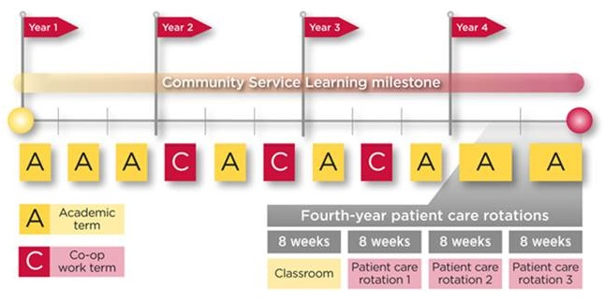

Slide 13
Ontario College of Pharmacists
In 2017, new model of assessment: Practice Assessment of Competence at Entry (PACE)
PACE is assessment first then, if needed, individualized self-directed development with a coach to address any identified areas of performance under key competencies
Pass/fail decisions to be made according to a set cut score
Determine readiness for practice vs need for further development

Slide 14
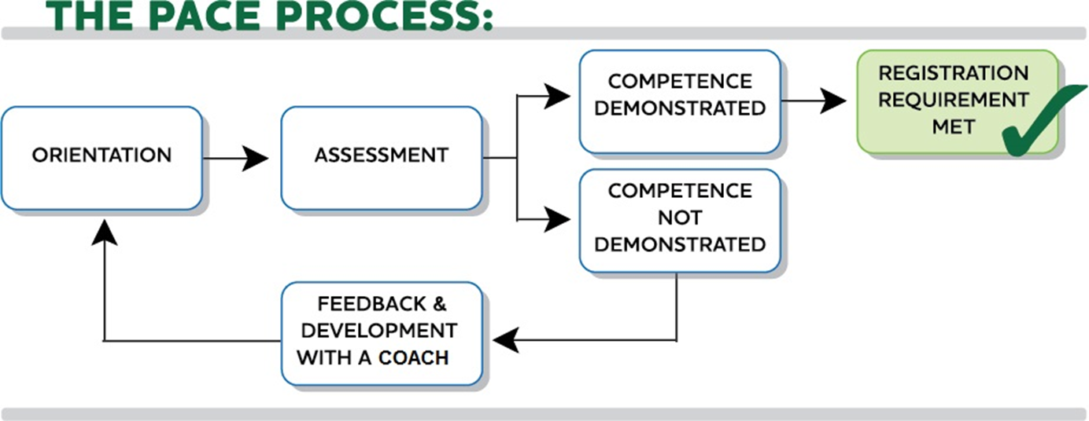
1 week
2-3 weeks
Notes:
As a refresher, this is a visual illustration of the PACE process – I will use it to walk through the steps of the model
Orientation
The candidate will complete a period of orientation over one 35 hours - one week. During orientation, candidates will have the opportunity to become familiar with the site and workflow systems and processes in place.
Assessment Period
The actual assessment is where the candidate has the opportunity to demonstrate their practice performance. This will occur over either 2 weeks full time, or 3 weeks part time. The duration of the assessment is 70 hours.
The candidate will engage in all scope of practice activities while under supervision of their assessor. Throughout the assessment period, the candidate will be reflecting on their practice in written journal entries along the way. This will help them to track their progress with demonstrating each of the competency elements throughout their assessment time.
It may be important to note that practice opportunities are captured in the assessor application form. We ensure that sufficient opportunities to practice to the full scope will be available to the candidate.
The assessment submitted to the College at the end of the assessment period will be obtained objectively through the use of a standardized assessment tool, that has been developed in collaboration with the universities of Toronto and Waterloo, and is being used to assess practice performance in their experiential rotations. The tool is unique in that it allows for the assessor to select ratings based on demonstrated behaviour of the candidate, while considering guidance, consistency and effectiveness of the practice.
***Please be clear that demonstrating entrance to practice competency is through standardized assessment. We don’t want to give the impression that the assessment component is individualized. What’s individualized, is Development (if required), and the ability for candidates who demonstrate competence to move forward without delay.

Slide 15
Pharmacy Residency Programs are …
1 year post-graduate programs done after completion of entry-to-practice degree
Focused on developing clinical practice, leadership, and project skills
Typically in hospital setting, but can be in other settings

Slide 16
Residency Adaptation of OPPCAT
OPPCAT supported by Hospital Pharmacy Residency Forum of Ontario (HPRFO)
High adoption rate by residency programs -12/15
Working on Level and Ranges document to accompany OPPCAT
Residency programs affiliated with an Ontario university

Slide 17
OPPCAT Tool
Standards
AFPC Educational Outcomes
Canadian Pharmacy Residency Board Standard
NAPRA Entry-to-Practice Competencies
Framework
Literature review
Competency based framework
Solo taxonomy
Five point Likert scale
Domains, elements and behavioural descriptors
Companion glossary

Slide 18
OPPCAT 5 Domains and 20 Elements
Patient Care (8)
Communication and Education (4)
Professionalism (2)
Practice Management (3)
Professional Collaboration (3)

Slide 19
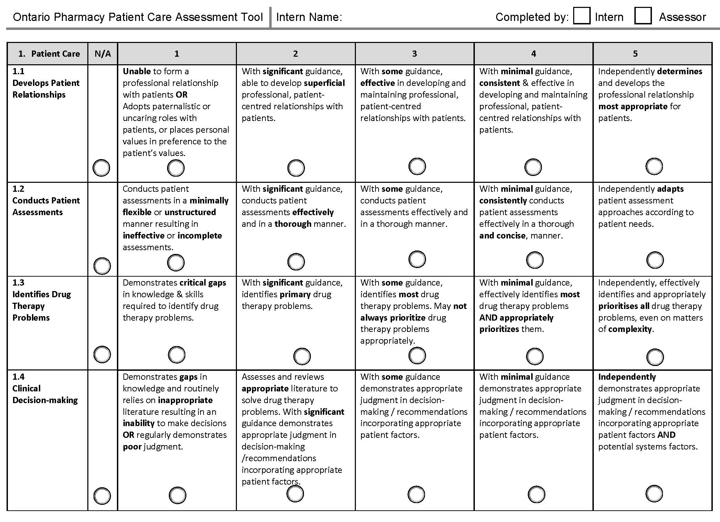
Domain
Rating Scale
Element
Behavioural Descriptor

Slide 20
Domain and Elements
Patient Care
Develops Patient Relationships
Conducts Patient Assessment
Identifies Drug Therapy Problems
Makes Clinical Decisions
Implements Care Plans
Refers Patients
Provides Follow-up and Evaluates Care
Promotes/Advocates for Patient Health & Wellness
Communication and Education
Demonstrates Communication Skills
Completes Documentation
Demonstrates Presentation Skills
Provides Student Mentorship

Slide 21
Domains and Elements
Professionalism
Applies Regulations and Ethical Principles
Demonstrates an Awareness of One’s Own Practice Limitations
Professional Collaboration
Develops and Promotes Inter-/Intra-professional Relationships
Fulfills Professional Roles and Responsibilities within Healthcare Team
Demonstrates Leadership

Slide 22
Domains and Elements
Practice Management
Prioritizes Patient Care Responsibilities to Manage Patient Workload
Manages Drug Dispensing
Demonstrates Patient and Medication Safety
Overall Assessment
Global Rating Scale

Slide 23
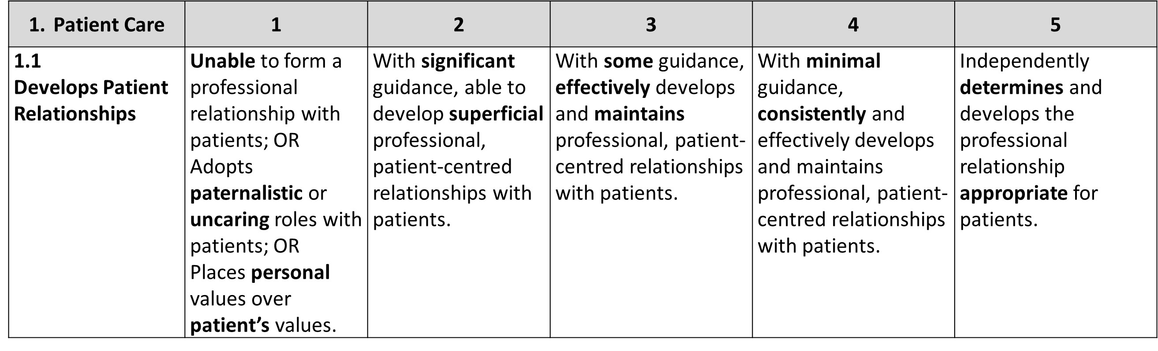
Behavioural Descriptors
Demonstrate progression from levels 1 to 5
Each descriptor has 3 components:
Guidance / support required
Effectiveness / quality
Consistency

Slide 24
Guidance Gradient (in Glossary)
Takes initiative readily
Uses judgement appropriately
Preceptor intervenes infrequently
Significant Some Minimal
Regularly demonstrates one to two positive characteristics
Difficulty taking initiative; requires frequent prompting
Inappropriate judgement
Preceptor intervenes regularly

Slide 25
Current Preceptor/Assessor Training on OPPCAT
 | U of T | UW | OCP | Residency
Pre-workshop (readings, training videos/modules) |  | √ | √
Self-assessment prior to In-person workshop |  |  | √
In-person Workshop | √ | √ (after completing #1) (train the trainer) | √ (after completing #1 & 2) | √
On-line Workshop (Articulate) | √ (alternative to #3) |  |  | √ (alternative to #3)

Slide 26
Fall 2017 - Preceptor Development Working Group
Sub-committee formed under original OPPCAT group
Objectives:
Take inventory of resources utilized by each program
Evaluate a platform for delivering on-line training
Review existing video resources online

Slide 27
Fall 2017 - Preceptor Development Working Group
Objectives cont’d:
Create a video focusing on ‘guidance’ terms
Consider a common certificate of completion or a designation for pharmacists
Assessing the need for an OPPCAT preceptor update module

Slide 28
OPPCAT Satisfaction Survey Results
P/A = Preceptors/Assessors S/R = Students/Residents
Questions | P/A (n=171) | S/R (n=69)
The layout was clear | 92% (YES) | 91% (YES)
The guidance terms were clear | 97% * | 92%*
The assessment form accurately captures learner performance | 91%* | 82%*
Missing content that should be included | 82% (NO)** | 85% (NO)
Overall satisfaction | 91%* | 85%*
*Percentage of neutral/agreed/strongly agree responses
** Note: majority of residency preceptors indicated missing content to be assessed

Slide 29
Survey Results – Points to Consider
Adding ‘not applicable’ – for some programs
Too long and difficult filling out form (fillable PDF) – from residency preceptors/ residents
Site freezes or hard to log on - from OCP assessors
Modifying some behaviour descriptors in the Patient Care domain
Assessing specific knowledge or behaviours – from residency preceptors

Slide 30
Work in Progress
Revising OPPCAT to Version 7
Standardizing preceptor training across programs
Validating OPPCAT
Drafting a publication
Disseminating OPPCAT to programs across Canada

Slide 31
Collaboration Lessons Learned
Collaboration possible due to the shared commitment and ‘investment’
Timing was important – i.e. right time and place
Need patience and perseverance
Different organizations need to ensure buy-in across all leadership teams
Notes:
-look for other sources of funding – e.g. project grants, grad students, other student support,
-ownership of intellectual property?

Slide 32
Collaboration Lessons Learned
Funding/financial support for work as it evolves
Online assessment tool
consider technology solution/platform across all organizations
Standardization of tool through combined preceptor training and shared resources

Slide 33
Questions?
Contact Information:
Annie Lee – awm.lee@utoronto.ca
Henry Halapy – halapyh@smh.ca

