Slide 1

Community Engaged Learning in Undergraduate Medical Education
Kelly Hollingshead, Western University
Dustin Carter, Middlesex-London Emergency Medical Services

Slide 2
Agenda
Share the growth and advancement of curricular Community Engaged Learning (CEL) at Western University
Highlight the successes and challenges of an interdisciplinary CEL project in Health Sciences and Medical Sciences

Slide 3
Terminology
Community Engaged Learning (CEL):
An educational approach that integrates community engagement with reflective learning. Students engage in a project, developed collaboratively with a community partner, that has mutually beneficial outcomes*.
*Curricular and Co-Curricular

Slide 4

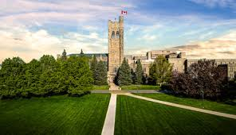
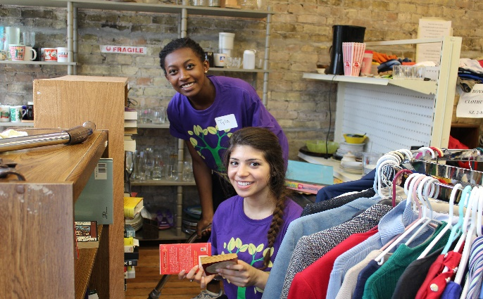
Curricular CEL
***Connects research and pedagogy with identified community needs through a common project***

Slide 5
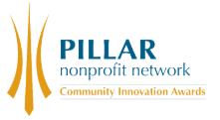
Growth of Curricular CEL (2009-2018)
2017 Pillar Innovation Award Winner!
2479*

Slide 6
What contributed to this growth?
1) Collaborated with faculty to design courses
2) Demonstrated that it worked
3) Support faculty: 3-part workshop, ELC, CEL COP
4) RBC endowment and advocating for more institutional support
5) Not possible without all stakeholders, including our community partners, faculty, grant funders, and students

Slide 7
Growth of Curricular CEL in Health Sciences and Medical Sciences (2015-2018)

Slide 8
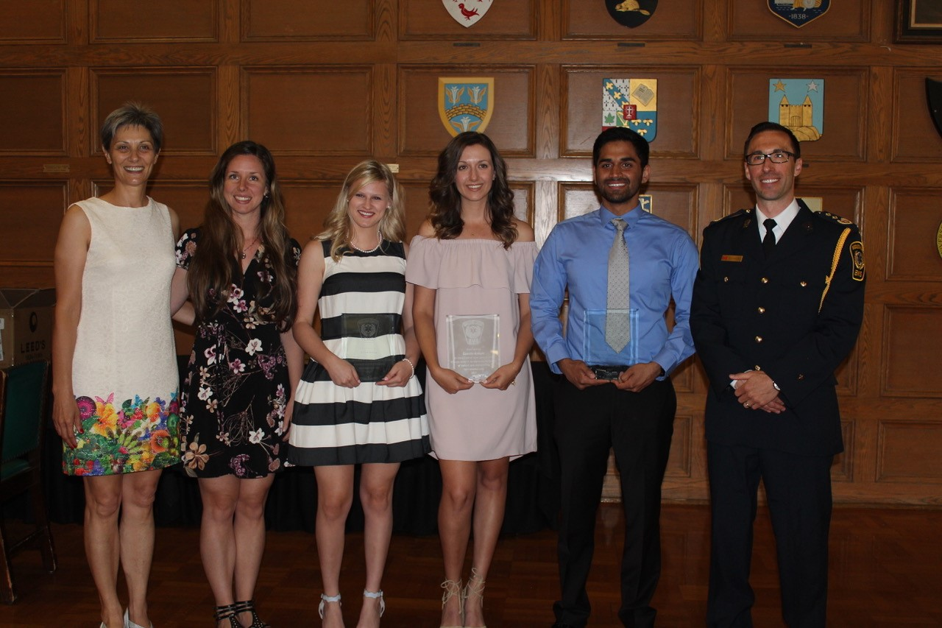
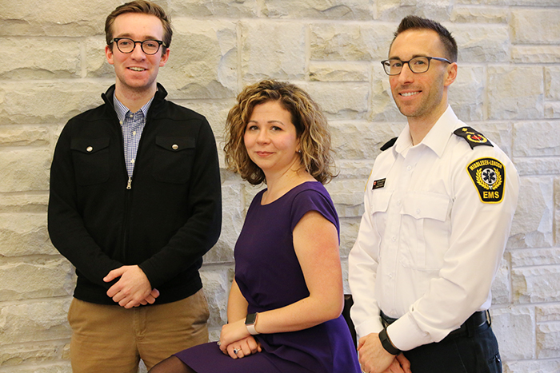
Health Sciences & Medical Sciences
Gerontology in Practice
(Health Sciences)
Addressing Healthcare Misconceptions (Medical Sciences)

Slide 9
What is Community Paramedicine?
Community Paramedicine allows paramedics to utilize their knowledge and skills outside of the traditional role of emergency response
The aging population in Canada is steadily increasing and placing greater demand on paramedic services, especially through the growing number of non-essential calls
Middlesex-London Paramedic Service researched current service data to identify various needs, and trends in our community, that if addressed would have significant impact on the health care system

Slide 10
What is the problem?
Lift assist – when an individual calls paramedic services and requests assistance to get up or mobilize, usually after experiencing a fall; no care is rendered on scene and the patient refuses transport to hospital (Schierholtz et al., 2018)
Lift assists are an under-recognized event in North America and little research has gone into solving the problem

Slide 11

Impact of Lift Assist Calls on Middlesex-London Paramedic Service

Slide 12
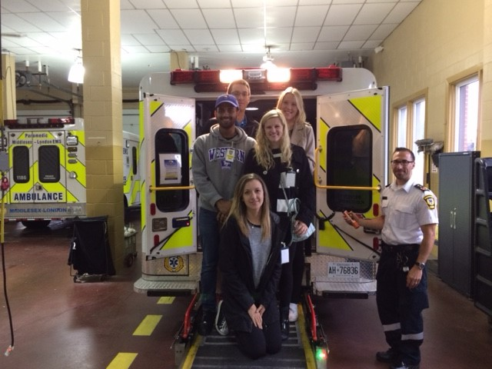
Gerontology in Practice
Course: Gerontology in Practice (Fall 2016-17)
Faculty Member: Dr. Aleksandra Zecevic, Ph.D.
Student Team: 6
Project Description: The purpose of this study is to describe the characteristics of LA calls in patients aged 65 and older, and determine their impact on local paramedic services.
Deliverables:
Extract LA only calls from a de-identified dataset
Conduct text analysis to identify reoccurring patterns
Complete quantitative analysis of relevant variables
Prepare a written report with findings

Slide 13
Practicum
Course: Health Practicum (Winter 2016-17)
Faculty Member: Dr. Daniel Belliveau, Ph.D.
Participating Practicums: 5
Project Description: Students from the previous course elected to create and participate in individual practicums to further analyze sub-themes extracted from the initial research
Deliverables: Conduct additional research on key themes and/or findings that emerged from the initial LA study

Slide 14
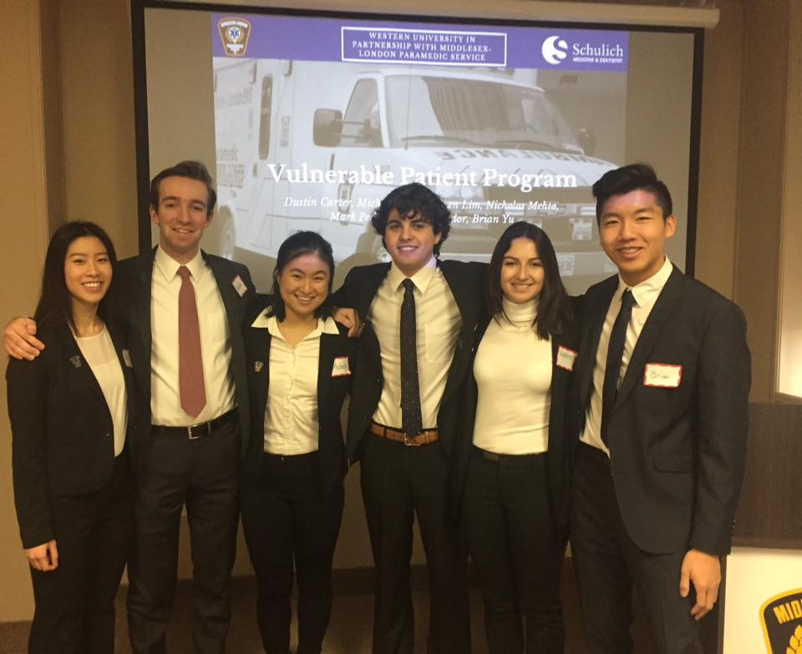
Interdisciplinary Medical Sciences
Course: Addressing Health Care Challenges Using
Scientific Inquiry (Winter 2017-18)
Faculty Member: Dr. Sarah McLean, Ph.D.
Student Team: 6
Project Description: Students focused on addressing health care misconceptions using scientific inquiry, and developed a concrete business case for submission to local and provincial
government with an innovative and cost-effective solution
Deliverables:
Review all material related to the initial LA study
Develop a business case based on a proposed innovative solution
and present to key stakeholders and governance

Slide 15
Successes
Presentations:
Canadian Association on Gerontology 2017: Evidence for Action in an Aging World
Canadian Geriatrics Society 2018: Advances in Care from the Individual to the Technology
Canadian Frailty Network 2018: Frailty Matters Innovation Showcase
Media Coverage:
Western News: Bringing classroom knowledge to the community (2018)
Western News: Study eyes gap in aiding fall-prone seniors (2018)
CTV News London: Lift Assists (2018)
CBC Radio Ontario Morning: Podcast (2018)
London Free Press: Senior Falls a Hidden Cost to Ambulance Services (2018)
Publication:
Prehospital Emergency Care Journal - Impact of Lift Assist Calls on Paramedic Services: A Descriptive Study (Schierholtz et al., 2018)

Slide 16
Challenges
Finding a balance between the project, full course load, and down time.
Setting clear and realistic expectations for the students and community partner.
Changing the community partner’s stakeholder's frame of mind relating to what the students offer.

Slide 17
Lessons Learned
Immerse them in your work to increase interest and understanding of the subject.
Providing effective and ongoing communication fosters a positive working relationship, which in turn will improve learning and increase productivity.
Offer guidance and making yourself available as needed.
Instill confidence in each student’s individual abilities to use their transferable skills to engage in self-directed learning.

Slide 18
Future of CEL at Western
Anticipate continued growth of Curricular CEL
RBC endowment ending; requires new funder or greater institutional support
Piloting more interdisciplinary projects
Mapping CEL learning outcomes
CityStudio in London

