Slide 1


Building Conceptual Awareness:
Experiential Learning and the Degree Level Standard
Wm. Paul Meahan
Melissa Barnard
Andrew Wilson

Slide 2
Characteristics of an Ontario college degree program…
a technical or professional education based on the fundamental principles in each field
application of theory to practice, of learning by doing, and of converting personal experience into knowledge and skills through laboratory, applied research, and work experience
cultivation of the analytical skills to evaluate new information and the ability to apply new knowledge to the field
a balance of professional study and general education/breadth courses to enhance students' understanding of the environment in which they will function as professionals and as educated citizens and to enhance their understanding by exposure to disciplines outside their main field of study
2017 PEQAB Handbook, p. 12
2017 PEQAB Handbook, p. 12

Slide 3
Finding a place for experiential learning…
Conceptual Framework
Learning Outcomes
Teaching Methods
Assessments
Learning Activities and Resources

Slide 4
Conceptual Awareness – Student View
An understanding of methods of enquiry or creative activity, or both, in their primary area of study that enables the student to
a. evaluate the appropriateness of different approaches to solving problems using well established ideas and techniques
b. devise and sustain arguments or solve problems using these methods
c. describe and comment upon particular aspects of current research or equivalent advanced scholarship
2017 PEQAB Handbook, p. 16-17
2017 PEQAB Handbook, p. 16-17
We know that we have to demonstrate these student/graduate requirements to PEQAB and PECs, but what about our programs themselves?

Slide 5
Conceptual Awareness – Program View
The vision and mission of the institution
The mission and philosophy of the program itself
The professional goals of the program
The knowledge bases of the program
Adapted from Calvin College, Faculty of Education
Adapted from Calvin College Faculty of Education

Slide 6
Taking Stock…
Mission and Philosophy – What are we doing here? Who are our graduates?
Professional Goals – What does a graduate of yours do and think? What does he or she value?
Knowledge Bases – What is the ethical framework of your graduates’ decision-making processes? How will they see the world in which they work?

Slide 7
Advising the Program… (or “why me?!”)
We are responsible for the “assessment of the continuing consistency of the program with the college's mission, educational goals, and long-range plan” and the “assessment of the learning outcome achievements of students/graduates by comparison with the program’s stated learning outcome goals and standards.”
At the end of the day, what are the themes, theories, models, values, and ethical/philosophical/moral underpinnings of your curriculum?
2017 PEQAB Handbook, p. 27
2017 PEQAB Handbook, p. 27

Slide 8
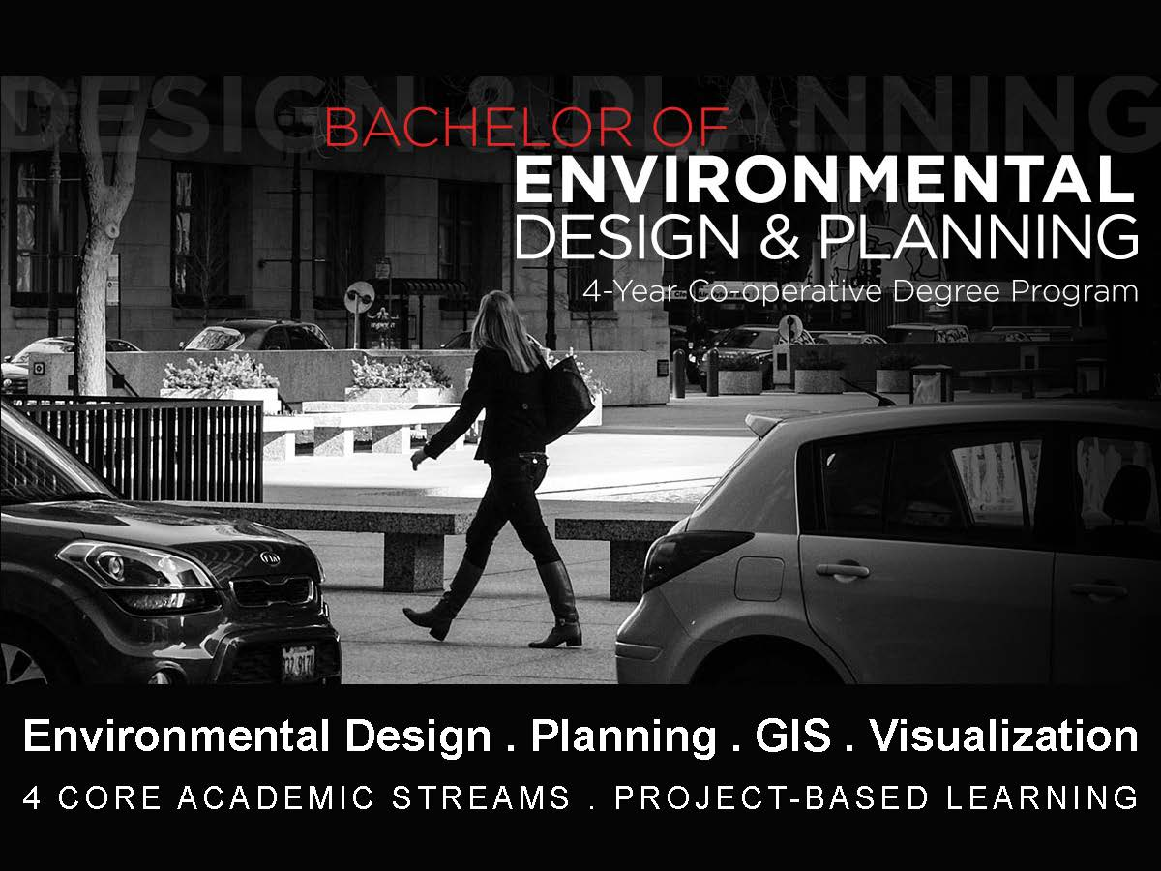

CONCEPTUAL
METHODOLOGICAL
AWARENESS

Slide 9
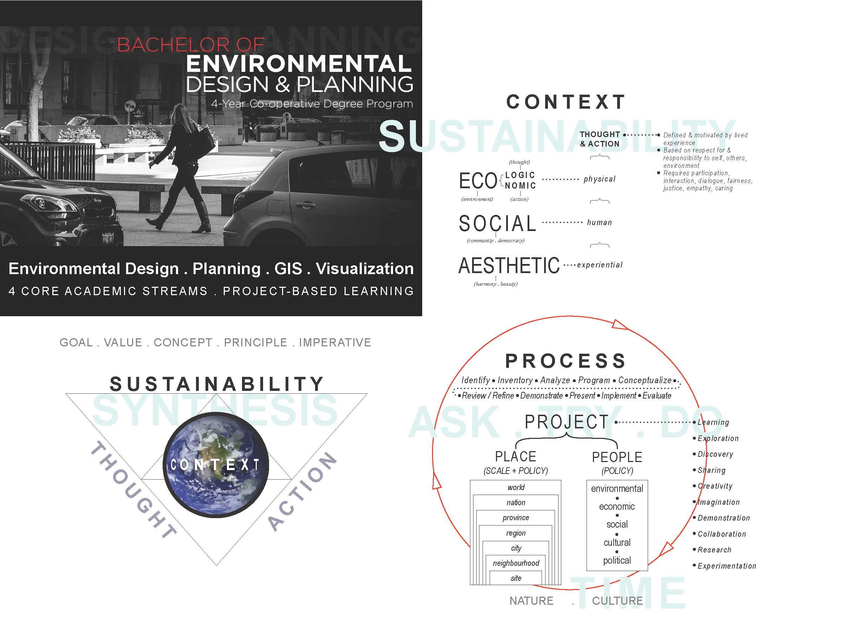
CONCEPTUAL
METHODOLOGICAL
AWARENESS

Slide 10


Slide 11
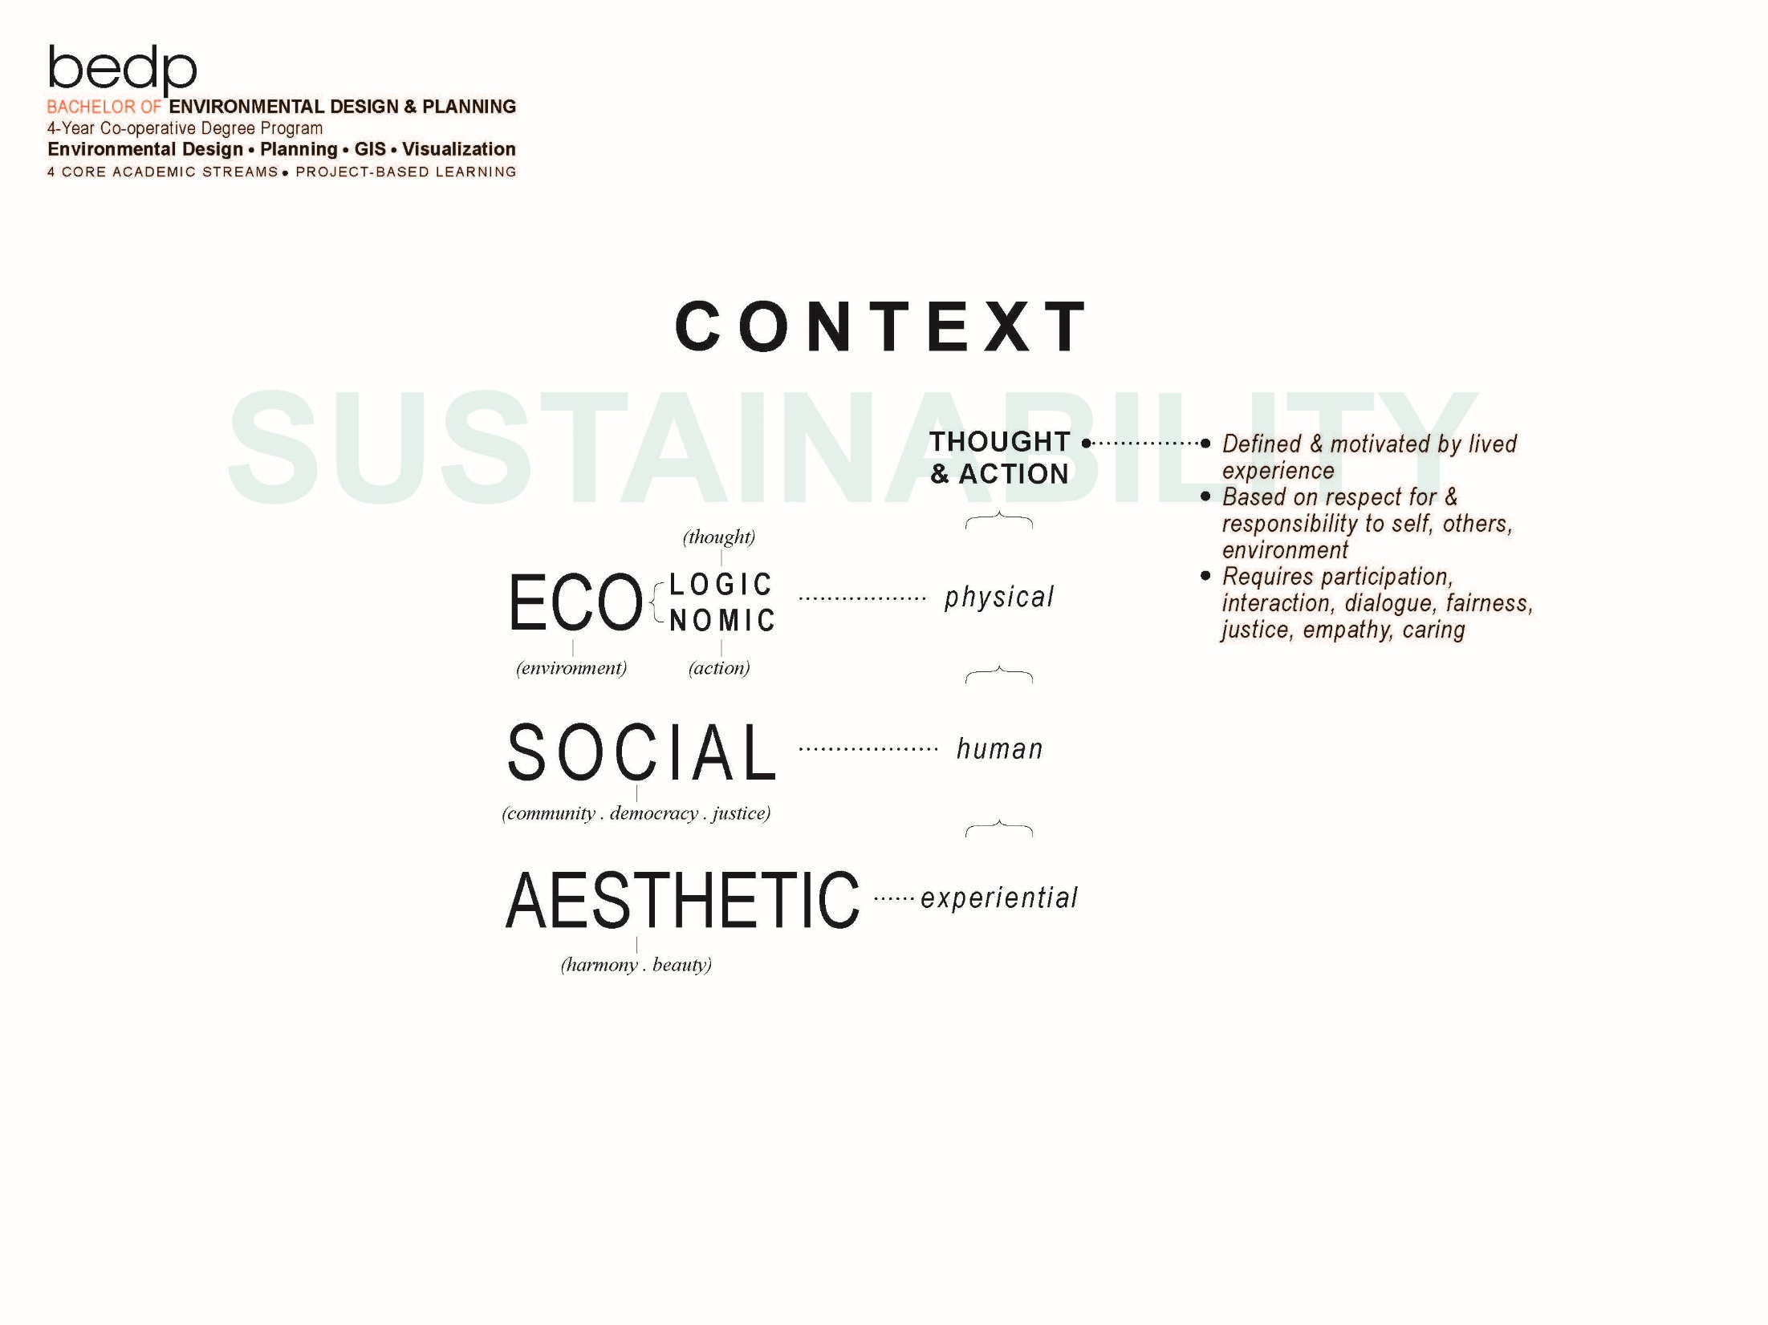

Slide 12
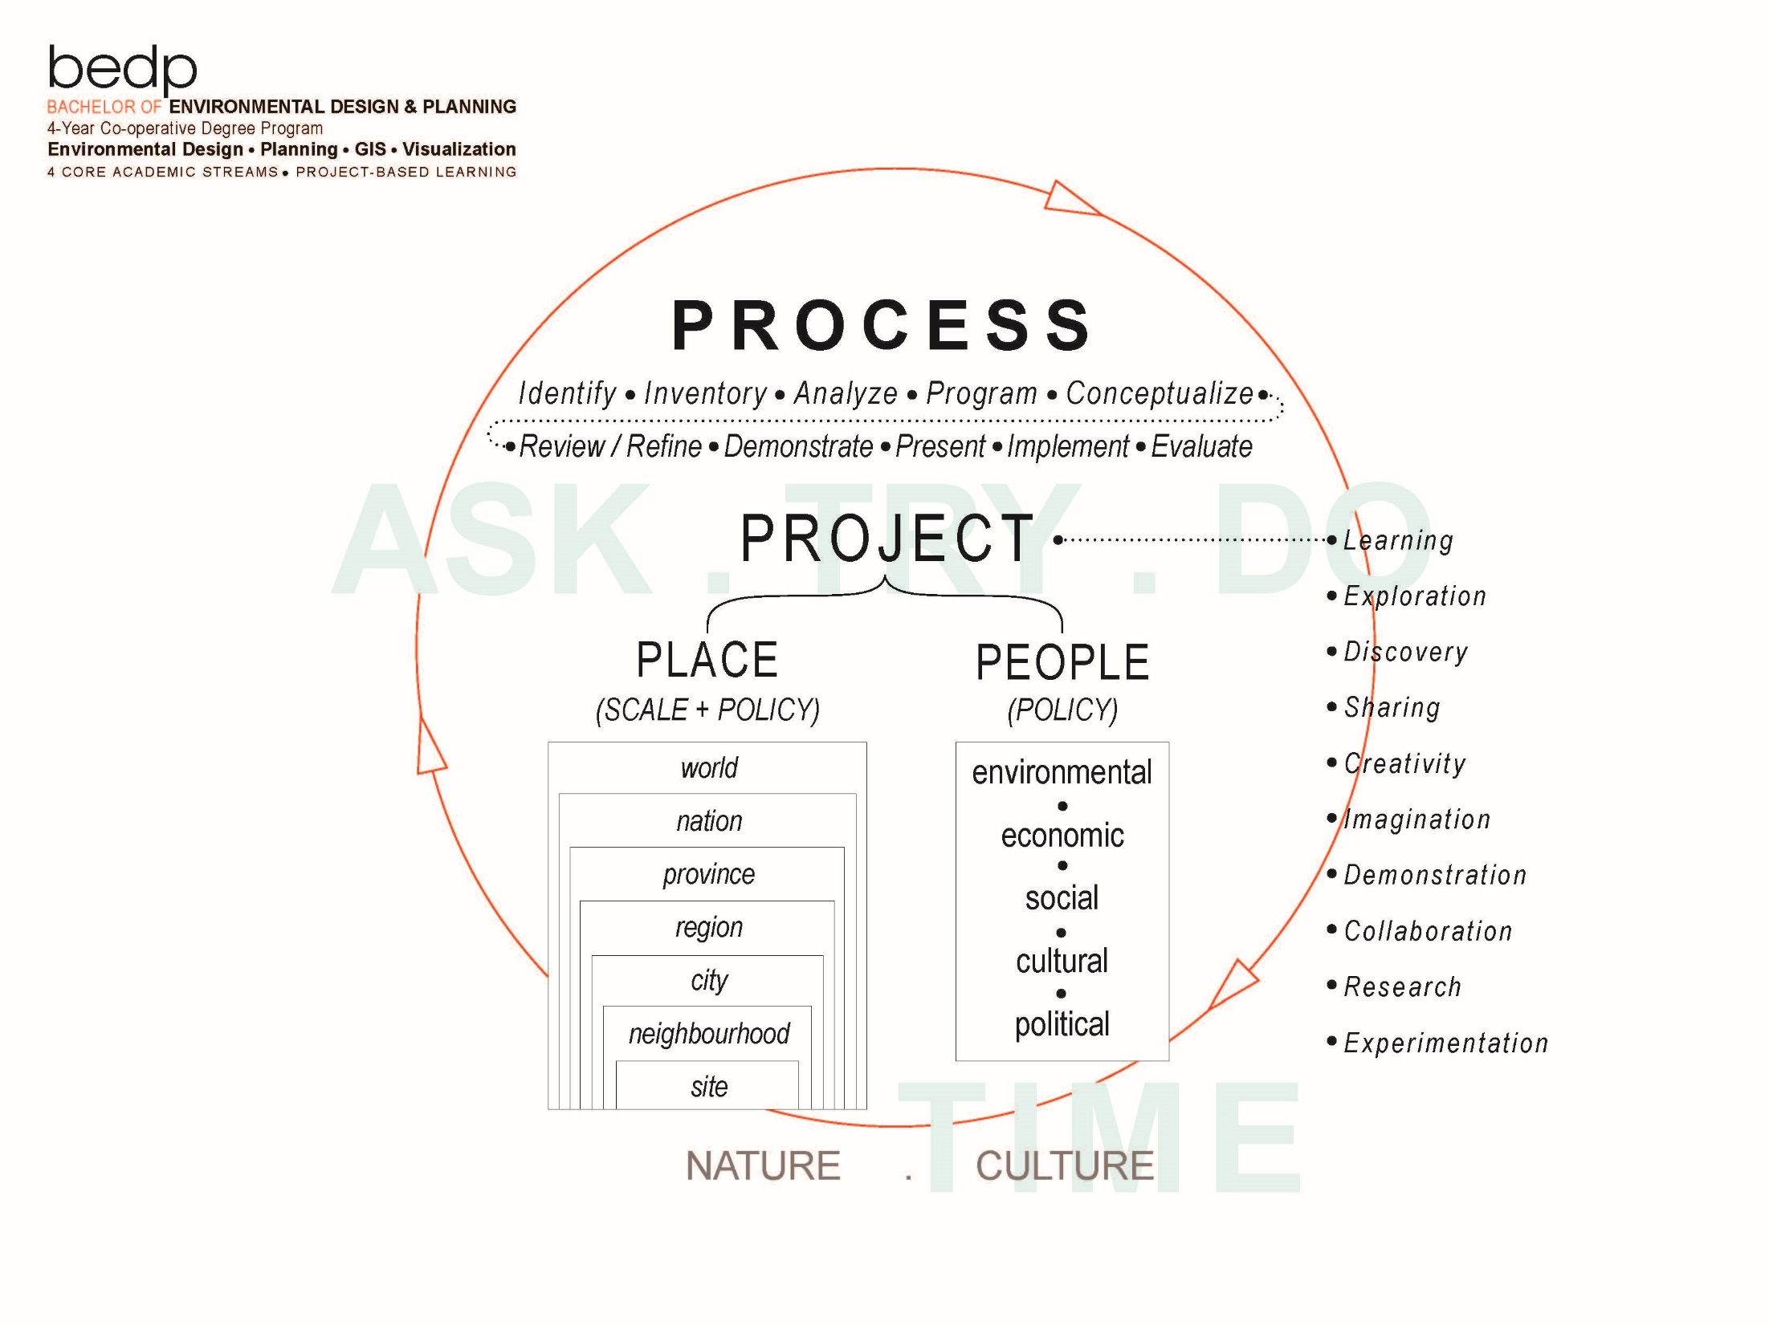

Slide 13
Site
Neighbourhood
City (Urban)
Rural/Region
Region/Province
Country/ International
Streams

Slide 14
LEVEL 8 . DESG 7032 . CAPSTONE LEARNING OUTCOMES
Complete a comprehensive, integrated environmental design, planning and GIS project.
Identify a problem suitable for environmental design, planning and GIS study.
Choose a research method appropriate to an identified environmental design and planning problem.
Define a study context. Research the context of an environmental design and planning problem.
Develop a contextually relevant design program based on research findings.
Conceptualize contextually relevant design solutions.
Demonstrate environmental design thinking that reflects current design and planning knowledge and understanding.
Document the outcomes of context research, environmental design and GIS study.
Present a professional level environmental design project for critical review and evaluation.
Use design visualization tools and techniques to explore, visualize, communicate and present ideas and produce a complete, professional project.

Slide 15
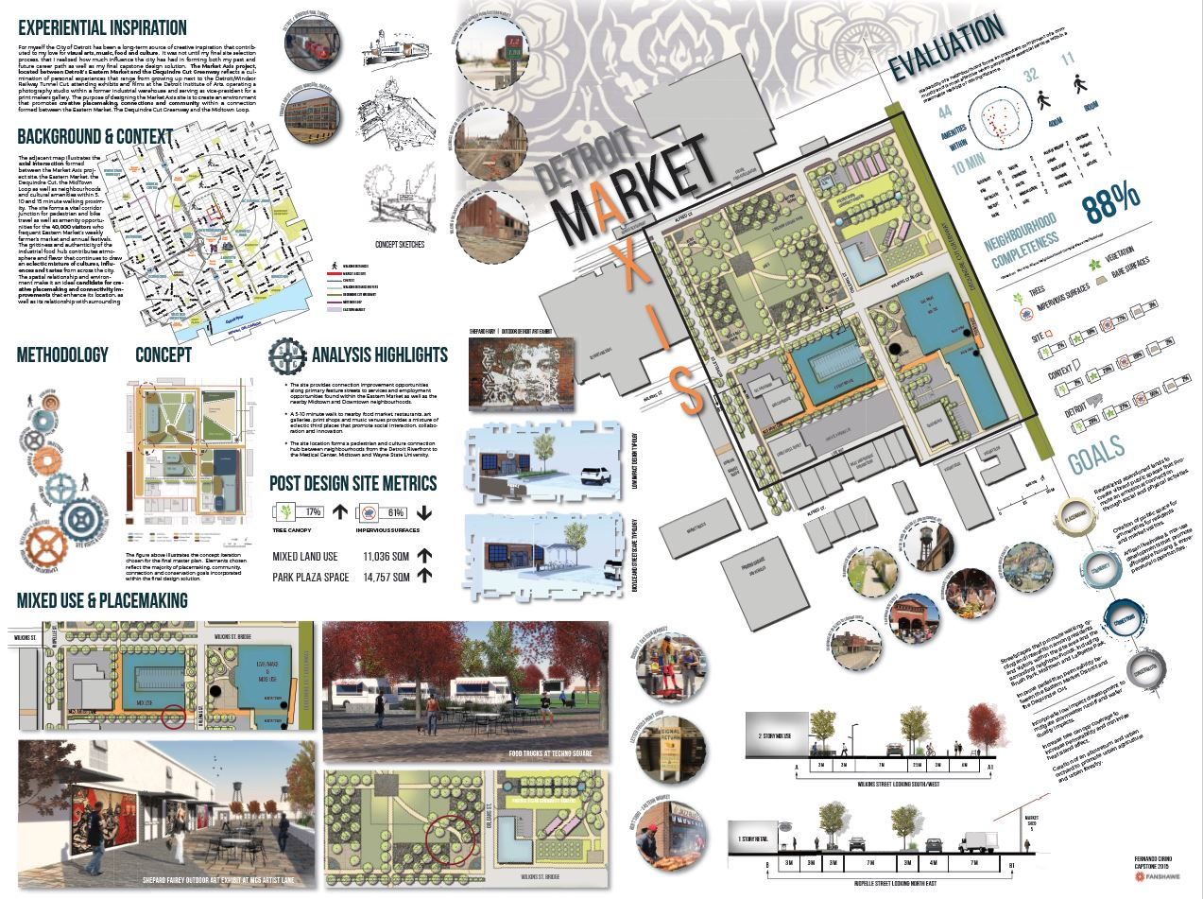

Slide 16
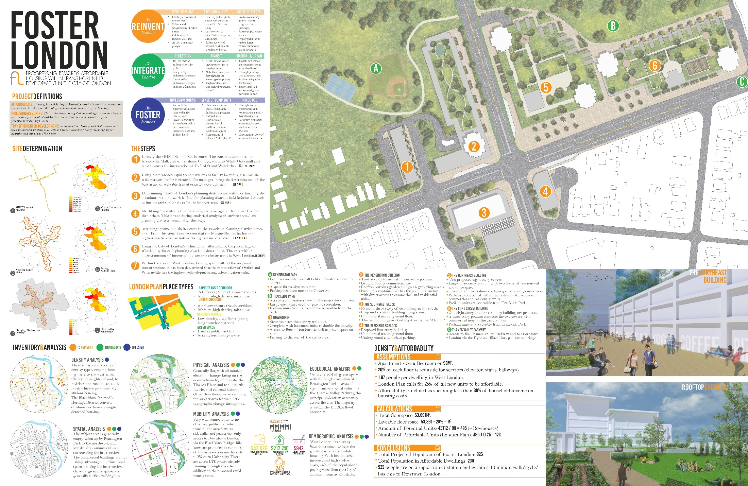

Slide 17
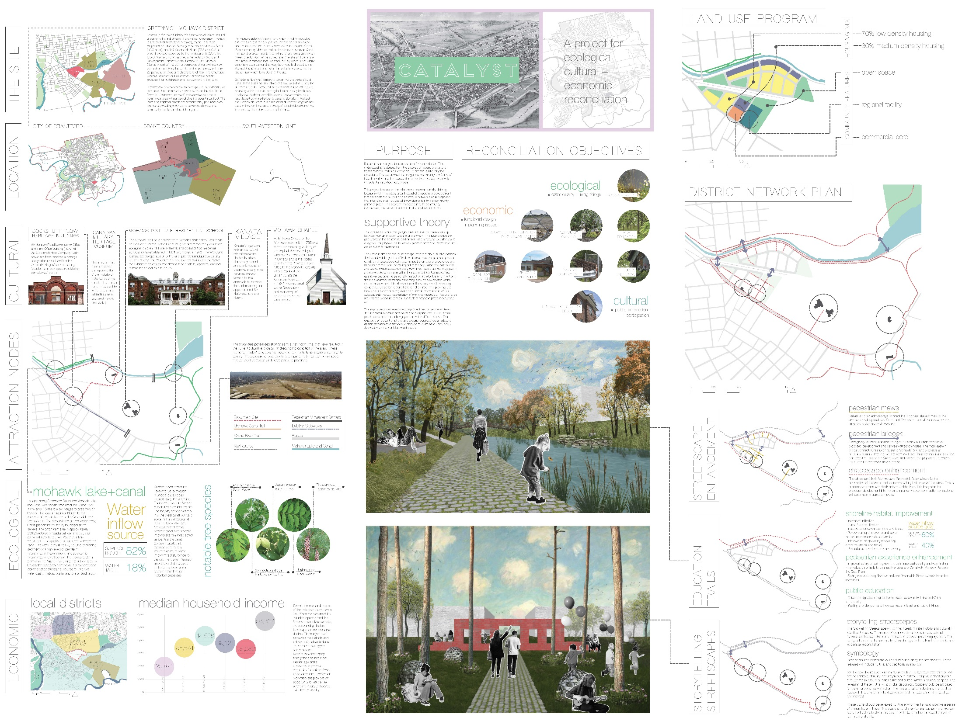

Slide 18

Contact Information
Wm. Paul Meahan
Curriculum Consultant, Centre for Academic Excellence
Fanshawe College
pmeahan@fanshawec.ca
Melissa Barnard
Curriculum Consultant, Centre for Academic Excellence
Fanshawe College
mbarnard@fanshawec.ca

