Slide 1



Defining, tracking and assessing WIL at the national level
Kristine Dawson, Conestoga College
Anne-Marie Fannon, University of Waterloo
Cara Krezek, Brock University

Slide 2
Background
Founded as the Canadian Association for Co-operative Education (CAFCE) in 1973
29 members representing 15 institutions – colleges and universities
Objectives focused on broadening the understanding of the significance and value of co-op and strengthening co-op programming through an exchange of ideas and best practices
Great interest in the value of co-operative education for preparing students to transition effectively from post-secondary to the labour market
Notes:
(a) Broaden the interpretation and understanding of the significance and value of cooperative education.
(b) Strengthen the function of co-operative education through active interchange of ideas and experience amongst educators, employers and students.
(c) Provide a source of information about co-operative education to counsellors, teachers, and administrators in secondary education.
(d) Extend co-operative education participation to more colleges and universities, more students and more employers.

Slide 3
Establishing national standards
Established an accreditation council in 1979
First – we needed to define co-op education and its quality attributes
  Each work situation is developed and/or approved by the co-operative educational institution as a suitable learning situation;
  The student is engaged in productive, full-time work rather than merely observing;
  The student receives remuneration for the work performed;
  The student’s progress on the job is monitored by the institution;
  The student’s performance on the job is supervised and evaluated by both the employer and the institution;
  The total co-operative work experience is normally 50% of the time spent in academic study, and in no circumstances will this figure be less than 30%.
Notes:
Education is a provincial mandate
Lobbying for federal funding to create new co-op programs
CAFCE accreditation criteria used to determine eligibility for federal funding and other incentives (Ontario Co-operative Education Tax Credit)
Funding for the association to establish a secretariat and develop resources for practitioners – helped to create quality programming across the country
1976-1977
There was a very clear need identified in this period of rapid growth in co-operative education programs to more strictly define co-operative education which, even in the education community, seemed to mean different things to different people. McCallum added further to this debate by suggesting that co-operative education was part of an umbrella term of experiential education. Whether a learning experience is paid or not paid, whether it is full time or part time, whether it is recurring or formal or a onetime event determines whether the experience is considered as co-operative education, internship, field experience or work study.17
Bruce McCallum, 1976-1977 President, reported, “….getting disturbed when I hear that a so called co-operative program is being established which will have, as its bare minimum, a one-month work experience within a program. I should point out that I am not against these kinds of programs, but surely they are not co-operative education?

Slide 4
The development of the association
Volunteer run association funded primarily through membership fees and professional development activities
National board with representation from across the country, university and college sectors, employer and government representatives
Numerous committees including: government relations, communications and PR, professional development, research, membership, international committee
Developed national statistics database on co-op work terms in Canada

Slide 5
The CEWIL National Statistics Database
Scalable and built with expansion in mind
Truly national: transcends individual provincial contexts
Development and adoption of a common language (over many years)
Bilingual
Data directly submitted by CEWIL Canada Member Institutions

Slide 6
Data we collect
Number of Co-op Work Terms
  Domestic & International Students
Institution type: college, polytechnic, university
Academic discipline
Gender
Salary
Work Term Locations
  Canada (Provinces & Territories)
  USA
  International
Employer Sectors
  Federal Government
  Federal Agency
  Provincial Government
  Provincial Agency
  Municipal Government
  Not for Profit
  Private

Slide 7
Generating Data: Beginning to tell the story
Reporting functions:
  Work Terms by Year/Term
  Year/Term Comparisons
  Work Term Totals by Employer Type
  Work Term Totals by Work Term Location
  Work Term Totals by Occupational Discipline
  Co-op Salary Summary
  Work Terms by Institution

Slide 8
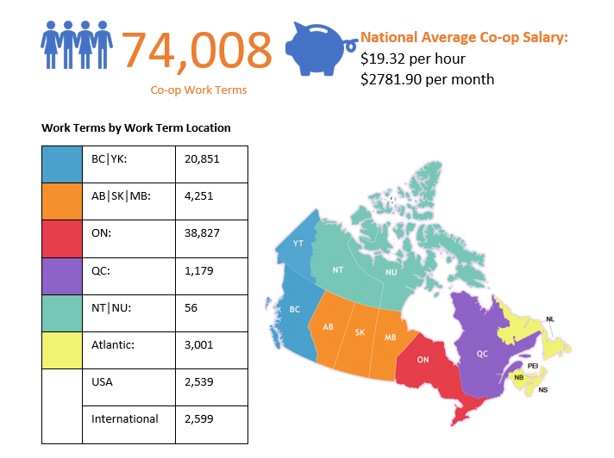
2017-2018 Co-op Data

Slide 9
Expansion into Work-Integrated Learning (WIL)
Building on our legacy of Co-op, move to expand into other forms of WIL
Current Co-op Practioners, familiar with or working within WIL
As growth for call in WIL, CEWIL moved to expand with a focus on QUALITY WIL
Building on work done in BC
2017 vote to expand mandate to officially include WIL

Slide 10
A Definition and 9 Forms of WIL
Define what WIL is (and what it is not)
Build on the base of our membership – experts, practioners
Not prescriptive but inclusive – the ability to map definitions to broad categories
Passed by our Board of Directors in 2018
Still evolving…

Slide 11
WIL Defined
Work-integrated learning (WIL) is a model and process of experiential education, which formally and intentionally integrates a student’s academic studies with learning in a workplace or practice setting. WIL experiences normally include an engaged partnership between an academic institution, a host organization/employer and a student. WIL occurs at the course or program level and includes the development of learning outcomes related to employability, personal agency and life-long learning.

Slide 12
Forms of WIL
Apprenticeship: Apprenticeship is an agreement between a person (an apprentice) who wants to learn a skill and an employer who needs a skilled worker and who is willing to sponsor the apprentice and provide paid related practical experience under the direction of a certified journeyperson in a work environment conducive to learning the tasks, activities and functions of a skilled worker. Apprenticeship combines about 80% at-the-workplace experience with 20% technical classroom training, and depending on the trade, takes about 2-5 years to complete. Both the workplace experience and the technical training are essential components of the learning experience.
Co-operative Education (co-op alternating and co-op internship models): Co-op alternating consists of alternating academic terms and paid work terms. Co-op internship consists of several co-op work terms back-to-back. In both models, work terms provide experience in a workplace setting related to the student’s field of study. The number of required work terms varies by program; however, the time spent in work terms must be at least 30% of the time spent in academic study for programs over 2 years in length and 25% of time for programs 2 years and shorter in length.
Internships: Offers usually one discipline specific (typically full-time), supervised, structured, paid or unpaid, for academic credit or practice placement. Internships may occur in the middle of an academic program or after all academic coursework has been completed and prior to graduation. Internships can be of any length but are typically 12 to 16 months long.
Entrepreneurship: Allows a student to leverage resources, space, mentorship and/or funding to engage in the earlystage development of business start-ups and/or to advance external ideas that address real-world needs for academic credit.

Slide 13
Forms of WIL
Service Learning: Community Service Learning (CSL) integrates meaningful community service with classroom instruction and critical reflection to enrich the learning experience and strengthen communities. In practice, students work in partnership with a community based organization to apply their disciplinary knowledge to a challenge identified by the community.
Applied Research Projects: Students are engaged in research that occurs primarily in workplaces, includes: consulting projects, design projects, community-based research projects.
Mandatory Professional Practicum/Clinical Placement: Involves work experience under the supervision of an experienced registered or licensed professional (e.g. preceptor) in any discipline that requires practice-based work experience for professional licensure or certification. Practica are generally unpaid and, as the work is done in a supervised setting, typically students do not have their own workload/caseload.
Field Placement: Provides students with an intensive part-time/short term intensive hands-on practical experience in a setting relevant to their subject of study. Field placements may not require supervision of a registered or licensed professional and the completed work experience hours are not required for professional certification. Field placements account for work-integrated educational experiences not encompassed by other forms, such as co-op, clinic, practicum, and internship.
Work Experience: Intersperses one or two work terms (typically full-time) into an academic program, where work terms provide experience in a workplace setting related to the student’s field of study and/or career goals.

Slide 14
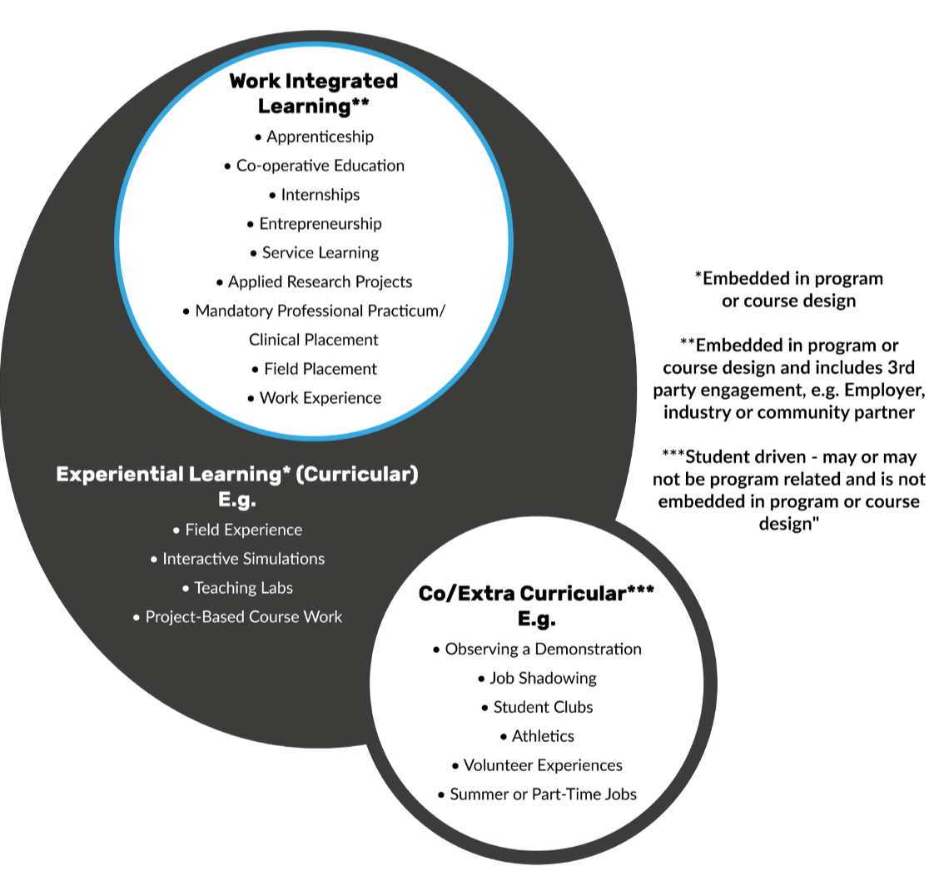
WIL within EL

Slide 15
Government advocacy today
CEWIL is an excellent subject matter resource available to support an interest in investing in supporting youth transitions to employment through work-integrated learning
Budget consultation papers to FINA
Submission and presentation to HUMA for the Experiential Learning and Pathways to Employment for Canadian Youth Study
ESDC Labour Standards Stakeholder Consultations for Interns in Federally Regulated Workplaces

Slide 16
Government advocacy today

Slide 17
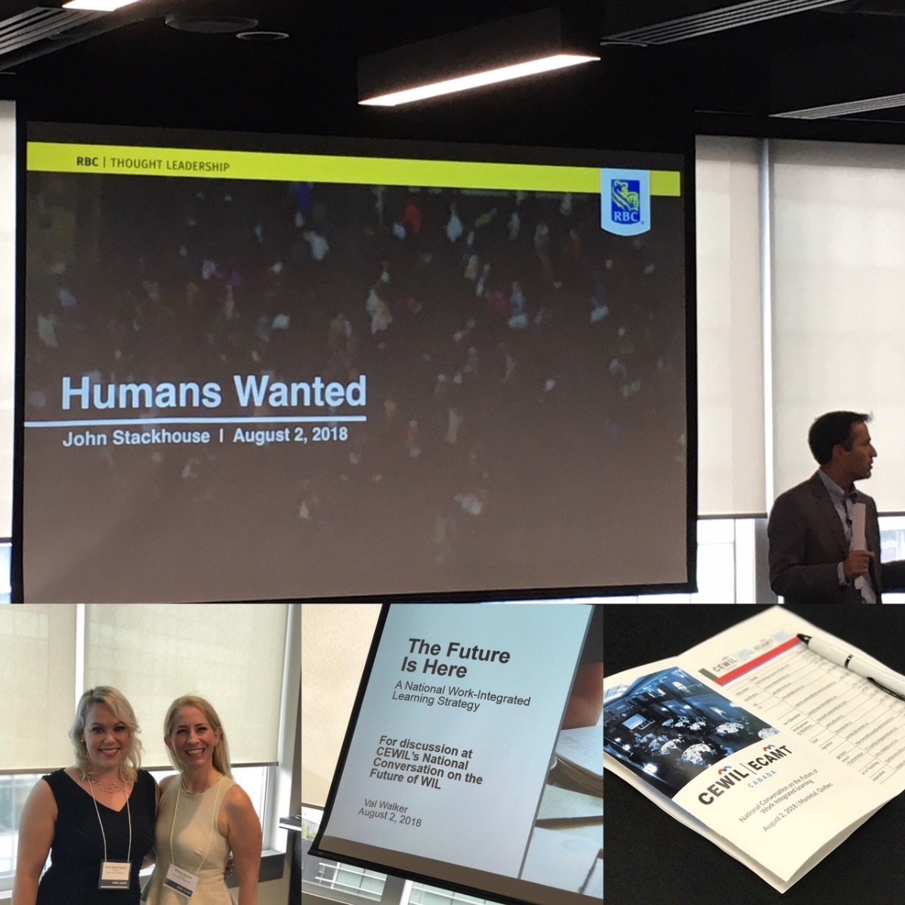
National Conversations on WIL
  Bringing together post-secondary, government and industry to discuss the role of work-integrated learning in Canada’s economic future
    Resources to help employers connect with students
    National data collection
    Terminology and quality attributes
    National strategy

Slide 18
WIL quality framework: quality matters
Build on expertise in co-op and co-op accreditation success
Shared attributes of quality WIL
Quality assurance framework in development
Whitepaper to be released later this month
Next steps
  Quality standards need to be defined
  Outcome measurement

Slide 19
Questions and Discussion
Thank you

