Slide 1

Network-based Outcomes Assessment for Program Improvement
Educating for the Future:
Learning Outcomes and Experiential Learning Symposium 2018
Brian Frank, Associate Dean Teaching and Learning
Faculty of Engineering and Applied Science, Queen’s University
Jill Scott, Vice-Provost (Teaching and Learning), Queen’s University
http://www.queensu.ca/qloa/home

Slide 2
Network-based outcomes assessment for program improvement
This session will start by describing and comparing several institution-wide approaches to assess learning outcomes development in order to inform program improvement. The approaches presented include assessing outcomes within courses, externally scoring course artefacts using generic rubrics, and using standardized tests. Data and conclusions drawn from five years of institutional assessment at Queen’s University will be used to illustrate the impact of the process and data. This includes a better connection between courses in a program, improved alignment between course goals and delivery, redeveloped assignments, and a network of instructors discussing both assessment and overall teaching. Participants will have an opportunity to work with some samples to illustrate the approaches. This will be used to initiate group discussions to explore current assessment initiatives, and interest in forming a network of institutions doing learning outcomes assessment to inform program improvement. Social change literature identifies that instructors are heavily influenced by disciplinary norms, suggesting that pan-university collaboration is a powerful way to influence assessment and program delivery.

Slide 3
Workshop goals
Describe process and results of collaborative program improvement processes
Demonstrate approaching to assessing student development

Slide 4
Factors influencing how to make change in Tertiary Institutions
Multiple power and authority structures within and outside institutions
Shared governance
Mixed allegiance of faculty
Disciplinary communities
Kezar, A. (2014). Higher Education Change and Social Networks: A Review of Research. The Journal of Higher Education, 85(1), 91–125. https://doi.org/10.1080/00221546.2014.11777320

Slide 5
Change management in higher ed (Kezar, Kotter, Leuke)
Establish commitment of stakeholders
Develop a shared vision
Identify data, expertise, challenges
Identify leadership
Select strategies and interventions
Create short-term wins, consolidate and build on gains
Monitor impact, adjust strategies
Institutionalize the changes

Slide 6
Vehicle for driving program improvement: assessment

Slide 7
Learning results from what the learner does and thinks and only from what the learner does and thinks. The teacher can advance learning only by influencing what the student does to learn.
Herbert Simon

Slide 8
Prior knowledge
Characteristics of learners
Learning environment
Course learning outcomes
Role of the unit/module
Personal expectations
Program learning outcomes
Departmental, disciplinary norms
Professional, vocational or employment-related requirements
Sector-based accountability
Assessment principles and policies
Considerations
Assignment
Course
Program
Institution
To support learning (formative)
To quantify achievement (summative)
As a learning tool (I.e. self/ peer-evaluation)
To justify grades and inform evidence-based decision making
For certification, accountability and continuous improvement
To advance research
excellence, leadership and innovation
Rationale for assessment
Notes:
Marking course assignments- where do they fit in the big picture

Slide 9
Different Forms of Assessment
Type of assessment (not an exhaustive list) | Description/ purpose
Diagnostic | Often used at the beginning of a course Used to gauge the learners prior knowledge and guide future instruction
Formative | The use of feedback (qualitative or quantitative) to guide and improve student performance Does not contribute to the final mark in the course
Summative | Usually given at the end of a block of work Used to gauge the degree to which the student has met the intended learning outcomes Contributes to the final mark in the course.
Examples
Quiz/ test/ exam (answer key)
Criterion-referenced: grade descriptors rubrics
Answers guide (with examples of quality responses)
Performance evaluation (expert knowledge)- verbal or written feedback

Slide 10
Assessment principles
Use multiple assessment approaches that address the most important assessment questions
Strengthen feedback loops between assessment process, results, and changes in policy and practice
Engage the faculty: process needs to be intellectually compelling, professionally rewarding, and relatively unburdensome
Implement using highest standards of scholarship
Banta, T. W. (Ed.). (2002). Building a Scholarship of Assessment (1st ed.). Jossey-Bass.

Slide 11

1
2
3
Outcomes-based continuous improvement process
Learning Outcomes Assessment Consortium Round 1
Learning Outcomes Assessment Consortium Round 2
Engineering-wide assessment
Four year longitudinal study of transferable cognitive skills comparing multiple tools
Cognitive Assessment Redesign: Network-based assessment redesign in first and fourth year

Slide 12
Approaches to measuring student development and inform program improvement
Standardized,non-embedded
Course artifacts
Embedded, non-standardized
Repeated used of validated discipline-independent tool
Artefacts from range of courses scored on consistent rubric
Outcome scores from course assessment
YEAR 1
YEAR 1
YEAR 1
Writing
Critical thinking
Problem solving
Writing
Critical thinking
Problem solving
Writing
Critical thinking
Problem solving
YEAR 4
YEAR 4
YEAR 4
Writing
Critical thinking
Problem solving
Writing
Critical thinking
Problem solving
Writing
Critical thinking
Problem solving

Slide 13
Using assessment data from course artefacts
Course artifacts
Outcomes scores from course assessment
YEAR 1
Writing
Critical thinking
Problem solving
YEAR 4
Writing
Critical thinking
Problem solving

Slide 15
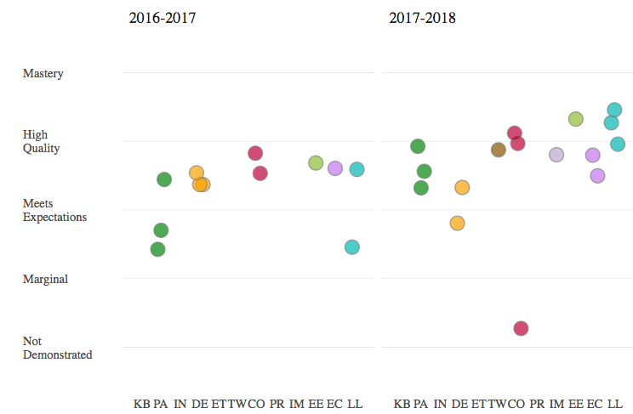

Slide 16
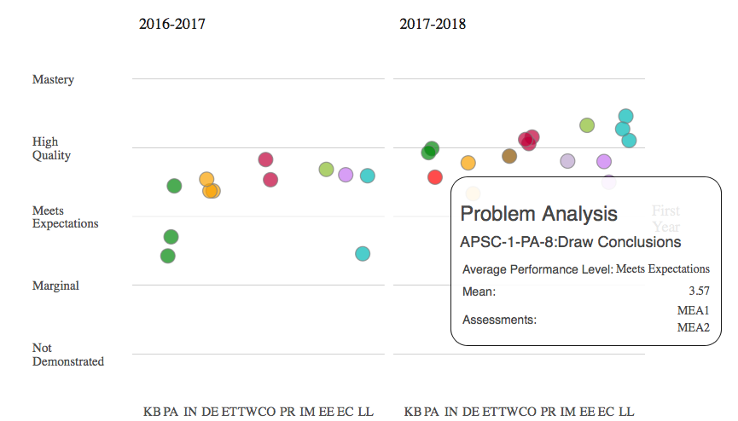

Slide 17
Using assessment data from course artefacts
Course artifacts
Strengths
Well aligned and linked to course delivery
Meaningful for instructor
Informs course level improvement
Weaknesses
Validity and reliability depend on quality of course assessments which vary considerably
Even with pooling data from multiple courses, it is challenging to infer student development over duration of the program
Outcomes scores from course assessment
YEAR 1
Writing
Critical thinking
Problem solving
YEAR 4
Writing
Critical thinking
Problem solving

Slide 18
Three approaches for measuring student development to inform program improvement
Standardized,non-embedded
Course artifacts
Embedded, non-standardized
Repeated used of validated discipline-independent tool
Artefacts from range of courses scored on consistent rubric
Grades from course assessment
YEAR 1
YEAR 1
YEAR 1
Writing
Critical thinking
Problem solving
Writing
Critical thinking
Problem solving
Writing
Critical thinking
Problem solving
YEAR 4
YEAR 4
YEAR 4
Writing
Critical thinking
Problem solving
Writing
Critical thinking
Problem solving
Writing
Critical thinking
Problem solving

Slide 19
Three approaches to measuring student development and inform program improvement
Standardized,non-embedded
Repeated used of validated discipline-independent tool
YEAR 1
Writing
Critical thinking
Problem solving
YEAR 4
Writing
Critical thinking
Problem solving

Slide 20
HEIghten scores by Program
 | Year group n
 | First | Final
BAH | 99 | 6
BASC | 616 | 65
BCMPH | 13
BNSC | 79 | 62
BSCH | 714 | 14
UHSC1 | 9

Slide 21
Significance of Effort on Score

Slide 22
HEIghten Sub-Scores
 | Year | Mean | Std. Deviation | N | d
"Analytic" | 1 | 4.97 | 2.26 | 1533 | 0.428
 | 4 | 5.91 | 2.13 | 151
"Synthetic" | 1 | 5.43 | 2.18 | 1533 | 0.497
 | 4 | 6.38 | 2.07 | 151

Slide 23
Three approaches to measuring student development and inform program improvement
Standardized,non-embedded
Strengths
Measurable psychometric properties
Excellent reliability
Weaknesses
Often poor alignment and connection to course delivery
Questionable meaning for instructor
Challenging to get time to administer
Students often not motivated
Repeated used of validated discipline-independent tool
YEAR 1
Writing
Critical thinking
Problem solving
YEAR 4
Writing
Critical thinking
Problem solving

Slide 24
Three approaches for measuring student development to inform program improvement
Standardized,non-embedded
Course artifacts
Embedded, non-standardized
Repeated used of validated discipline-independent tool
Artefacts from range of courses scored on consistent rubric
Grades from course assessment
YEAR 1
YEAR 1
YEAR 1
Writing
Critical thinking
Problem solving
Writing
Critical thinking
Problem solving
Writing
Critical thinking
Problem solving
YEAR 4
YEAR 4
YEAR 4
Writing
Critical thinking
Problem solving
Writing
Critical thinking
Problem solving
Writing
Critical thinking
Problem solving

Slide 25
Three approaches for measuring student development to inform program improvement
Embedded, non-standardized
Artefacts from range of courses scored on consistent rubric
YEAR 1
Writing
Critical thinking
Problem solving
YEAR 4
Writing
Critical thinking
Problem solving

Slide 26
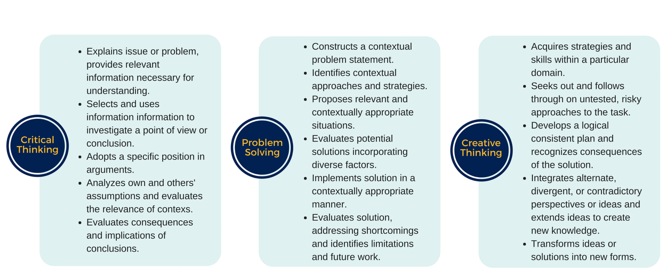
VALUE Outcomes assessed (2017-18)
10 courses
(all dimensions in 4 courses)
22 courses
1 course

Slide 27
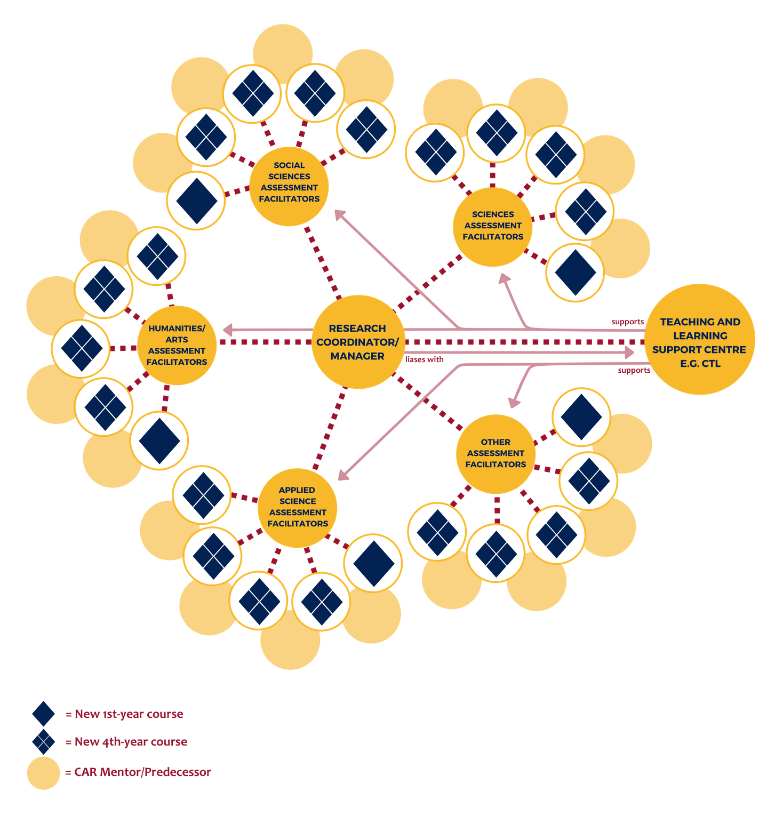
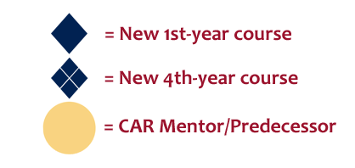

Slide 28
Calibrating, scoring, and mediating using a rubric
 | Not demonstrated (0 point) | Developing (1 Point) | Accomplished (2 Points) | Advanced (3 Points)
Issues | Introduction of issues is unclear and/or not linked to the study topic. | Presents issues and omissions in related to the study topic. | Explains key issues impacting on the study topic. | Critiques key issues impacting on the study topic.
Context/ Assumptions | Contextual factors are introduced, but do not relate to the study design. | Explains some contexts related to the study design, but awareness of assumptions is not apparent. | Demonstrates awareness of assumptions and analyses how different contexts impact on the study design. | Questions their own and others assumptions in the analyses of contextual factors related to the study design.
Hypothesis | Hypothesis is unrelated to the topic. | Hypothesis is stated, but is not able to be tested under the proposed study design. | Hypothesis is stated, and may be able to be tested under the proposed study design. | The hypothesis is clear, testable and the study design allows for the full range of variables to be investigated.
Implications/ recommendations | Conclusions are incorrect or incoherent | Explains implications without making recommendations | Addresses implications, making recommendations for corrections future work | Weighs impacts, accounting for implications when recommending future work.
Quality levels
Assessment dimensions
Scoring strategy
Quality indicators (Performance criteria)

Slide 29
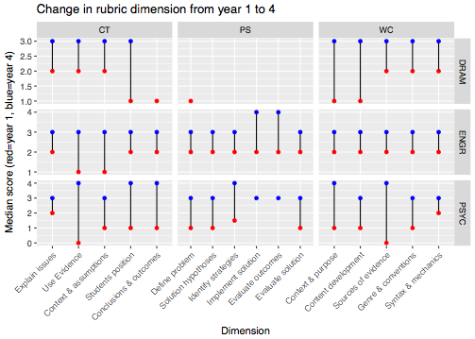
Authentic
Traceable
Reliable
Useful
Common understanding

Slide 30
Critical thinking Outcomes
Explanation
of issues
Evidence
Context &
Assumptions
Position
Conclusions &
outcomes
Explanation
of issues
Evidence
Context &
Assumptions
Position
Conclusions &
outcomes
Explanation
of issues
Evidence
Context &
Assumptions
Position
Conclusions &
outcomes

Slide 31
Select one of the following…
(Please move to the relevant table)
Note: These assignments are drawn from first-year courses participating in the Cognitive Assessment Redesign project http://www.queensu.ca/qloa/home
Alcohol & conformity:
Research study design
Literary study: Essay
Diversity of fish populations: Research project
Anatomy: Case study

Slide 32

Process for rubric-based assessment
Individually read through...
The assignment instructions to make sure you understand what the students were asked to do
The rubric and identify any unfamiliar terms
A student response and identify where in the assignment the dimensions are demonstrated
The quality indicators and make a judgement of performance level for each dimension (make notations as you go to justify your judgement and aid in discussion)
Compare judgements made and identify discrepancies
Discuss differences in interpretation
Make an agreement as to what level you can agree the sample to be at (take notes for future reference and clarification)
As a group…
This process is referred to as calibration, the goal is to build a common understanding for consistency in scoring.

Slide 33

Possible issues…
What if you are asked to use a rubric that refers to latent bahaviours, such as?
  Understand
  Know
  Appreciate
  Comprehend
You can make inferences from observations, but you can’t quantify the knowledge that’s still in someone’s head.

Slide 34
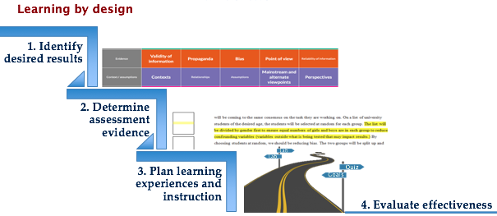
Alignment between instruction, learning outcomes and assessment
Referred to as backward design:
  Wiggins, G. P., & McTighe, J. (2005). Understanding by design. Alexandria, VA: Association for Supervision and Curriculum Development.
Or constructive alignment:
  Biggs, J. (2014). Constructive alignment in university teaching. HERDSA Review of Higher Education, 1(1), 5–22.

