Slide 1
Uncharted territory a model for mapping the co-curriculum
Heather Campbell & Jennifer Foley Brescia University College

Slide 2

outline
By the end of the session, participants will be able to interpret the flexible model for co-curriculum and discuss its benefits and drawbacks in relation to their context
Background
Co-Curriculum?
Brescia: A Case Study
Observations and Next Steps
Questions

Slide 3
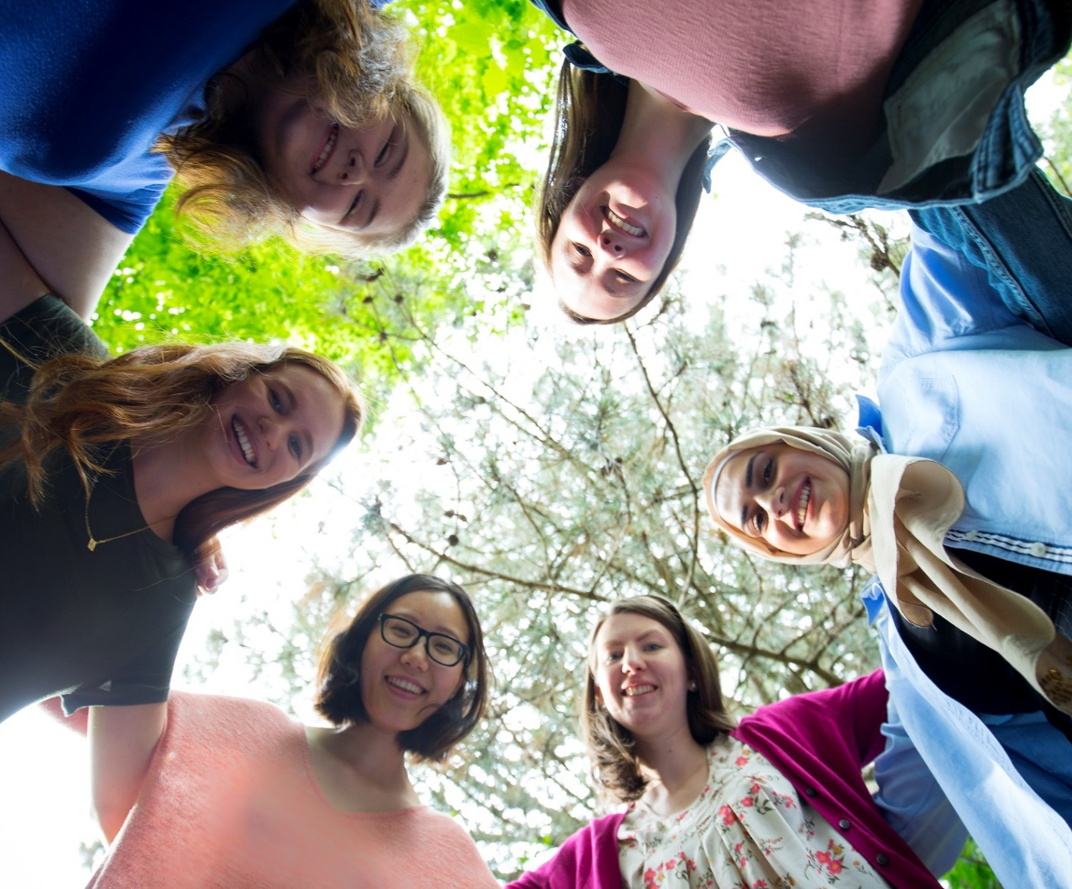
Background: welcome to Brescia
Canada’s ONLY women's university
OUTCOMES model of education
Educate the WHOLE person

Slide 4
What is meant by ‘co-curriculum’?
At BRESCIA:
Student learning a goal of the initiative
Voluntary by students, usually short-term
Curriculum
e.g. Courses
Co-Curriculum
Extra-Curricular
e.g. Internships
e.g. Sports
Required
Required?
Voluntary
Information Literacy Program?
Work-Study?

Slide 5
Step 1: identify mapping goals
Institutional Mapping?
Advertise programming?
Identify gaps?
Quality assurance?
Student learning of the Competencies
Identify staff goals re. learning outcomes

Slide 6
Step 2: recruit co-curriculum partners
Initiatives align with mapping goals?
Champions in each department?
Consider starting with the library
Participants
Beryl Ivey Library
Still to come
Campus Ministry
Does not fit goals
Student Life Centre
Academic Advisors
International Student Coordinator*
Student Clubs*
Residence Life
Experiential Education*

Slide 7
Step 3: Sort and identify initiatives
List of initiatives
Link to Mapping Goals
Initiatives to map
Outcomes needed
Library
Info Lit
Reference
Student Life
Career Services
Peer Mentor
Circulation
O-Week

Slide 8
Step 4: develop Learning outcomes
Learning outcomes
Professional Standards
Developmental vs Surface
a) Pre-reading*
c) Follow-up meeting(s) or emails
b) Learning outcome workshop
Workshop

Slide 9
STEP 5: Map
Provide templates
Surface Maps: Completed in Workshop
Developmental Maps as Homework

Slide 10
Institutional Outcomes
Institutional Competencies
Program Outcomes
Module Titles
Course/Unit Outcomes
Modules Levelled Learning Outcomes
Lesson Outcomes

Slide 11
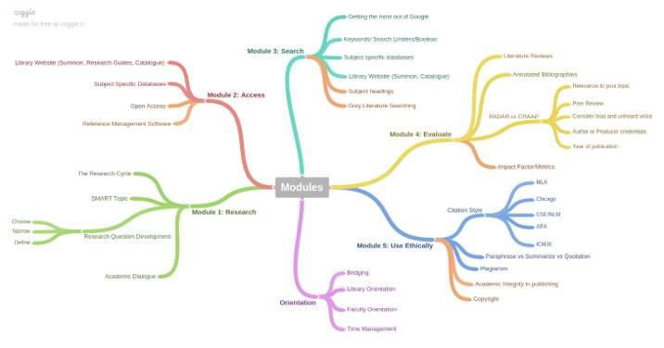
Modules

Slide 12

Brescia University College
Co-Curriculum Mapping of Library Services
Mapping Goals
MAP institutional competencies LEARN about IL program
Jennifer Foley, Learning and Curriculum Support Librarian
Recruit Partners
Information Literacy Program & Reference Services
Sort Initiatives
Circulation Services
Develop Outcomes
Modules with levelled Learning Outcomes
Information Literacy
DEVELOPMENTAL MAPS
Map
Reference Services SURFACE MAPS
Assess Results
Written into Information Literacy Program Plan 2018 - 2022
Started advertising Modules as a jumping off point
Dissemi-nate
H.Campbell & J. Foley (2018). Learning Outcomes Symposium, Toronto, October.

Slide 13
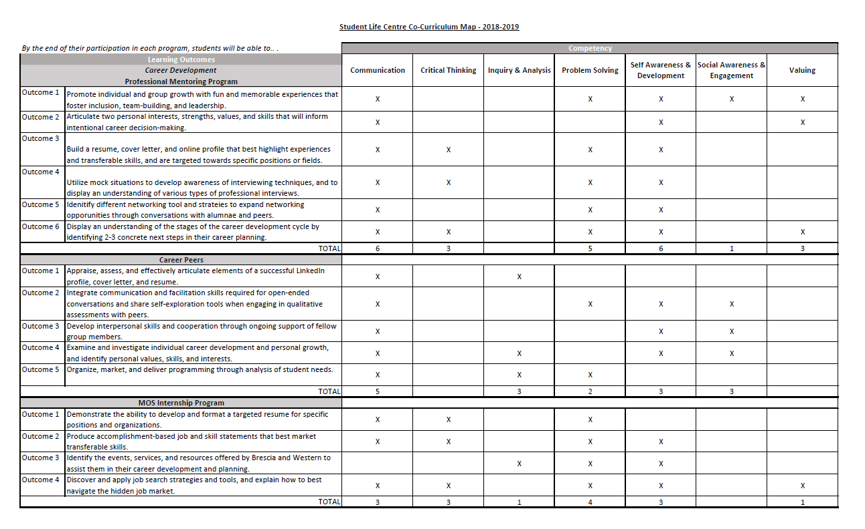
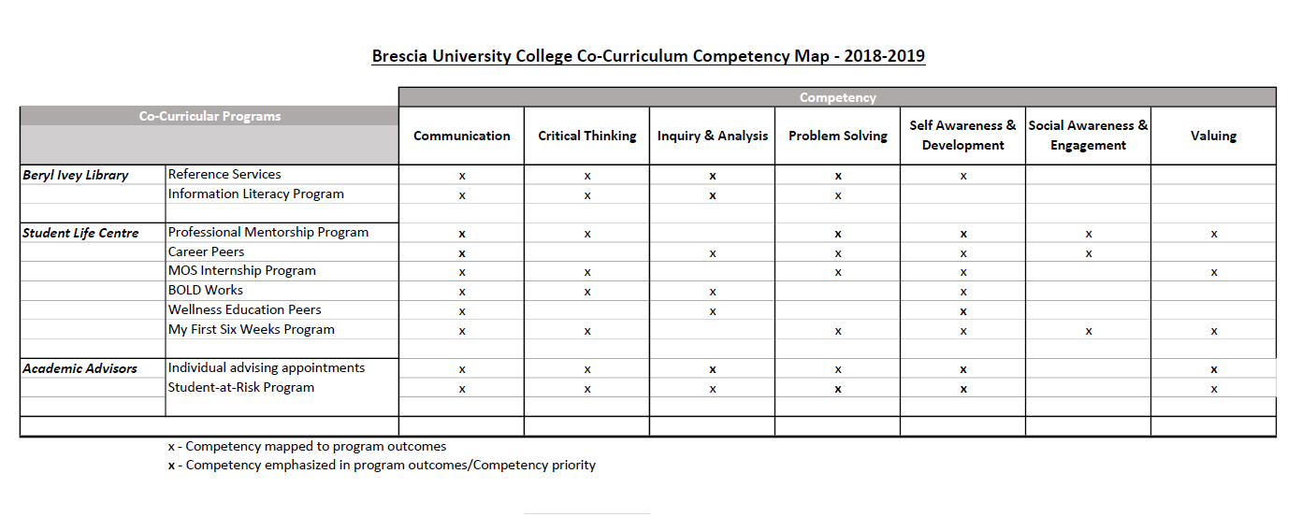
Examples

Slide 14
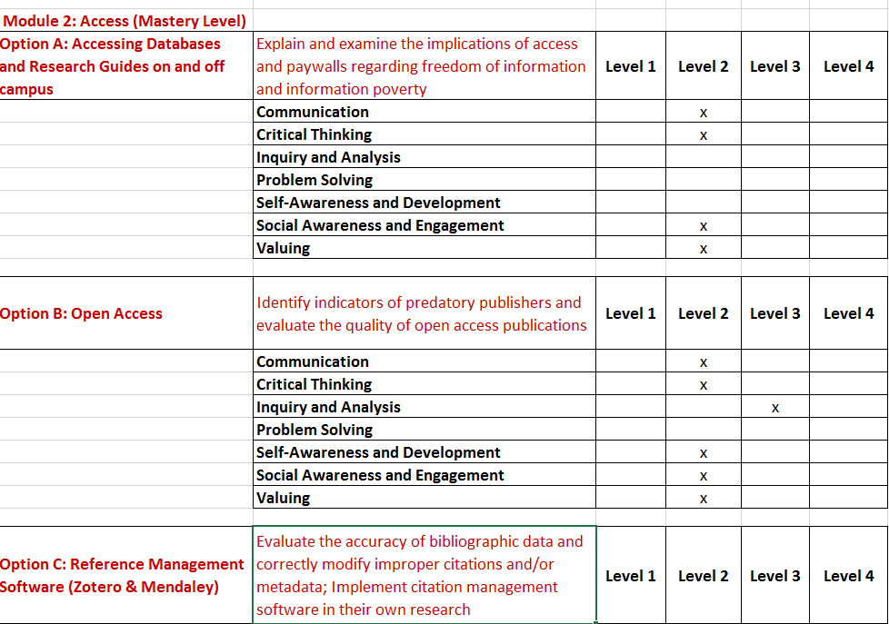
Examples

Slide 15
Step 6: Assess results
Student Life
Academic Advising

Slide 16
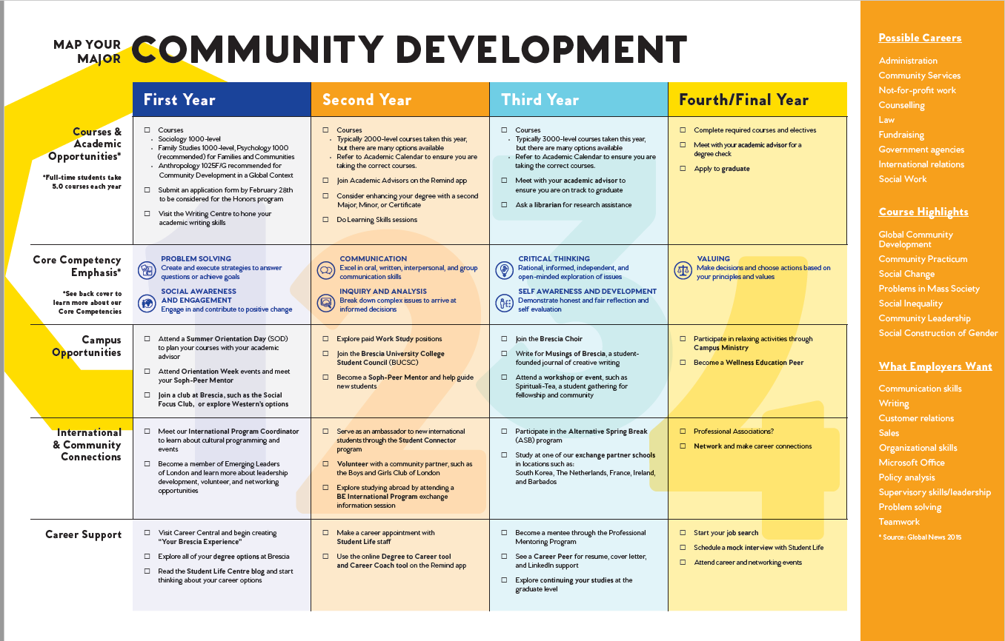
Step 7: Disseminate

Slide 17
Observations
Next Steps
Remaining Departments
“Other” Learning Outcome Work
ePortfolios?
Institutional Branding
“Co-Curricular” Experiential Learning
“Information Literacy” Curricular? Co-Curricular?
“Experiential Learning” Curricular vs Co-Curricular
Clear Taxonomy Required
Imposter Syndrome

Slide 18
Questions?
Thank you!
heather.campbell@uwo.ca
jfoley26@uwo.ca

