Slide 1
Making sense of the holistic student experience
Notes:
Joe

Slide 2
Meet the panel…
Joseph Beer - Director of Teaching Learning and Development
Shirley Hall- Educational Developer
Jensen Arsenault - ExpLaur pilot student
Erin McHarge- ExpLaur pilot student
Notes:
Joe

Slide 3
Making sense of the holistic student experience
  Outline of presentation
    Introduction and Framing
    Embedded Research Process
    The Student Experience
    Challenges, Successes and Lessons from the Pilot
    Moving the Project Forward
Notes:
Joe

Slide 4
Introduction and Framing
  Why we are here
  Background to the project
  ExpLaur pilot course
Notes:
Joe

Slide 5

Course Design, Pilot Development, Embedded Research & Evaluation Process
Associate Vice President of Teaching
& Learning
Faculty of Liberal Arts Dean & Dean’s Advisory Council (FLA)
Director of Teaching, Learning & Development [Instructor]
Educational Developer
Research Ethics Board approval
Survey
Focus Groups
Notes:
Shirley

Slide 6
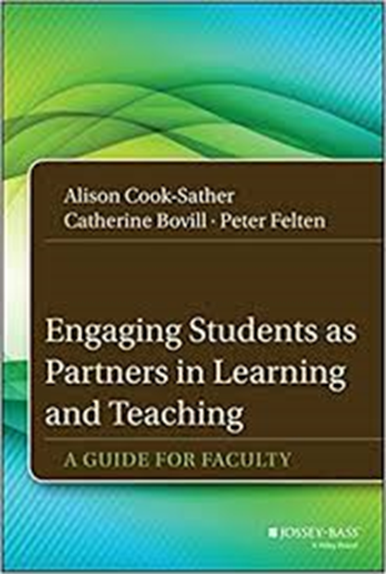

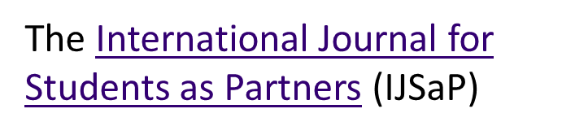
Course Design, Research & Evaluation Process
Engaging Students as Partners in Learning and Teaching: A Guide for Faculty
Alison Cook-Sather; Catherine Bovill;
Peter Felten
Notes:
Shirley

Slide 7
ExpLaur Experiential Learning Reflection Pilot
  The gift of time and freedom
  The meaning-making process
  Finding my medium of expression
  Thinking beyond tangible means
  Evaluation
Notes:
Erin

Slide 8
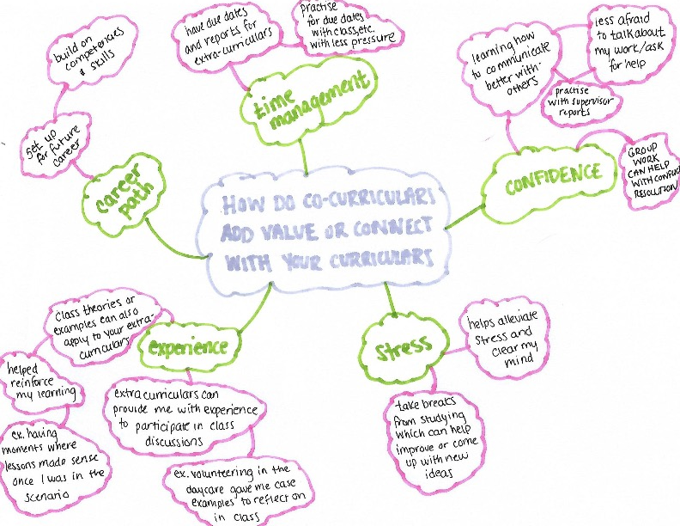
Notes:
Jensen

Slide 9
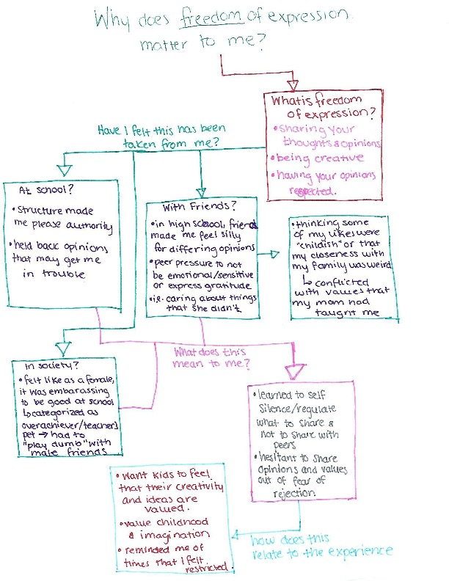
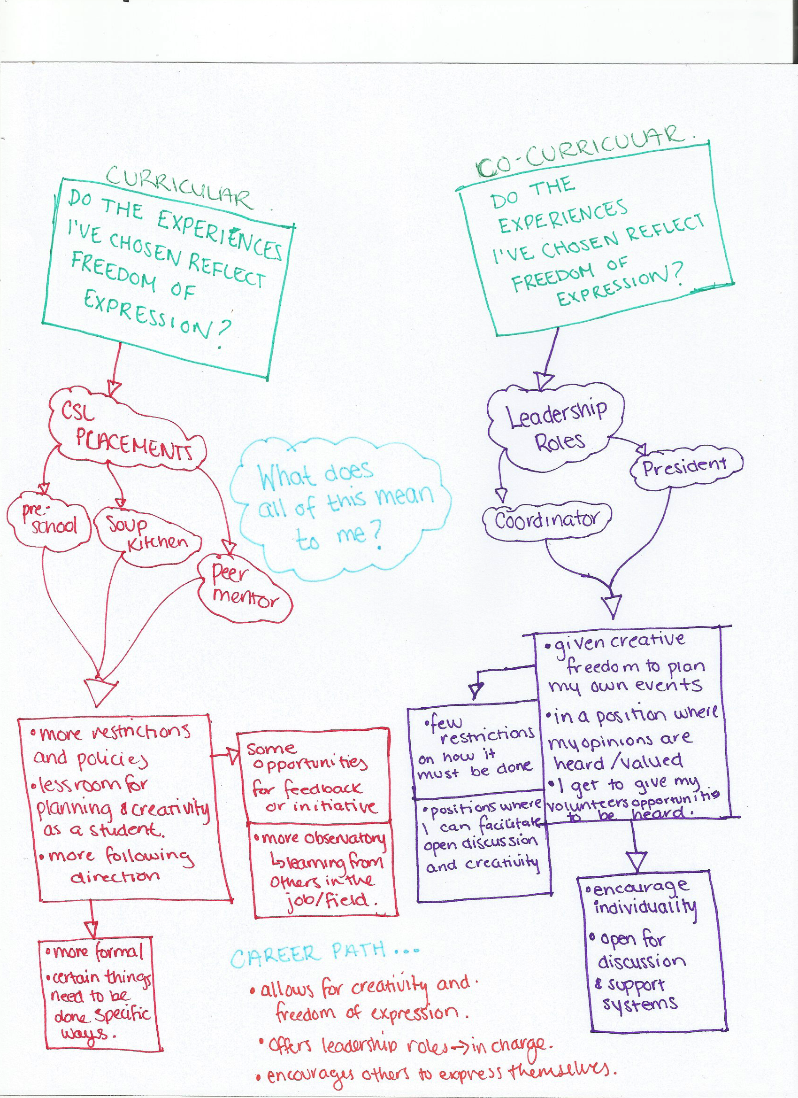
Notes:
Jensen

Slide 10
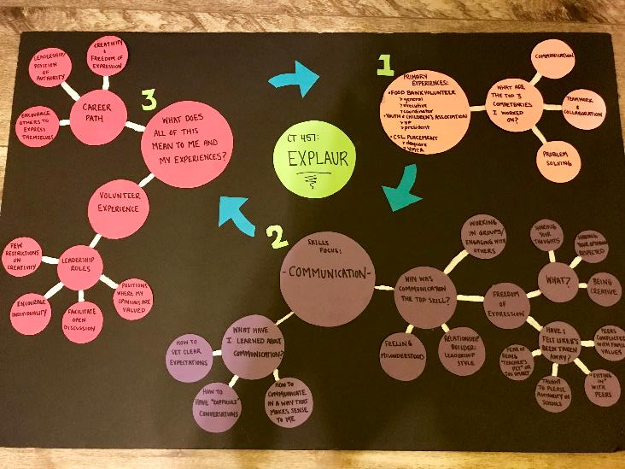
Notes:
Jensen

Slide 11
Challenges, Successes and Lessons from the Pilot
  Undoing the reflective work
  Bringing the self back into the learning process
  The importance of flexibility
  Developing ‘with’ student not ‘for’ student
Notes:
Joe

Slide 12
Challenges, Successes and Lessons from the Pilot
  Next steps…
  Moving the project forward
Notes:
Joe

Slide 13
Thank you!
Joseph Beer jbeer@wlu.ca
Shirley Hall shall@wlu.ca
Notes:
Joe

