Slide 1


Key Challenges for the Development and Implementation of an OSCE for Optometric Education
Patricia Hrynchak, OD, MScCH(HPTE), FAAO

Slide 2
Disclosures
Clinical faculty member at the University of Waterloo, School of Optometry and Vision Science
No conflicts of interest

Slide 3
Learning Objectives
Define an Objective Structured Clinical Examination
Describe the development process for implementing the assessment
Appreciate challenges of introducing this form of summative assessment into an existing curriculum

Slide 4
The Assessment of Competence/Outcomes
The literature shows that multiple forms of assessment are required to determine if clinical competency has been reached in healthcare education, i.e., a system of assessment
Currently, in the University of Waterloo, professional optometry program, only one assessment method is in place, a global rating scale which includes the assessment of 5 clinical skills and 8 clinical behaviors using anchored behavioral descriptors
This is used daily during the on-site term and periodically during the external clerkships

Slide 5
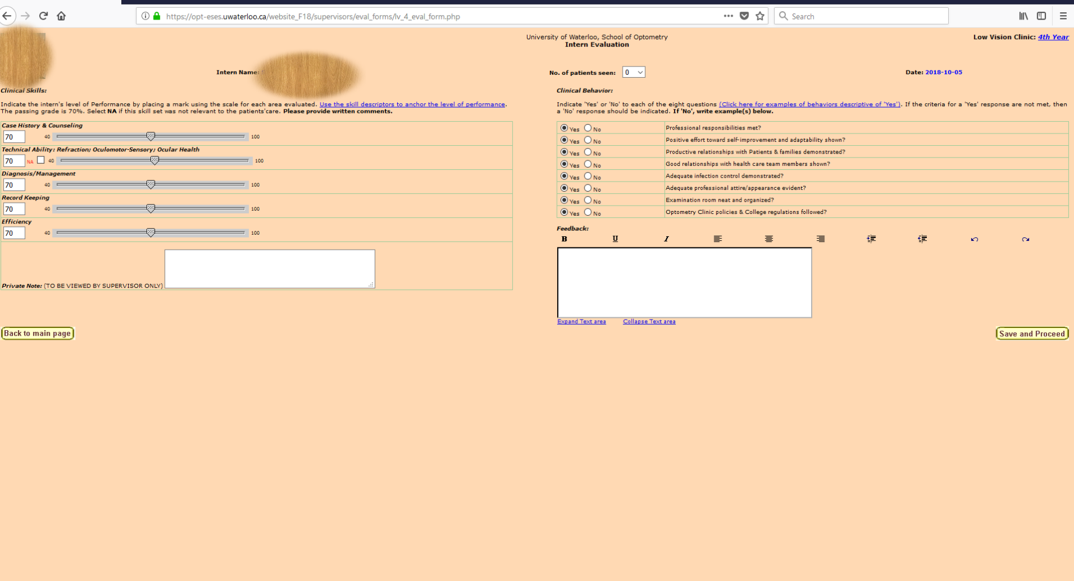

Slide 6
The Assessment of Competence/Outcomes
Performance ratings determined by use of these global rating scales have the advantages of:
rating various aspects of performance
evaluating “soft” traits such as interpersonal skills
being less obtrusive than other techniques so the measurement has less effect on the performance
providing rapid feedback for formative purposes, and
being well known to the clinical instructors

Slide 7
The Assessment of Competence
However, the validity and reliability of the tool has also been questioned.
Factors affecting the reliability and validity are:
limited rater training
the relationship between the student and the rater
the impact of clinical teaching evaluations completed by the student
changing performance expectations by instructors throughout the academic year, and
variable patient profiles (e.g., severity of illness).

Slide 8
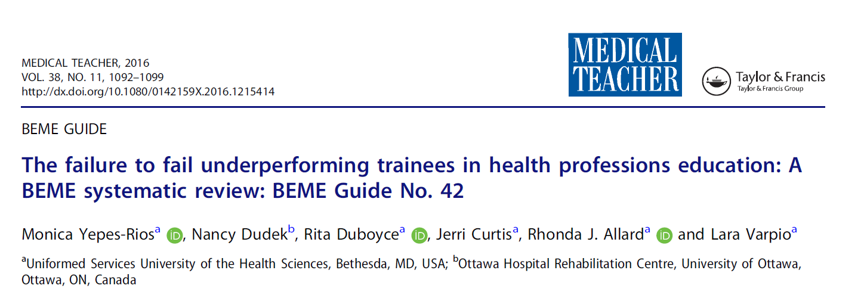
The Assessment of Competence
While this evaluation tool has been found to provide important feedback to the student and facilitate continuous improvement of clinical behaviour it has not been useful in identifying deficient clinical skill performance and therefore, should not stand alone as a reliable measure of clinical competency.

Slide 9
Objective Structured Clinical Examination
The OSCE is a performance-based examination in which students are evaluated while demonstrating various clinical skills (e.g., communication including history taking, making a diagnosis, analyzing test results) as they rotate through a series of stations.
It is able to assess performance at the “shows how” level of Miller’s pyramid of assessment.
The main advantage is that it can assess clinical reasoning in a controlled, objective environment.

Slide 10
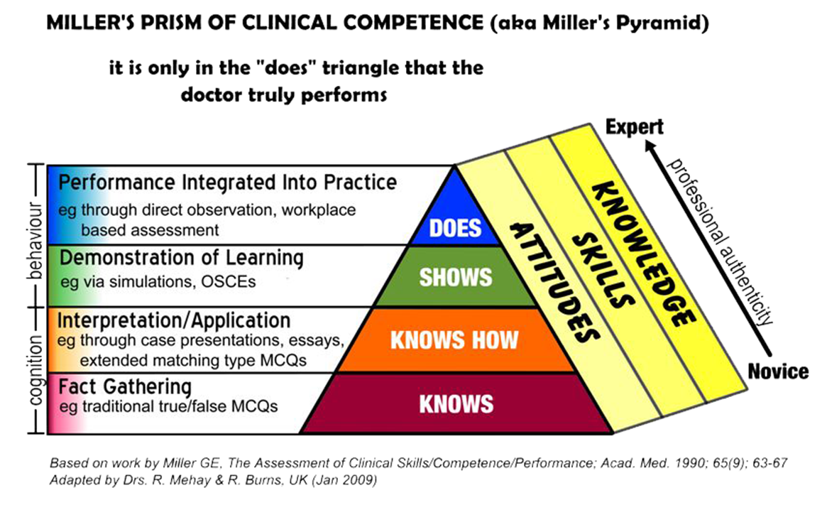

Slide 11
Objective Structured Clinical Examination
First developed in the 1970s by Ronald Harden, it has been rigorously evaluated with an extensive body of research and has become the international ‘gold standard’ for evaluating clinical competence.
Established in the literature the main challenges to using the OSCE are:
The initial faculty development time
Increased administrative staff time commitment (e.g., organizing subjects annually)
Subject costs

Slide 12
In our context
The OSCE will:
help prepare students to be successful on national board examinations (as they will gain exposure to this format which is used in the Optometry Examining Board of Canada’s entry-to-practice examinations) and,
use standardized methodology to increase reliability and validity of the assessment system
The results of this assessment will be used in program evaluation to improve the quality of the Doctor of Optometry curriculum.

Slide 13
The Development Process
AMEE guide by Khan et al. 2013 The Objective Structured Clinical Examination (OSCE): AMEE Guide No. 81. Part II: organisation & administration.
Preparation and Planning
Organizational structure
Examination scheduling, rules and regulations
Blueprinting, mapping and examination length

Slide 14
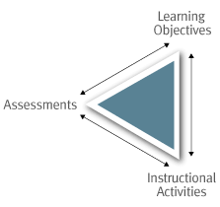
Blueprinting
Content validity is necessary for every assessment and is achieved when the assessment is congruent with the learning objectives and the learning and teaching methods.
Learning Objectives Learning Outcomes
Learning Outcomes Competencies

Slide 15
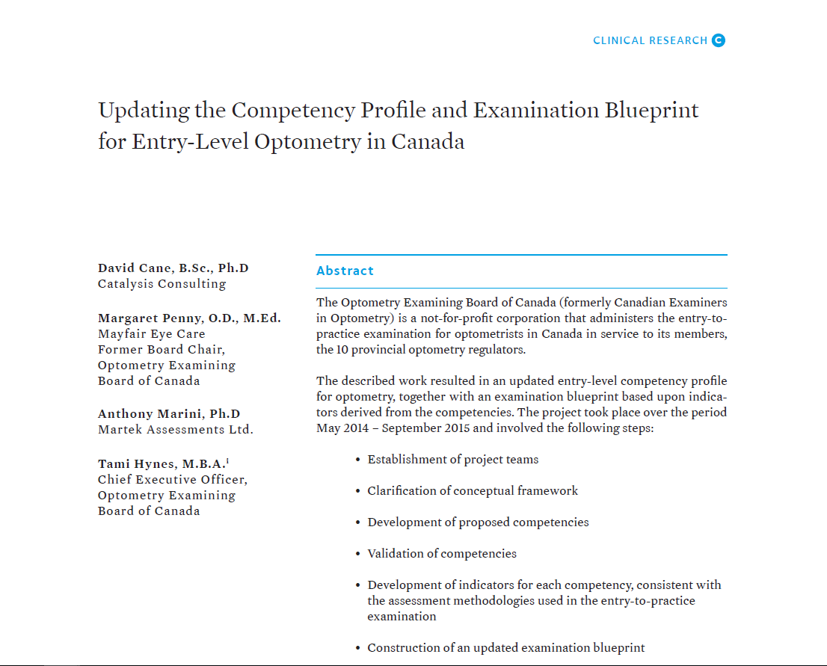
Canadian Examining Board of Canada
Canadian Journal of Optometry
Volume 80 Issue 2

Slide 16
Competency Areas
Communication
Professionalism
Patient Centered Care
Assessment
Diagnosis & Planning
Patient Management
Collaborative Practice
Scholarship
Practice Management
Each area has sub-competencies and indicators

Slide 17
Development Process
AMEE guide by Khan et al. 2013 The Objective Structured Clinical Examination (OSCE): AMEE Guide No. 81. Part II: organisation & administration.
Developing a bank of OSCE stations
Choice of topics
Choice of station writers
Choice of station types
Choice of OSCE station writing template
Station writing
Marking guidance
Peer review workshops
Piloting (IOBP candidates)
Psychometric analysis

Slide 18
Development Process
AMEE guide by Khan et al. 2013 The Objective Structured Clinical Examination (OSCE): AMEE Guide No. 81. Part II: organisation & administration.
Choosing a scoring rubric and standard stetting
Developing a pool of trained examiners (UW School of Optometry)
Developing a pool of trained standardized patients (Touchstone Institute or McMaster University)

Slide 19
Standard Setting – cut score
Criterion vs norm referenced
Angoff Method
Proportion of borderline candidates that would be able to pass the station – prospective
Borderline regression
Proportion of candidates that were rated as boarderline – the mean of their scores is the pass score – retrospective

Slide 20
Development Process
AMEE guide by Khan et al. 2013 The Objective Structured Clinical Examination (OSCE): AMEE Guide No. 81. Part II: organisation & administration.
Running the OSCE
Administrative tasks
Choosing the venue
Setting up the OSCE circuit and equipment
Running the OSCE circuit and troubleshooting
Post-OSCE considerations
Complaints and appeals
Quality assurance
External examiners
Post-hoc psychometrics
Evaluation

Slide 21
Challenges
First attempt at developing an OSCE was in 2004
It was to replace the existing exit assessment (3 oral examinations) with a more valid and reliable assessment method
Work progressed on the project
The faculty members of the School of Optometry voted to eliminate exit assessment from the curriculum as they felt that the recently implemented board examination process fulfilled that role

Slide 22
Challenges
Renewed interest in using an OSCE as an assessment of competence in 2017 with a change in administration
Secure funding in a resource constrained environment
Successful Learning Innovation and Teaching Enhancement (LITE) grant at the University of Waterloo
$30,000
Money for ongoing administration?
Resistance to change
Longstanding program (51 years at UW)
No competition (only English instruction school in Canada)
Traditional curriculum with suspicion of innovation

Slide 23
Challenges
Implementation in the curriculum:
Proposed as a summative examination for the doctor of optometry program
First step was to introduce a milestone into the program that was a requirement to pass
But!
Faculty support was lacking and the assessment changed to formative from summative
Significant concern over the lack of a specific remediation program other than an additional term of clinical training
Lack of faculty support blocked change even with Director support

Slide 24
Challenges
Scholarship of teaching and learning:
Office of research ethics required consent to use data from the examination in any scholarly outputs
Ethics consent process onerous
Arms length
Sealed
Students have graduated before consent is known

Slide 25
Challenges
Risks to formative assessment
Lack of consent
Lack of participation
The hope is that students will want a change to challenge an examination that is unfamiliar in a no-risk setting to gain the experience

Slide 26
Challenges
Time commitment is significant
Project team participation has waned
Recruitment of assessors
Training time for assessors
Actual examination time
Set up and delivery
Staff support

Slide 27
Thank you

