Slide 1
Learning Outcome Assessment of Entrepreneurial-WIL
Alon Eisenstein,
Educator, Experiential Learning
Impact Centre
University of Toronto
Brendan Wylie-Toal
Program Manager
GreenHouse
University of Waterloo

Slide 2




Teaching Incubation Research

Slide 3





Research on Innovation

Slide 4




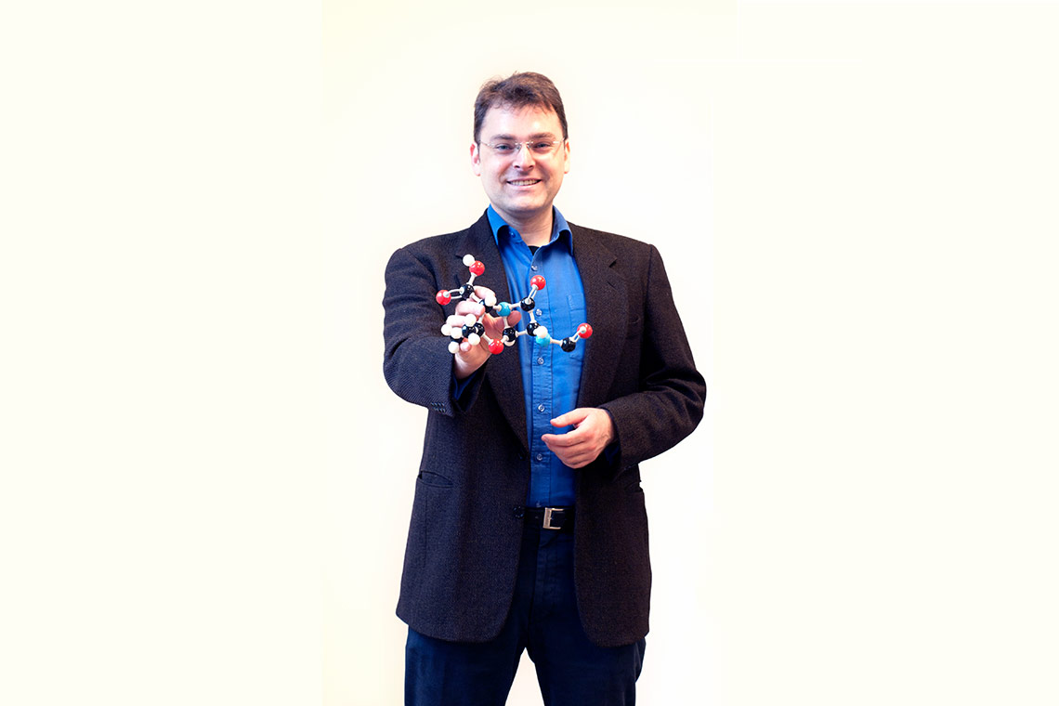






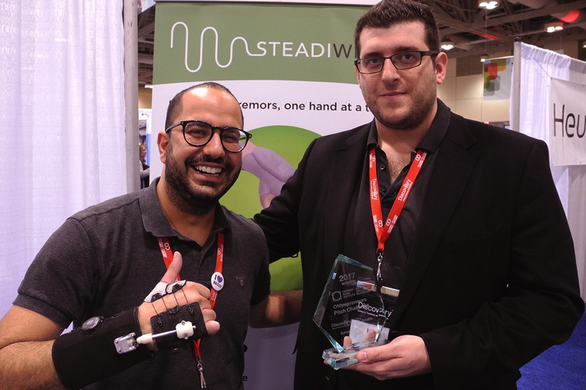
Techno – nurturing Entrepreneurship

Slide 5

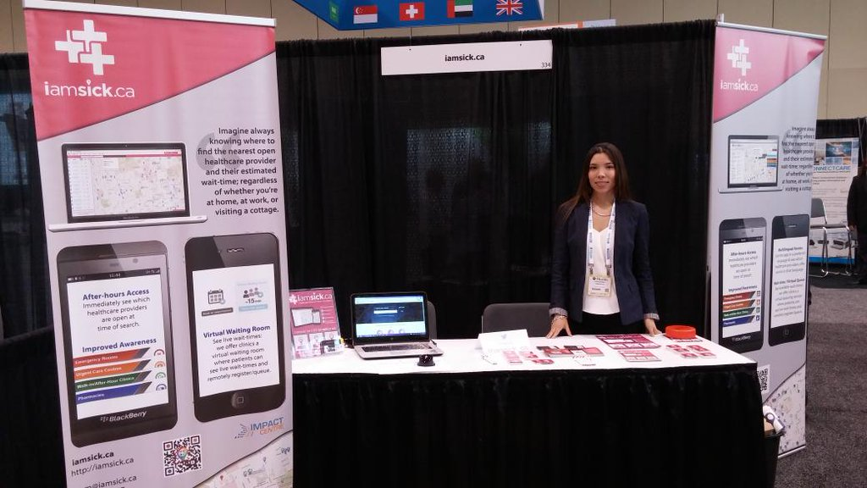

Entrepreneurial - WIL
“Exploring New Ventures” course:
100/200 placement hours with startups
Bi-weekly workshops on entrepreneurship topics

Slide 6
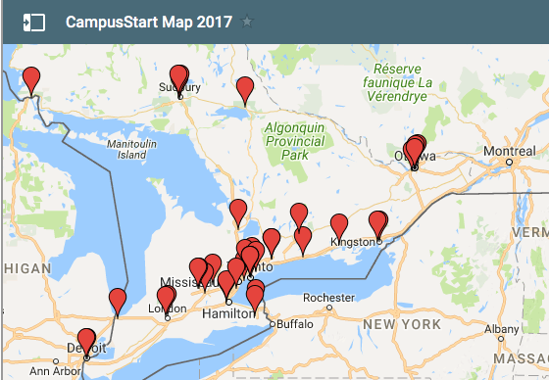
Entrepreneurship programs in Ontario
2013 Budget - $25 million over 2 years
2015 Budget - $27 million over 2 years

Slide 7
The State of Entrepreneurship Education
“majority of extracurricular programs …
evaluate … through
informal mechanisms
and emphasize
participant satisfaction…”
Sá, C., Kretz, A., Sigurdson, K. (2014). The State of Entrepreneurship Education in Ontario’s Colleges and Universities. Toronto: Higher Education Quality Council of Ontario.

Slide 8

Call for Quality Assurance Measures

Slide 9
Learning outcomes for E-WIL
Critical thinking
Creative thinking
Written communication
Oral communication
Information literacy
Teamwork
Problem solving

Slide 10

Project objective
To develop, validate, and implement a critical thinking skills measurement tool for students in entrepreneurial work-integrated learning (E-WIL) programs and activities

Slide 11

Design Principles
Use existing framework
Entrepreneurship context
Easy to incorporate

Slide 12
Design Features
The gold standard - open-ended questions
The most practical– multiple-choice questions

Slide 13
Initial consultation
Framework of Critical Thinking consulted with
  E-WIL program managers/facilitators
  Entrepreneurs (as former E-WIL students)
  Entrepreneurs (as E-WIL supervisors)
  Former E-WIL students

Slide 14
Current Assessment Tool
Scenario based
Evolving sections
Follow up critical questions
Answer + support required

Slide 15

Project Status – Work in Progress
Launching a validation process of the critical thinking assessment tool
Comparing against VALUE rubrics

Slide 16


Slide 17
Framework for Program
Formal/Weekly Programming (10%)
  Weekly Socials
  Academic Courses
Informal Programming (20%)
  1:1 Coaching
  Network Mediation
Experiential Learning (70%)
  Self-Directed work to complete milestones and apply skills
  Over 100 hours over 12 weeks

Slide 18
Problem
Main evaluation of program impact were economic measures
  venture creation, job creation, revenue
Limited evaluation of the learning and personal development

Slide 19
About vs For Entrepreneurship
“Often programmes equate entrepreneurship with new venture creation and educate ‘about’ entrepreneurship and enterprise rather than education “for” entrepreneurship
“Only rarely… is the focus on developing in their students the skills, attributes, and behaviour of the successful entrepreneur”
  Kirby, D. (2004) “Entrepreneurship education: can business schools meet the challenge?”. Education and training, 18(3).

Slide 20
New Definition of Student Success
Students have an understanding of, and experience with the process of launching a venture
Students are able to recognize and demonstrate entrepreneurial behaviours, and apply core skills
Students develop their professional network

Slide 21
Assessment of Outcome 1
1. Students have an understanding of, and experience with the process of launching a venture
  Progress and peer based through level-up presentations

Slide 23
Assessment of Outcome 2
2. Students are able to recognize and demonstrate entrepreneurial behaviours, and apply core skills
  Bi-weekly reporting and monthly reflection/articulation

Slide 24
Skill | Reported Behaviours
Communication | Communicating clearly in written form
 | Communicating clearly in verbal form
 | Actively listening
Leadership | Enabling others to act by promoting cooperative goals and building mutual trust
 | Creating a vision for an uplifting and ennobling future that appeals to people’s values, interests, hopes and dreams
 | Searching out challenging opportunities to change, grow, innovate and improve
Teamwork/ Collaboration | Collaborating with others on tasks, projects, and presentations
 | Giving and receiving clear, thoughtful feedback
 | Resolving conflicts in a fair, respectful manner
Problem solving | Identifying and defining problems
 | Identifying multiple approaches for solving a problem that apply within a specific context
 | Testing hypotheses and/or evaluating potential solutions
Critical Thinking | Researching, analyzing, and synthesizing information to form opinions and strategy
 | Analyzing own and/or others' assumptions
 | Making decisions using sound ethical and logical reasoning

Slide 25
Skill | Reported Behaviours
Organization and accountability | Prioritizing tasks when juggling multiple deadlines
 | Managing time in order to complete assigned duties
 | Accepting responsibility for errors or missed deadlines
Technical | Solving problems using technology
 | Completing administrative tasks using software
 | Developing digital literacy
Risk-taking/risk assessment | Experimenting with new ideas and/or committing to an action without knowing every outcome
 | Learning from your experiences and not being afraid to make mistakes
 | Seeking out new information to identify and minimize risk
Implementation and design thinking | Ideating, prototyping, testing, and refining based on feedback
 | Set realistic goals and priorities
 | Plan for contingencies, be ready with alternative strategies
Network and relationship building | Network widely to identify new partners and build relationships
 | Be coachable and establish professional relationships with mentors and advisors
 | Persuading, self-expression, and story telling
Systems thinking and discipline specific knowledge | Improving your understanding of the social system your are working within
 | Systems and/or relationship mapping
 | Solving a problem or generating an idea using knowledge earned through academic study or experience

Slide 28
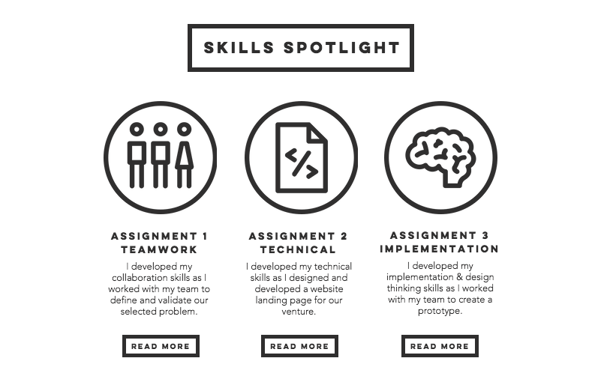

Slide 29
Lessons Learned
Milestone presentations allow for self-directed pace, passive pressure, celebration of incremental progress
Skill reporting allows for coaching of mindsets and behaviours
  Drives program planning week-to-week (personal vs program level data)
  Currently assessing application of skills, not assessing growth/development

Slide 30




Acknowledgements
The team:
A. Eisenstein
E. Veletanlic
J. Li
L. Vranic
Prof. E. Istrate
Prof. A. Rummens
Prof. C. Goh
With collaboration:
- K. Janzen
- Prof. C. Sá
The team:
B. Wylie-Toal
T. Del Matto
A. Filion
With Collaboration:
- EDGE @ Uwaterloo
- Centre for Teaching Excellence

