Slide 1

Under our noses: Existing assessments as critical and creative thinking milestones
Paisley Worthington
John Dawson
University of Guelph
Notes:
30 mins

Slide 2

Do you have an assessment that focuses exclusively on critical and creative thinking?

Slide 3

Explore value in examining the evolution of our expectations in a program
Learn about a tool that characterizes the challenge posed by a problem solving assignment
Consider how this type of analysis can change longitudinal assessment of transferrable skills

Slide 4

Critical and Creative Thinking
Required to thrive in our constantly changing global community (“Employability Skills,” 2018; Gini-Newman & Case, 2015; Puccio, Mance, & Murdock, 2011)
Extremely amorphous skill → hard to define, teach, and measure (“Critical Thinking,” 2018; Martini & Clare, 2014)
Can use skills relying heavily on critical/creative thinking to gauge thinking… like problem solving! (Desmarais, 2012; Frederiksen & Ward, 1978; Mayr, Smuc, & Risku, 2010; Pithers & Soden, 2010)

Slide 5

Effective programs are scaffolded

Slide 6
How scaffolded are our programs?

Slide 7
Characterizing the Problem Solving Profile
E-mail study team for more info!

Slide 12
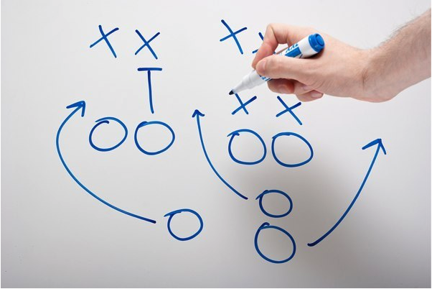
How can this data change our approach to LOA?

Slide 13
How can this data change our approach to LOA?
Provides consistent check in points for critical/creative thinking
Shows diversity of problem solving assignments (beyond content)
Helps us understand how courses work together in a program

Slide 14
Explore value in examining the evolution of our expectations in a program
Learn about a tool that characterizes the challenge posed by a problem solving assignment
Consider how this type of analysis can change longitudinal assessment of transferrable skills

Slide 15
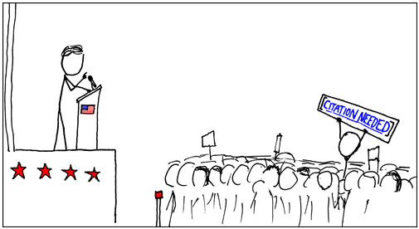
References
Critical Thinking. (2018). Retrieved January 23, 2018, from https://www.utc.edu/walker-center-teaching-learning/teaching-resources/ct-ps.php
Desmarais, S. (2012). University of Guelph Learning Outcomes. Retrieved March 18, 2016, from http://www.uoguelph.ca/vpacademic/avpa/outcomes/pdfs/Undergraduate Learning Outcomes.pdf
Employability Skills. (2018). Retrieved March 27, 2018, from http://www.conferenceboard.ca/(X(1)S(hezwd3s304dsx3yusglxz4cm))/spse/employability-skills.aspx?AspxAutoDetectCookieSupport=1
Frederiksen, N., & Ward, W. C. (1978). Measures for the study of creativity in scientific problem-solving. Applied Psychological Measurement (Vol. 2).
Gini-Newman, G., & Case, R. (2015). Creating thinking classrooms. Vancouver, British Colombia: The Critical Thinking Consortium.
Jonassen, D. H. (2000). Toward a Design Theory of Problem Solving. Educational Technology Research and Development, 48(4), 63–86.
Martini, T. S., & Clare, M. (2014). Undergraduates’ Understanding of Skill- Based Learning Outcomes: Can e-Portfolios Help?, 1–44.
Mayr, E., Smuc, M., & Risku, H. (2010). Many roads lead to Rome. Proceedings of the 3rd BELIV’10 Workshop on BEyond Time and Errors: Novel EvaLuation Methods for Information Visualization - BELIV ’10, 8–15. http://doi.org/10.1145/2110192.2110194
Pithers, R. T., & Soden, R. (2010). Critical thinking in education : a review. Educational Research, 42(3), 237–249. http://doi.org/10.1080/001318800440579
Puccio, G., Mance, M., & Murdock, M. (2011). Creative Leadership: skills that drive change. (L. Shaw, M. Vail, E. Garner, & P. Schroeder, Eds.) (2nd ed.). Los Angeles: SAGE Publications, Inc.
Images:
Title slide: https://www.clarizen.com/when-to-use-milestones-in-your-project-plan/
Slide 2: https://www.uuworld.org/articles/passion-reason
Slide 3: https://www.riskgroupllc.com/the-outcome-economy-unleashing-the-potential-of-internet-of-things/
Slide 4: https://www.unomaha.edu/college-of-arts-and-sciences/master-of-arts-in-critical-and-creative-thinking/index.php
Slide 5: https://www.teachermagazine.com.au/articles/effective-implementation-of-project-based-learning
Slides 12 and 13: https://timemanagementninja.com/2013/01/losing-9-ways-to-change-your-game/
This slide: https://xkcd.com/285/

Slide 16

Thank you!

Slide 17
Overlay with student performance data…

