Slide 1
Mapping Life-long Learning:
A Deep Dive into a Graduate Attribute
Patti Dyjur, PhD
Kim Grant, PhD
University of Calgary
Notes:
Notes

Slide 2
Agenda
Definition of life-long learning
Mapping life-long learning in an Engineering program
Discussion

Slide 3
Graduate Attributes - Engineering
Knowledge base for engineering
Problem analysis
Investigation
Design
Use of engineering tools
Individual and team work
Communication skills
Professionalism
Impact of engineering on society and the environment
Ethics and equity
Economics and project management
Life-long learning
(Engineers Canada, 2017)

Slide 4
Life-long Learning
How might you go about teaching life-long learning?
And how in the world do you assess something that hasn’t even happened yet?

Slide 5
Definition of Life-long Learning
An ability to identify and to address their own educational needs in a changing world in ways sufficient to maintain their competence and to allow them to contribute to the advancement of knowledge.
(Engineers Canada, 2017)

Slide 6
Breaking Down the Definition
An ability to identify and to address their own educational needs in a changing world in ways sufficient to maintain their competence and to allow them to contribute to the advancement of knowledge.
Self-directed learning¹
Maintain competence
Reflection²
Metacognition²
1: Brennan, Eggermont, Rosehart, Deacon, Larson & O’Neill, 2014; Patterson, Labun & Eikenaar, 2016)
2: Borgford-Parnell, 2006

Slide 7
Characteristics of Life-long Learning | Working Definitions
Self-directed Learning | Identify and address one’s own educational needs¹
Maintain Competence | Maintain professional competence by learning about new ideas and developments in the field
Reflection | The ability to put thought or conscious attention to experiences, actions and thoughts, with the goal of interpreting or analyzing them so to learn from them²
Metacognition | The thought process about one's own learning, specifically to plan, monitor and assess one's understanding²
1: Brennan, Eggermont, Rosehart, Deacon, Larson & O’Neill, 2014; Patterson, Labun & Eikenaar, 2016)
2: Borgford-Parnell, 2006

Slide 8
Step 1: Workshop
Definition and characteristics of life-long learning
Examples of how each characteristic might be implemented in courses
Small group brainstorming and discussion to generate more examples specific to Geomatics Engineering

Slide 9
Step 2: Curriculum Mapping
Proposed process to identify what is currently being done in the program
Articulate which characteristics are being strengthened and at what point in the program
Identify which of the activities are graded

Slide 10
Mapping Life-long Learning

Slide 11
Decisions/ Assumptions for this Example
Map course outcomes to program-level learning outcomes (PLOs)
  This example is simplified and only course outcomes that align with characteristics of life-long learning are included
Map activities/ assignments to course outcomes (to help with accreditation)
Indicate whether activities and assignments are graded or not
Only required courses are included as we do not know what options students will take
  Again, the example is simplified for this presentation

Slide 12
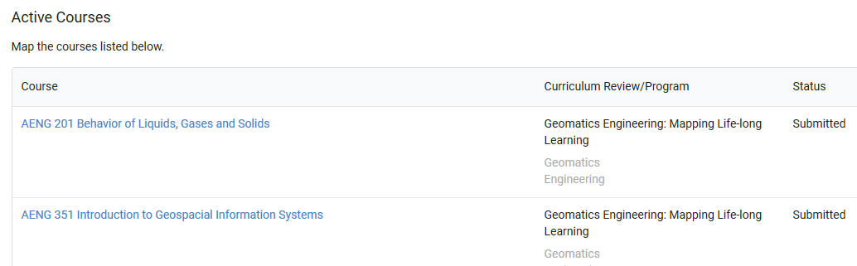
Curriculum Links – Used to Map Courses
Notes:
https://www.curriculum-links.com
Finish mapping AENG 435 – Remote Sensing

Slide 13
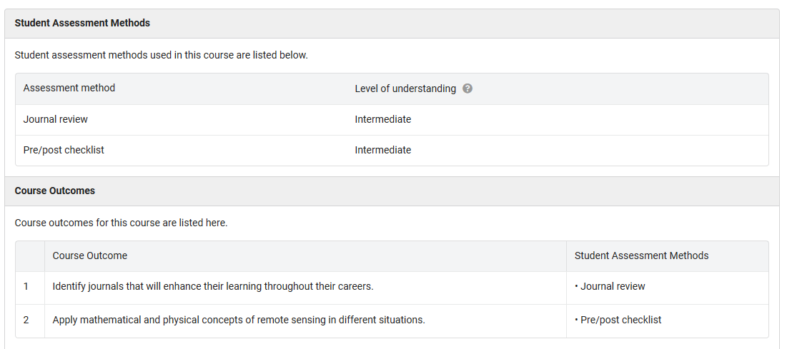
ENG 435 – Remote Sensing Course Report
Notes:
The course report includes the assignments/ assessments that I have identified for the course
It also includes the course outcomes I have indicated as well as assignments/ assessments that align with each one.

Slide 14
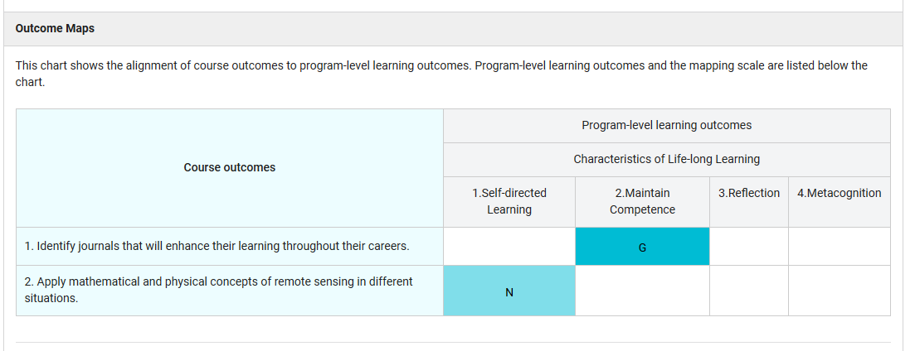
Notes:
The next section of the course report shows how each course outcome relates to characteristics of life-long learning.
The scale we have used is Non-graded and Graded, which highlights how many graded assessments the course has relating to life-long learning.

Slide 15
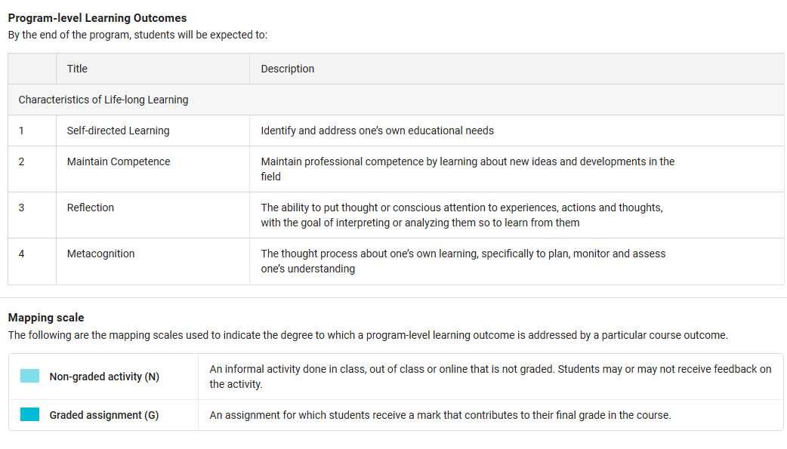
Notes:
Information at the end of the report shows:
List of PLOs
Mapping scale used to map assignments/ assessments to PLOs

Slide 16
Program Report
What can we tell about Life-long Learning by examining aggregate data for required courses in the program?

Slide 17
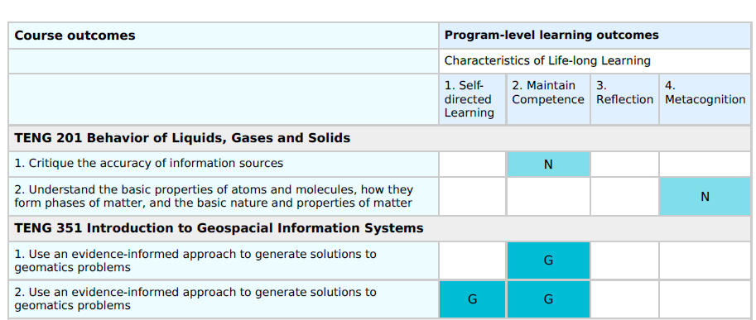
Program Report – Geomatics Engineering
Notes:
On this slide and the next we have the full detailed alignment charts where we can see where each course outcome for required courses aligns with the four characteristics of life-long learning.
A quick glance shows that we are emphasizing some aspects more than others. Ask the group which
Let’s look at the summary chart for a different perspective.

Slide 18
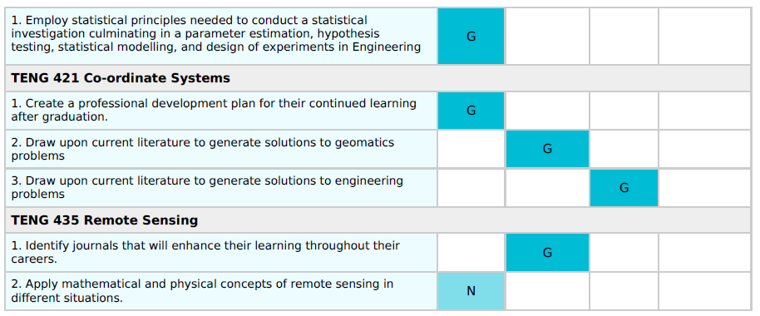

Slide 19
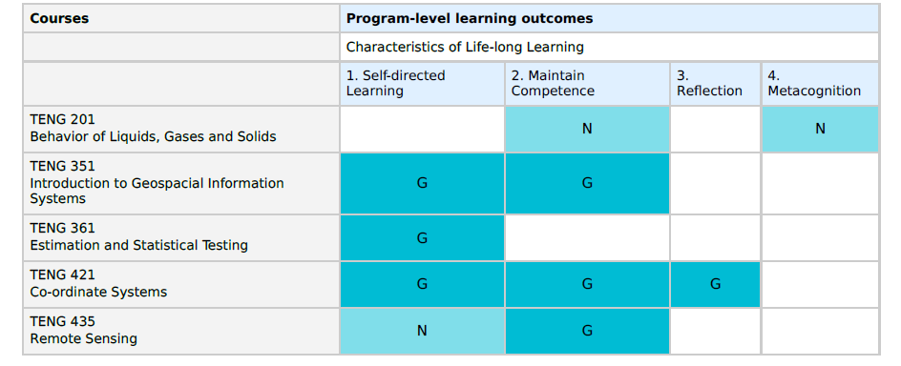
Course Contributions to Characteristics of Life-long Learning
Notes:
Ask the participants for their observations about this chart. Possibilities:
Each of the four characteristics is touched upon in at least one required course
However not all of them are graded. Metacognition has just one activity and it is not graded. This is a discussion point: do we want a graded item here? Or to emphasize it more?
Two are emphasized a lot more than the other two. Does this matter?

Slide 20
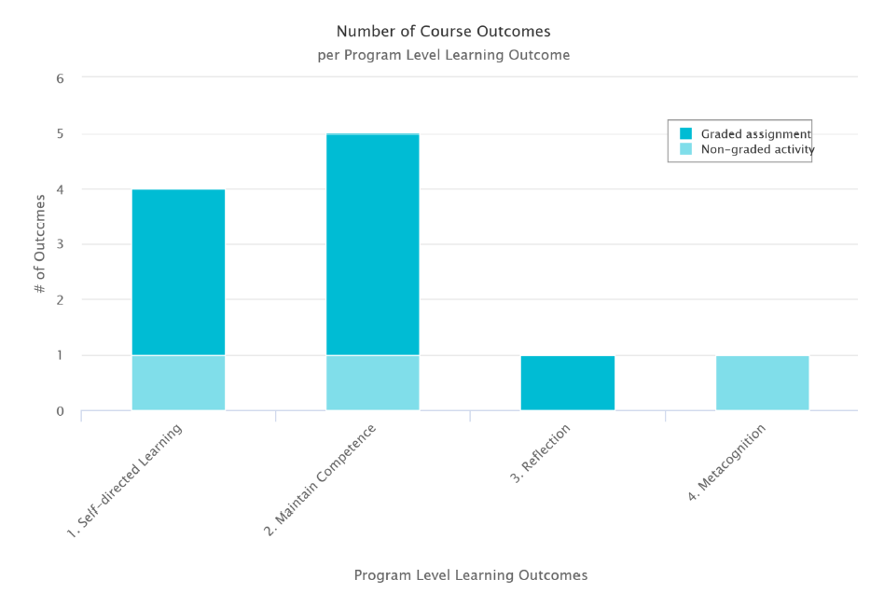
Notes:
The next chart shows a frequency count of the number of course outcomes that address each aspect of life-long learning.
It is helpful in that it shows what the collective contributions of the courses are, rather than showing what individual contributions each course makes. This can be an effective starting point for discussion in that it can remove individual blame, focusing on the program as a whole.

Slide 21
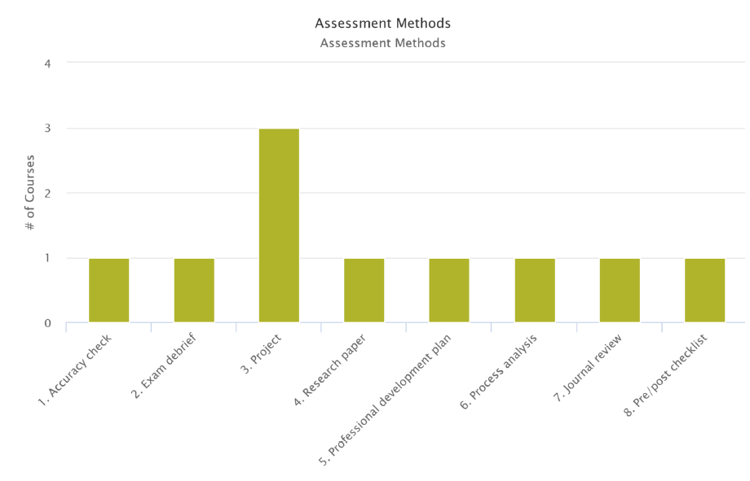
Notes:
The last chart shows the assessment methods that are used to evaluate characteristics of life-long learning. Here we have both graded and non-graded activities lumped together. If we set up the mapping process differently we could distinguish between the two. However for this example we have chosen to include both as we want to make sure we capture informal activities that contribute to student learning.

Slide 22
Small Group Discussion Questions
Given the data presented here, what changes could be made to enhance life-long learning in required courses across the program?
What are some advantages of presenting curriculum mapping data in these ways?
What questions do you still have regarding how life-long learning is addressed and assessed in this program? How could you find out?

Slide 23
Impressions
What are your impressions of using an approach such as this to investigate concepts such as life-long learning?
Are there any competencies/ characteristics/ initiatives that you would like to address in curriculum mapping? How might you approach the task?

Slide 24
Strategies/ Ideas to Map Other Concepts
Use terms and categories from accrediting or governing bodies
Read the literature to find out what is important about the concept
Talk to instructors
Pilot the mapping tool to see if any considerations or ideas are missing
Others? What other suggestions do you have for mapping beyond learning outcomes?

Slide 25
Comments/ Questions
Thank you for participating
in our session!

Slide 26
References
Borgford-Parnell, J. (2006). Teaching and assessing life-long learning. Center for Engineering Learning and Teaching, University of Washington. Retrieved from: http://depts.washington.edu/celtweb/wordpress/wp-content/uploads/2014/12/Assessing-Lifelong-Learning.pdf
Brennan, R. W., Eggermont, M., Rosehart, W., Deacon, A. K., Larson, N., & O’Neill, T. A. (2014). Assessing life-long learning in a first-year design and communication course. Proceedings of the Canadian Engineering Education Association (CEEA), 2014. doi: 10.24908/pceea.v0i0.5855.
Engineers Canada. (2017). Canadian Engineering Accreditation Board 2017 Accreditation Criteria and Procedures. Retrieved from https://engineerscanada.ca/sites/default/files/accreditation-criteria-procedures-2017.pdf
Patterson, L., Labun, C., & Eikenaar, J. (2016). Teaching and assessing “lifelong learning” in engineering communication courses. Proceedings of the Canadian Engineering Education Association (CEEA), 2016. Dalhousie University, June 19-22, 2016.

