Slide 1

International Assessment of Generic Skills
Doris Zahner
Kelly Rotholz
October 12, 2018 |Toronto, Canada

Slide 2
Overview & Introduction

Slide 3
Overview
The focus on Generic Skills
Predictive Validity
CLA+ International Example Use Cases
Research & Development

Slide 4

Why Focus on Generic Skills?
Generic skills:
critical thinking
problem solving
qualitative and quantitative reasoning
written communication
are judged by employers, professors, and thought leaders to be very important in today’s knowledge economy.

Slide 5
Specifically
National leaders want to know how well their universities are preparing their students
Faculty and administrators want to know how to improve their teaching and learning
Students want credible, third-party evidence (certificates) of their skill levels obtained when they graduate to show potential employers
Employers want credible evidence of the skill levels job applicants have not only grades students’ received in college
Context: Over 100 million college students world wide today. Up to 500 million projected by 2030.

Slide 6
Critical Policy Issues
CLA+ International attempts to evaluate and solve the following kinds of problems:
The inability of employers to identify high ability students who attend less selective universities
The national level measurement of generic skills in tracking economic productivity growth
The rising costs, access deficits, disruptive changes such as student loan debt, and the decline of permanent faculty affects the quality of student learning

Slide 7
Post-UNIVERSITY outcomes Study 1 Zahner & James, 2016

Slide 8
Post-University Outcomes, Study 1
University seniors – CLA+ in spring 2014
Surveyed 3, 6, and 12 months following graduation
Approximately 13,000+ students
1,585 agreed to participate in the survey
993 persisted through all three phases

Slide 9
Post-University Outcomes, Study 1
Predictive Validity of CLA+ and Other Variables on Post-University Outcomes
 |  | Post-university outcomes (all) | Salary | Employ | Full-time employ | Grad school
CLA+ and | EAA |  | * |  | *
 | Barron’s |  |  |  | *
 | Field of study |  | * |  | *
 | Gender |  | *
 | Parent education
 | Race/Ethnicity | * | * | * | * | *

Slide 10
Post-University Outcomes, Study 1

Slide 11
Post-University Outcomes, Study 1
CLA+ is predictive of post-university outcomes such as employment and salary.
Use of CLA+ scores can address some of the challenges employers and recent graduates face by highlighting these critical skills.
Assessments like the CLA+ serve as both an effective instrument for identifying high-achieving students from less and non-competitive institutions and making their skills more visible to perspective employees.

Slide 12
Post-UNIVERSITY outcomes Study 2 Zahner & Lehrfeld, 2017

Slide 13
Post-University Outcomes, Study 2
University seniors – took CLA+ in spring 2014
Fall 2015 – Surveyed 75 employers of original cohort of students

Slide 14
Post-University Outcomes, Study 2
On a scale from 1 – 5,
How important are the following skills to successful performance in the participant’s position:
Analysis and Problem Solving
Writing Effectiveness
Writing Mechanics
How would you rate the participant on the following skills:
Overall, where does the participant’s performance rank compared to other recent university graduates in your workplace?

Slide 15
Post-University Outcomes, Study 2

Slide 16
Post-University Outcomes, Study 2
Ordinal logistic regression models for predicting participants’ post-university performance as measured by their managers
 |  | APS | WE | WM | Relative Rank
CLA+ |  | * | * | * | *
 | t-statistic | 17.55** | 26.00* | 23.80** | 16.56**

Slide 17
Post-University Outcomes, Study 2
Employers find critical thinking and written communication skills to be important or very important for entry-level positions in the workforce.
Students with higher CLA+ plus scores tended to have higher ratings from their employers
Findings from this study offer support for the conclusion that critical-thinking and written-communication skills are important in predicting career placement and workplace success (Arum & Roksa, 2014).

Slide 18
CLA+ International

Slide 19
CLA+ International
90 minute assessment of generic skills based on the Collegiate Learning Assessment which requires the student to demonstrate their generic thinking abilities.
It features:
Performance Task (a real world problem) that is document based and requires an open ended response (60 minutes)
25 selected response questions (30 minutes)

Slide 20
The CLA+ International Protocol
Measures six sub scores
PT:
Analysis and Problem Solving (APS)
Writing Effectiveness (WE)
Writing Mechanics (WM)
SRQ
Critical Reading and Evaluation (CRE)
Critique an Argument (CA)
Scientific and Quantitative Reasoning (SRQ)

Slide 21
Important Milestones and Activities
Online test platform will be refitted and translated into one language per country/association
Translation of all test materials and scoring rubrics
Administrative instructions and guides provided to member teams
Cognitive labs performed with CAE oversight
Exemplary best practices, communications materials, training and logistics guidance provided
Student recruitment with CAE support
Test administration using secure online testing platform
Program-wide in-person training of Lead Scorers by CAE
Scoring by member scorers using CAE’s secure online scoring platform
CAE review and analysis of data followed by preparation of member reports
Individual student reports and secure badges/certicates prepared and distributed by CAE and/or member

Slide 22
Translation and Adaptation Overview
Translatability overview
Double translation and adaptation
Member team review
Focused verification
Cognitive labs

Slide 23
Example use cases for CLA+ international

Slide 24


Institutions, consortia, and ministries use
CLA+ International to:
Estimate institutional and individual student learning gains in critical-thinking and written communication
Research the efficacy of general education programs and curriculum changes
Demonstrate individual, class, and institutional proficiency

Slide 25

ANVUR TECO Testing
Legal mandate to evaluate learning outcomes
Translated and adapted CLA+ to Italian in 2013 and 2015
Assessed over 11,000 exiting students across 23 universities
Zahner, D., & Ciolfi, A. (2018). International Comparison of a Performance-Based Assessment in Higher Education. In O. Troitschanskaia (Ed.), Assessment of Learning Outcomes in higher education – Cross-national comparisons and perspectives. (pp. 215-244). New York, NY: Springer.

Slide 26





England
HEFCE funded pilot project to measure Learning Gains in universities across England
Birmingham City University is leading a consortium of 4 partners (Coventry University, Liverpool John Moores University, Staffordshire University)
University of Reading is participating independently, but collaborating with the BCU consortium
Adapted testing platform and test items to British English
Longitudinal and Cross-sectional testing model

Slide 27

Universidad de Guadalajara
Translation and Adaptation of CLA+ to Spanish
Assessment of learning outcomes for over 6,000 students across 55 bachelors degree programs
Longitudinal and Cross-sectional
Control Group (completed both EGEL and CLA+)
Notes:
University of Guadalajara has applied the Examen General de Egreso de la Licenciatura (EGEL for its acronym in Spanish) since 1995. This examination is elaborated and administered by the National Center for the Evaluation of Higher Education (CENEVAL for its acronym in Spanish). The objective of the EGEL is to measure the learning outcomes of undergraduate students. However, our institution currently has 55 bachelor's degree programs that do not have an EGEL exam related to their discipline, mainly because they are innovative multidisciplinary programs.

Slide 28

Akita International University
Cross-sectional testing model
Cohort 1: Incoming students during orientation
Cohort 2: Exiting students approaching degree completion
Notes:
Akita International University is a young university in Japan. They have been participating in CLA+ for 5 years. They use a traditional cross-sectional testing model, testing entering and exiting students. They are interested in their institutional value-added scores and mastery levels.

Slide 29

18 Universities in Finland
Universities, applied sciences, art, and defense
Cross-sectional testing model
Spring 2019

Slide 30
Future research

Slide 31
Future Research & Development
CLA+ Deconstructed
Predictive validity
Efficacy of programs
Construct equivalence across countries
Educational policy impact (e.g., skills gap, leveling the playing field)

Slide 32
SkillMetric
60 minute assessment of generic skills based on the CLA+
It features:
Performance Task (a real world problem) that is document based and requires students to demonstrate their analysis and problem solving skills (30 minutes)
25 selected response questions (30 minutes)

Slide 33
SkillMetric
Measures Analytic Reasoning and Evaluation and Problem Solving with an optional writing section
PT:
Analysis and Problem Solving (APS)
SRQ
Critical Reading and Evaluation (CRE)
Critique an Argument (CA)
Scientific and Quantitative Reasoning (SRQ)

Slide 34
SkillMetric
Completed:
Assessment development
Scoring key
Pilot testing
Scoring
Item and data analysis
Scaling and equating
Standard setting study

Slide 35
SkillMetric
To be completed:
Equivalency (to CLA+) study
Marketing and Branding
Website

Slide 36
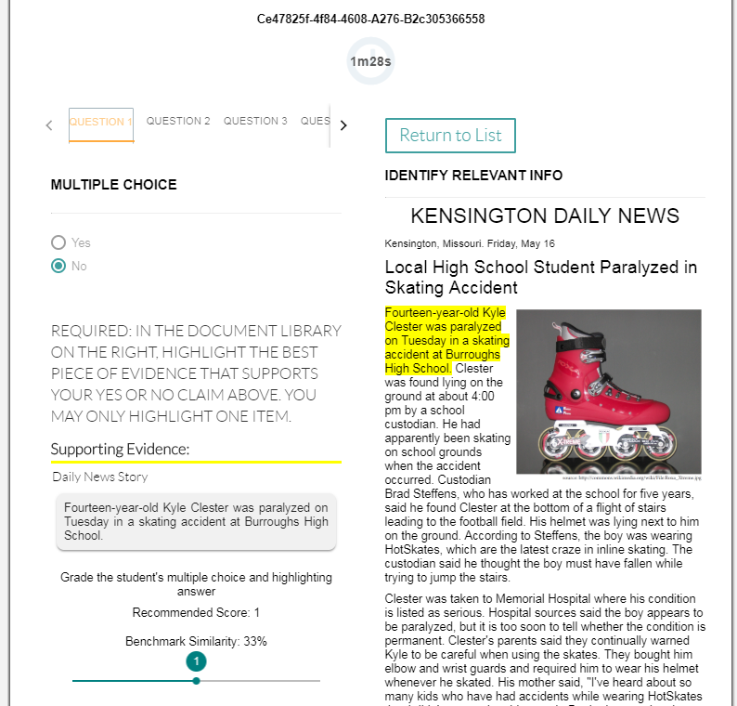

Slide 37
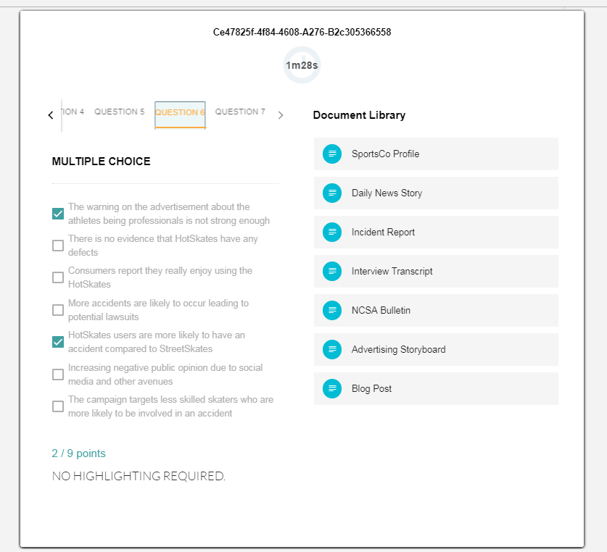

Slide 38
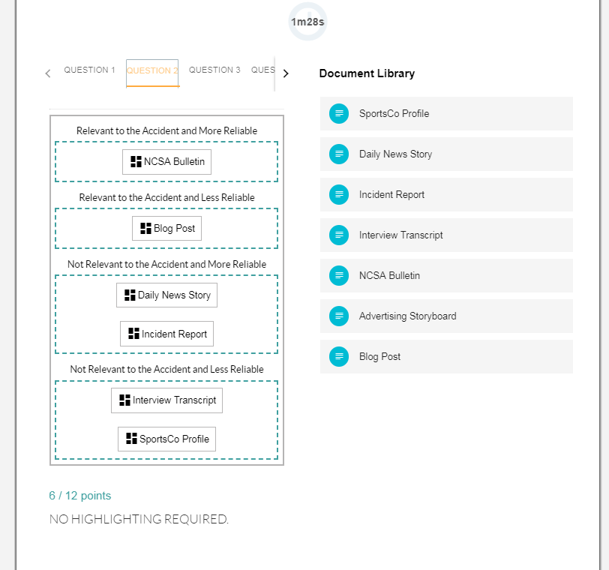

Slide 39
Questions & Comments

