Slide 1

Widening Career Pathways for Arts and Social Sciences Graduate: Advanced Digital and Professional Training (ADaPT)
Wendy Cukier, MA,MBA, PhD, DU (hon) LLD (hon) M.S.C.
Founder & Academic Director, TRSM Diversity Institute
Professor, Entrepreneurship & Strategy, Ryerson University
wcukier@ryerson.ca
Educating for the Future: Learning Outcomes and Experiential Learning Symposium, 2018

Slide 2
AGENDA
What is innovation?
Skills Gap
Case Study: ADaPT Program
Lessons Learned

Slide 3


WHAT IS INNOVATION?
Doing differently
New products and services
New initiatives or organizations
New processes
“Creativity is thinking up new things.
Innovation is doing new things.” -Theodore Levitt

Slide 4










Disruptive and Exponential Technologies
AI and Machine Learning
Robotics
Internet of Things (IOT)
Virtual and Augmented Reality
Digital Twin
Blockchain and Distributed Logistics
Conversational Systems
Mesh Apps and Service Architecture
Digital Technology Platforms
Adaptive Security Architecture

Slide 5

Innovation is not just about creating new technologies
There is no innovation without users and adoption
Canadian consumers lead in mobile but companies lag
40% of Ontario’s SMEs do not have an internet presence
20% of labour force is in the public sector
Arts and Social Sciences are essential

Slide 6

The rise of the “Imagination Age”?
“The hardest activities to automate are those involving complex decision-making, planning, human interaction, imagination, or creative work” - McKinsey Global Institute
“Imagination is more important than knowledge” – Albert Einstein

Slide 7


SKILLS GAP
Surveys of 200 employers (2013)found that 28 % of SMEs and 31 % of large employers face challenges recruiting recent graduates
“Lack of technical skills among graduates” reported by 21% of the employers
Notes:
There is a disconnect between supply and demand.
Survey conducted with 200 Employers in 2013 for the Ontario Human Capital Research and Innovation Fund (OHCRIF)

Slide 8


Gaps in Employer and Graduate Perception
Student Perception
93% believe they are highly proficient in writing, 91% in oral communication
Employer Perception
39.4% believe recent graduates are highly proficient in writing, 47% in oral communication

Slide 9
ge
University Grads: Earnings (2 yrs.)
 | 2005 grad | 2012 grad
Dentistry | $103,750 | $99,839
Veterinary Medicine | $70,714 | $77,001
Law | $75,376 | $73,470
Medicine | $68,333 | $71,123
Computer Science | $56,828 | $66,677
Engineering | $58,939 | $65,265
Nursing | $58,927 | $61,745
Mathematics | $50,814 | $56,776
Business & Commerce | $52,383 | $53,286
Health Professions | $51,410 | $50,320
Therapy & Rehabilitation | $50,313 | $48,334
Other Arts & Science | $49,954 | $46,322
Physical Sciences | $48,860 | $45,107
Education | $47,992 | $43,787
Social Sciences | $43,996 | $42,105
Kinesiology/ Recreation/ Phys Ed. | $42,647 | $39,681
Agriculture & Biology | $42,038 | $39,391
Humanities | $41,550 | $38,399
Journalism | $40,870 | $38,734
Fine & Applied Arts | $36,911 | $34,695
Average | $49,669 | $49,001

Slide 10
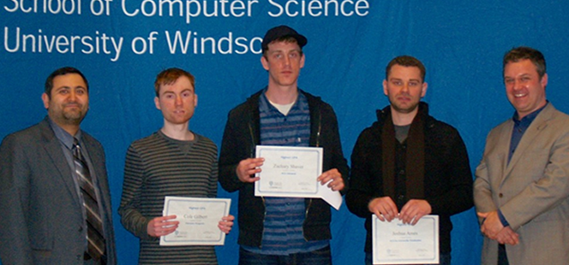


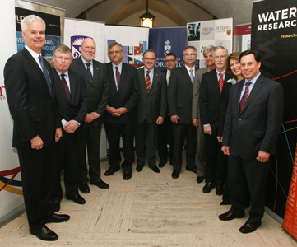

STEM is necessary but insufficient

Slide 11

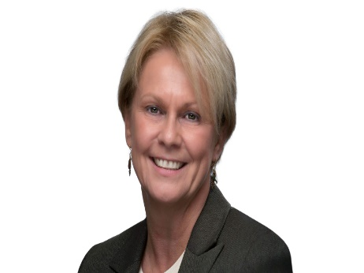
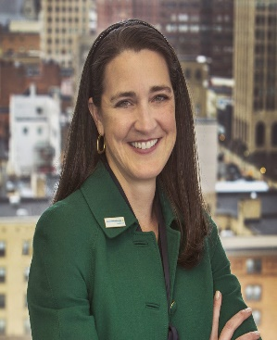
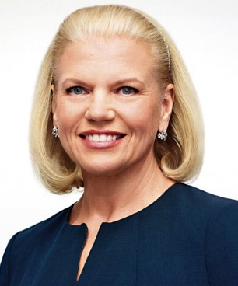


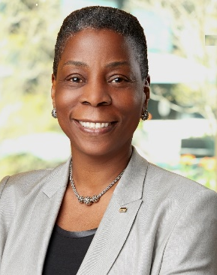
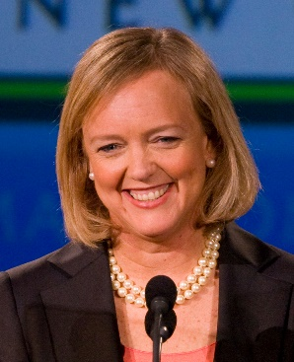
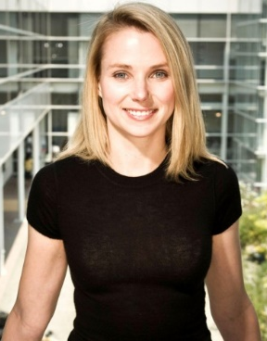
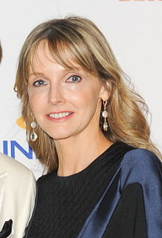

Alternative Narratives and Pathways: only 6 of these CEOs have STEM backgrounds
Notes:
Top Row (Left to Right)
Cheryl Sandberg – COO of Facebook
Vicki Hollub – President and CEO of Occidental Petroleum
Patti Poppe – President and CEO of CMS Energy
Ginni Romety – CEO of IBM
Safra Catz – Co-CEO of Oracle
Bottom Row (Left to Right)
Susan Wojcicki – CEO of YouTube
Ursula Burns – CEO of Xerox
Meg Whitman – Former CEO of HP Enterprise
Marissa Mayer – Former President and CEO of Yahoo!
Kirstine Stewart – CRO TribalScale
Lisa Su – President and CEO of AMD

Slide 12
Déjà Vu?
“Our sustained growth and on-going success in a competitive global marketplace require large numbers of new Canadian graduates in computer science, electrical and computer engineering, physics, and mathematics.”(Roth, 1998)
Access to Opportunities Program (ATOP) spent $150 million over three years into Ontario universities to address these skills.
“Technological skills are not the only need. it [was] assumed that the industry's biggest problem was a lack of programmers [but] the real problem was finding sales and marketing people…."Marketers are harder to find than engineers." (CATA, 2001)

Slide 13
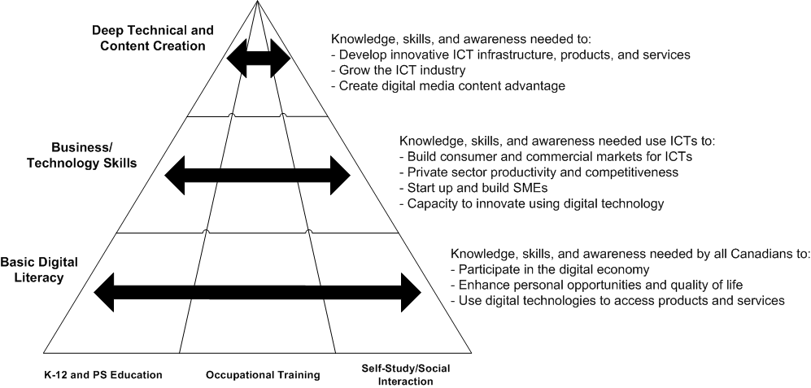
What are Digital Skills?

Slide 14


Skills Gap Paradox: Diverse Groups Face Barriers
Decline of women in CS and little progress in Eng Better represented in “hybrid” programs
Applicants with “foreign sounding” last names are 30% less likely to be called for an interview.
University grads with a severe disability have same employment outcomes as HS drop-outs.
Socio-economic status can also present a big barrier including lack of social capital.
Indigenous youth are fastest growing segment of the population; worst education and work outcomes.
Highly skilled immigrants driving cabs

Slide 15

Diverse Groups face WIL Barriers
WIL improves employment outcomes and earnings for university graduates
Employers use co-op programs to develop workforce skills and to pre-screen potential employees
Preference for STEM amplifies gender differences in employment outcomes and pay equity
Coop can be expensive – extending duration of programs
Many disciplines have challenges with traditional coop
Many faculty members have no experience outside of academia
University structures do not favor flexibility or agility
Unpaid internships may have a negative impact on those belonging to lower socio-economic groups
“Valley of Death” for youth is between graduation and first job

Slide 16
Limited Data on WIL Access / Experiences
63 out of 76 Canadian universities do not track student racial demographics at all
WIL offices also typically do not track either access by diverse groups, or their experiences with discrimination. (Cukier, Campbell, & McNamara, 2018)
Large scale datasets do not capture full scope of WIL programs.
  E.g. National Graduates Survey (2013) only captures information on co-op programs, but not internships/apprenticeships, etc.
Notes:
1. CBC Investigation report. https://www.cbc.ca/news/canada/race-canadian-universities-1.4030537

Slide 17
Experiences in Work Integrated Learning
“…She'd gone to her first interview without the hijab, and went to her second interview with the hijab, and told me that she felt like they weren’t treating her the same, or they weren't really looking her in the eye, making a lot of eye contact... And, you know, it's unfortunate to hear that.” (WIL Office Rep)
“...when I was working in [another department at the same institution] as a career consultant, I have had complaints from my female students about sexism in the interview process... being asked illegal and inappropriate questions with a very prominent employer that we would frequently host on campus...” (WIL Office Rep)
“…she [the student] contacted me to tell me that she had had a few unfavorable interactions with the director of her department where they...had made some comments that were demeaning against women... All of this stuff sounded like it was out of a case study, a textbook; it was kind of unbelievable to hear.” (WIL Office Rep)
Source: Cukier, Campbell & McNamara (2018). Ensuring Equitable Access to Work-Integrated Learning in Ontario. Report funded by Ontario Human Capital Research and Innovation Fund Grant.

Slide 18
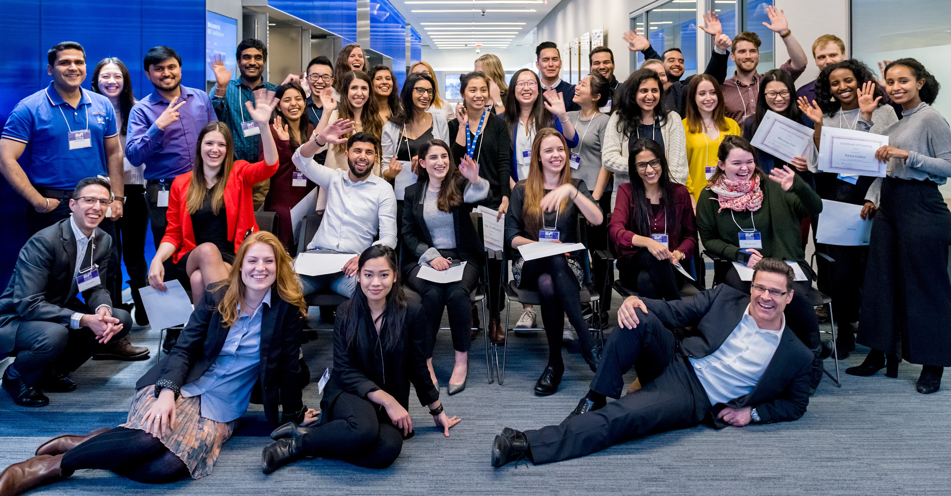



ADVANCED DIGITAL AND PROFESSIONAL TRAINING- ADaPT (2012-2018)
Work-integrated learning to address this skills gap between employer needs and graduate skills by providing intensive training for university graduates or senior students, in collaboration with employers and industry partners, in a paid internship, project or entrepreneurial experience. Harness innovation to advance inclusion.

Slide 19

ADaPT Process:
Evidence Based and Iterative
Employer Needs
Screening & Testing
Iteration
Training
Evaluation
Placement

Slide 20
Skills Development Assessment
Essential Skills
Interpersonal Skills
Oral Communication
Digital Technology
Document Use
Numeracy
Reading
Writing
Ability to Learn/Teach Others
Working in Teams
Negotiation Skills
Leadership
Skills
Critical
Thinking
Decision Making
Problem Solving
Job Task Planning
Finding Information
Significant Use of Memory
Thinking Skills

Slide 21
Technical Skills
MS OFFICE (Excel, Word, Powerpoint)
Website Design & Development
Graphic Design (Adobe Suite)
Digital Communications
Statistical Analysis
Databases
Networking
Interviewing
Self-Awareness
Career Planning
Resume Writing
Cover Letter Writing
Creativity
Entrepreneurship
Financial Literacy
Project Management
Ability to Learn on the Job
Professionalism & Etiquette
Job Search Skills
Other Skills

Slide 22

Core/Bootcamp
ADaPT Streams
Intensive Workshops
500+ participants trained
89.1% satisfaction rate
Customized Training
RBC Partnership

Slide 23













Advanced Digital and Professional Training (ADaPT) Boot Camp
Microsoft
Excel
Adobe
Creative
Suite
Business &
Marketing
Finance
Applied Research
Writing for
an audience
Presentation and Networking skills
Personal
Branding &
Communication
3D Printing
Google
Analytics
Search
Engine
Optimization
Coding
Big Data Analytics

Slide 24

Specialized Training: Data Analytics
One week intensive course in Excel, SQL, Tableau late August 2018
Employer Showcase: 7 employment partners participated
Placements: 7 placed within the first month
Satisfaction Rate: 88%
2 RBC ADaPT co-op students participated
Data for Leaders
Understands data analytics and data science as problem solving techniques and can evaluate the data needs of their team.
Data Analytics
Can use data sets to make critical decisions confidently in Excel, SQL, and Tableau.
Data Science
Can acquire, parse, and model large data sets to build and refine machine learning models that predict patterns.
Communication
Can communicate data-driven insights to technical and non-technical audiences in a way that drives action.

Slide 25
Eg.Pega/Cognizant: 3 Month Pathway to Highly Skilled Job
Collaboration between Cognizant Technology Solutions (hiring partner); Pegasystems (training provider) and ADaPT (outreach & recruitment, logistics, soft skills support, space and infrastructure).
4 week program: Technical training on PEGA platform and soft-skill training in-class. First certification exam end of training.
88 full applications: 16 in cohort
  All were internationally born; most were internationally educated
  more than 66% were female
  5 were Ryerson students or recent grads
  Computer science, engineering and business backgrounds
87% passed the Pega Certification exam on first or second try
75% were placed in Architect or Analyst positions

Slide 26

ADaPT Salesforce Course (in process)
Collaboration between Salesforce (training provider) and ADaPT (management)
5 Week Program: training on how to build apps and administer Salesforce while gaining access to job opportunities, free of cost. First week in-class, following two soft skill workshops, ending with certification exam.
61 Total Applications: 27 selected
  Diversity:: all participants are newcomers
  Degree: 44% Bachelors | 52% Masters | 4% Other
  Institutions: 21 International Universities represented
  Working Experience: 4% 1-3 years | 44% 4-7 years | 52% 8+ years

Slide 27
RESEARCH AND INNOVATION
Testing new models and delivery
Testing new tools for assessment, adaptive learning
Feasibility of replication and scaling across Canada
WIL for upskilling and reskilling diverse job seekers
Specialized just in time training eg. ITAC/WEF tech skills; curated online content
New processes to advance diversity and inclusion
Proposals under review: Future Skills Centre, Women’s Entrepreneurship Knowledge Hub;

Slide 28
ADaPT Core: Placements By The Numbers
Cohort | Season | Trained | Placed
ADaPT 1 | May 2014 | 31 | 31
ADaPT 2 | May 2015 | 28 | 26
ADaPT 3 | Fall 2015 | 25 | 23
ADaPT 4 | Winter 2016 | 46 | 39
ADaPT 5 | May 2016 | 35 | 33
 | Total | 165 | 152
92%
Placement Rate

Slide 29








Placements
      Account Coordinator (Agency)
      Entry Level Customer Service
Branch Managers
      Marketing Coordinator
      Entry Level Finance
      Event planning
      Business Development
Associate
      Assistant Automotive Manager
      Entry Level Marketing
      Finance
      Social Media Coordinator
      Underwriter Assistant
      Marketing Coordinator
      Communications
      Research Assistant
      Project Coordinator

Slide 30
Demographics: Schools/Discipline
20+
Universities represented
Notes:
While the majority of the students trained and placed to date have deliberately come from Social Science, Humanities and Applied Arts disciplines, to meet demand, there have been students from every faculty and more than 20 post-secondary schools.

Slide 31
Results
89% of the youth who completed the training were placed in the workplace
4% of them started their own business
Across more than 20 educational institutions measured showed skills improvement

Slide 32
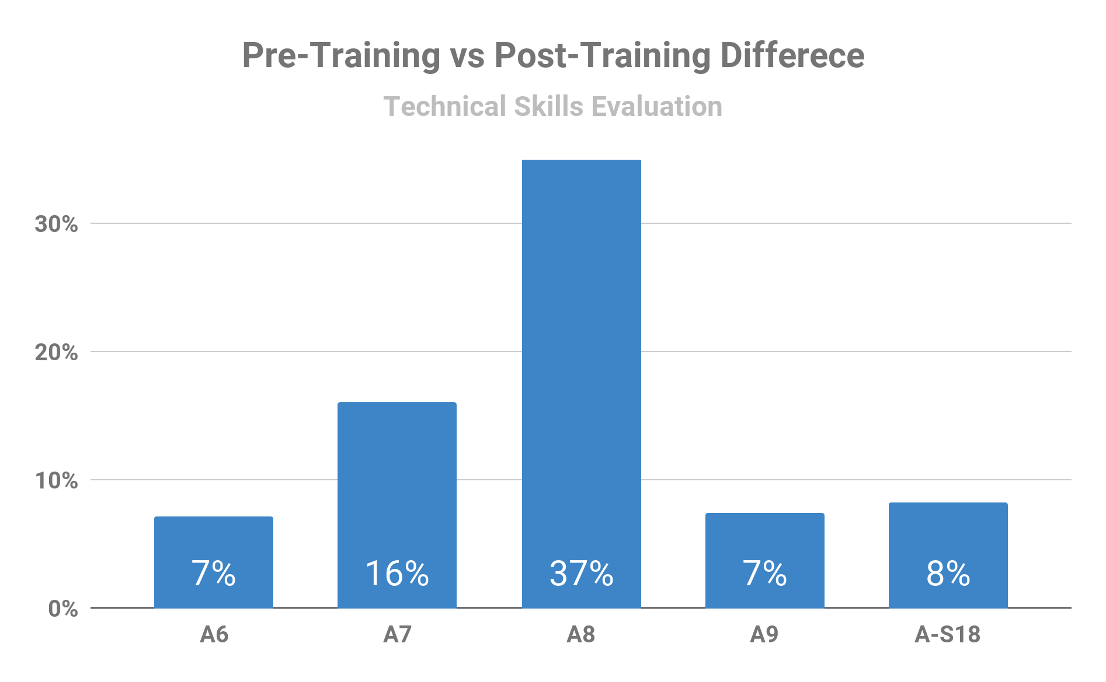
Improvement in Self Reported Skills
15%
Increase
in
Technical Skills

Slide 33
Student Feedback
“I liked all the suggestions. I actually do get nervous with public speaking, and I find examples and pointers like this very helpful.”
“The Excel instructor and Teaching Assistants ensured that everyone is on track and on the same page and I also learned something new from this session (pivot tables) which will be very helpful in the future. Thank you!”

Slide 34
Employer Feedback
  “The ADaPT Program is a great opportunity for our students to gain insight and knowledge into different areas outside their current skill sets. The program helps them bridge the gap between university and work experience to further diversify their capabilities. The skills that students gain enable them to apply their knowledge in everyday practical solutions, which broadens their approach to work at RBC.”
  “[the students] brought an innovative and new perspective to the roles. The program is well organized and students are an asset to our teams.”

Slide 35
RBC Partnership: Results
Five total cohorts delivered to date: Summer 2016, Fall 2016, Winter 2017, Winter 2018, Summer 2018. **Fall 2018 in planning stages.
136 total participants. 66 are working with RBC full time, 25 are working full time elsewhere, 45 have not reached graduation. Of the 91 participants who have reached graduation, 73% joined RBC.
78 participants (57%) are university undergraduates, 32 (24%) are Masters students, 26 (19%) are College students.
61 participants (45%) study business, 43 participants (32%) student engineering/I.T., 13 participants (10%) study science/math, 19 (13%)participants study other subjects.
Top schools by participants:

Slide 36

LESSONS LEARNED
Bridging the skills gap requires new approaches
Speed is the new currency of business
Innovation in PSE: rethink structures, policies and processes to provide more flexibility
We need better, accessible real time LMI
Leverage technology
Assess and evaluate
Learn from successes and failures: Iterate
Pivot. Make it up as you go along

Slide 37
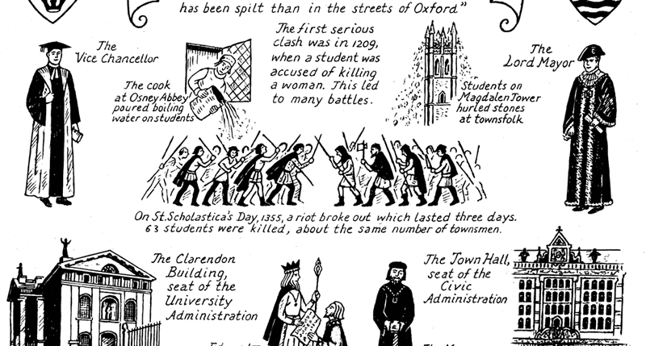
End 500 years of cultural warfare
KNOWLEDGE
VERSUS
THE ECONOMY
“Corporatization of the university”
“Preserve Academic Freedom”
“Liberal Arts are useless”
“Universities are irrelevant”

Slide 38

Developing a Coordinated Ecosystem of Platforms and Partners for Support Future Skills and Inclusive Innovation

Slide 39


















