Slide 1

Sounds good – but is it working?
Assessing the learning outcomes of an Interprofessional Education Clinical Teaching Unit
Dr. Jenn Salfi, RN, PhD
Kerri Podwinski, RN, MN (c)
2018 Educating for the Future: Learning Outcomes and Experiential Learning Symposium

Slide 2

Introducing…
  The Research Team
  The IPE Clinical Teaching Unit (IPE CTU)
  The IPE CTU Pilot Project
2018 Educating for the Future: Learning Outcomes and Experiential Learning Symposium

Slide 3

IPE CTU: Research Team
Brock University
  Dr. Jenn Salfi RN
  Dr. Dawn Prentice RN
  Kerri Podwinski RN, Research Assistant
Niagara College
  Carolyn Triemstra BRLS, Dean, Community and Health Studies
Niagara Health
  Lisa Hildebrand RN, Clinical Manager, 3A (IPE CTU)
  Zeau Ismail OT, Director, Interprofessional Practice, Ethics & Research
McMaster University
  Dr. Amanda Bell MD, Regional Assistant Dean, Medicine
2018 Educating for the Future: Learning Outcomes and Experiential Learning Symposium

Slide 4

IPE CTU: Background
2011: Steering committee formed (10 members)
  Grew to 27 members by September 2013
  Funding; IPE a priority
Niagara Health (former Niagara Health System)
  New St. Catharines Site Hospital, Opened March 2013
  First IPE CTU – 3A
2018: Steering committee revisited (10 members)
  Currently updating resources, planning & evaluating IPE experiences
  No funding; IPE a priority?
2018 Educating for the Future: Learning Outcomes and Experiential Learning Symposium

Slide 5

IPE CTU Objective
Clinical IPE integrated into core training for all involved professional groups:
    Nursing (BScN, PN)
    Medicine (MD, PA)
    Rehabilitative sciences (OT, PT, OTA, PTA)
Providing high quality, safe, ethical, competent client-centered care.
2018 Educating for the Future: Learning Outcomes and Experiential Learning Symposium

Slide 6
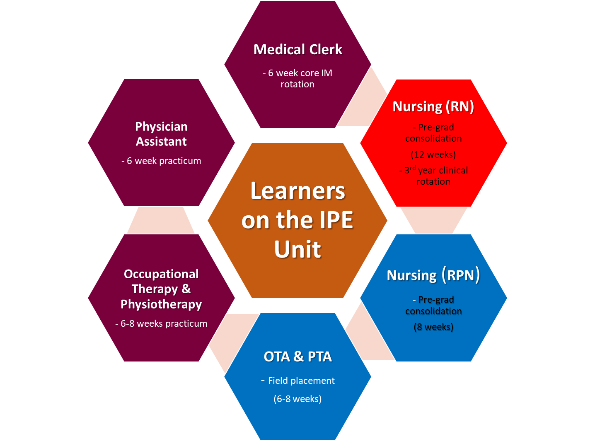
McMaster
Brock
Niagara College
2018 Educating for the Future: Learning Outcomes and Experiential Learning Symposium

Slide 7
Interprofessional Education (IPE)
“Interprofessional education occurs when two or more professions learn with, from and about each other in order to improve collaboration and the quality of care” (CAIPE, 2002).
2018 Educating for the Future: Learning Outcomes and Experiential Learning Symposium
Notes:
Centre for the Advancement of Interprofessional Education, Defining IPE. 2002, www.caipe.org.uk/about-us/defining-ipe

Slide 8
Interprofessional Collaboration (IPC)
“Interprofessional collaboration is the process of developing and maintaining effective interprofessional working relationships with learners, practitioners, patients/clients/families and communities to enable optimal health outcomes.”
“Elements of collaboration include respect, trust, shared decision-making, and partnerships” (CIHC, 2010).
2018 Educating for the Future: Learning Outcomes and Experiential Learning Symposium

Slide 9
Why IPE?
“If health care providers are expected to work together and share expertise in a team environment, it makes sense that their education and training should prepare them for this type of working arrangement.”
(Roy Romanow, 2002)
2018 Educating for the Future: Learning Outcomes and Experiential Learning Symposium

Slide 10
IPE Mandated Worldwide
WHO (2010): IPE is an essential step in preparing a “collaborative practice-ready” workforce
CIHC (2010): IPE...key to building effective health care teams; improving the experience and outcomes of patients
HFO (2010): IPE...builds the foundation upon which key interprofessional care activities can be implemented & sustained
2018 Educating for the Future: Learning Outcomes and Experiential Learning Symposium

Slide 11

National Interprofessional Competency Framework (2010)
  Role Clarity
  Team Functioning
  Conflict Resolution
  Collaborative Leadership
  Communication
  Client/Family/Community Centred Care

Slide 12
Learning Activities: Exposure
  Foundational in nature
  Exposure to other roles & responsibilities (role clarity)
  Awareness & ability to articulate own role in the context of a team
Examples:
  Shadowing/observing another professional
  Role presentations
  Professional interaction cards (PIC); IPComp checklist
2018 Educating for the Future: Learning Outcomes and Experiential Learning Symposium
Notes:
Professional interaction cards (PIC); IPComp checklist – in Student/Mentor Handbook

Slide 13
Learning Activities: Immersion
  Students begin to collaborate with other health professional students/professionals
  Communication, team functioning, client-centered care (shared decision-making, problem solving)
Examples:
  SBAR documentation
  Bullet rounds
  TOSCE (in past)
  Participation in family/team meetings; IP discharge planning; committees
2018 Educating for the Future: Learning Outcomes and Experiential Learning Symposium

Slide 14
IPE CTU: Current Learning Activities
Bullet / Team Rounds
Daily, on the unit; all health professionals present to round on patients
Role Presentations
Various professions discuss their scopes of practice
SBAR Documentation
“Situation, Background, Assessment, Recommendation”; framework for interprofessional communication
Resources – Student & Mentor Handbook
National IP Competency Framework, IP Competency Checklist; Professional Interaction Card (PIC)
2018 Educating for the Future: Learning Outcomes and Experiential Learning Symposium

Slide 15
According to the Research Literature…
  All of these individual IPE activities - evaluated as “effective” IPE strategies
  Proven to improve knowledge of other’s roles & scopes of practice
  Proven to improve knowledge of collaboration in general
  Proven to enhance communication strategies & other team skills
So in theory – the IPE CTU should help develop collaborative behaviours in the various student groups…
2018 Educating for the Future: Learning Outcomes and Experiential Learning Symposium

Slide 16
According to the only Research Literature on the IPE CTU
(collecting staff perceptions) …
Team members respected each other, however …
- More organizational support is required to further develop team skills
-“Not enough time” for team reflection or team processes
(Prentice et al., 2016)
2018 Educating for the Future: Learning Outcomes and Experiential Learning Symposium
Notes:
Study took place in spring 2013 – within the unit’s first year of operating
Cross sectional descriptive study collecting perceptions from IPE CTU staff (n=19)
- Assessment of Interprofessional Team Collaboration Scale (AITCS)(Orchard et al., 2012)

Slide 17
IPE CTU Pilot Project
1) Determine if the IPE CTU has any impact on competencies required for
effective interprofessional collaboration (*matched data, n=24)
  Change in approach to care planning? (pre/post responses to care scenario)
  Change in use of collaborative “language” (knowledge of IP competencies)
  Change in general knowledge re: IPC?
2) Aim to understand what students are learning as a result of their experiences
on the IPE CTU (*all data (n=42) – matched (n=24) + unmatched (n=18))
2018 Educating for the Future: Learning Outcomes and Experiential Learning Symposium
Notes:
Kerry 17- 24

Slide 18
Methodological Approach
Pilot Qualitative, Exploratory Case Study
To explore situations in which the intervention/program being evaluated has no clear, single set of outcomes (Yin, 2003).
Propositions essential
Proposition:
The IPE CTU is helping students develop competencies required for IPC
Rival proposition:
The IPE CTU is not helping students develop competencies required for IPC
2018 Educating for the Future: Learning Outcomes and Experiential Learning Symposium

Slide 19
Case Definition
Learning on the IPE CTU - defined as the case (or unit of analysis)
Bound by place - IPE CTU (3A) at St. Catharines Site Hospital
Bound by time - each student’s clinical rotation in the 2017/18 calendar year
Bound by professional group - RN, MD, RPN, OTA, PA
2018 Educating for the Future: Learning Outcomes and Experiential Learning Symposium
Notes:
Both Yin (2003) and Stake (1995) suggest placing boundaries on a case to prevent “explosion” from occurring, so for this study, the case will be bound by time, place, professional groups

Slide 20
Sampling
Purposive sampling
Inclusion criteria:
  Placement on 3A IPE CTU during the 2017/18 calendar year
  Enrolled in one of the following programs:
    Nursing (BScN, PN)
    Medicine (MD, PA)
    Rehabilitative sciences (OT, PT, OTA, PTA)
2018 Educating for the Future: Learning Outcomes and Experiential Learning Symposium

Slide 21
Data Collection
Pre-Post Questionnaires
  Demographic data
  Open-ended questions
  Client care scenario
Documents
  Individual IPE Activity Feedback forms (had planned to use these as another data source but they were not distributed by Niagara Health this year)
2018 Educating for the Future: Learning Outcomes and Experiential Learning Symposium
Notes:
Online invitation & consent via email
Token of appreciation
Draw to win one $250 gift card per term

Slide 22
Data Analysis & Strategies to Promote Trustworthiness
  Simultaneous data collection & analysis
  Coding/Clustering, Frequency Counts, Identifying Patterns/Themes, Within/Cross-Case Analysis, Peer Triangulation for Finalization of Themes, Pairing of Themes and Quotes (Hsieh & Shannon, 2005)
  Return to propositions (Yin, 2003)
  Credibility: triangulation of data sources, investigator
  Dependability: audit trail
  Transferability: different professional groups
2018 Educating for the Future: Learning Outcomes and Experiential Learning Symposium

Slide 23
Sample
 | All data |  | Matched data |  | Unmatched data
 | Frequency (N = 42) | % | Frequency (N = 24) | % | Frequency (N = 18) | %
Program of study
RPN | 8 | 19.0 | 6 | 25.0 | 2 | 11.1
RN | 16 | 38.1 | 12 | 50.0 | 4 | 22.2
PA | 1 | 2.9 | 1 | 4.2 | 0 | 0
MD | 16 | 38.1 | 4 | 16.7 | 12 | 66.7
OTA/PTA | 1 | 2.4 | 1 | 4.2 | 0 | 0
OT/PT | 0 | 0 | 0 | 0 | 0 | 0
Year of study
1 | 0 | 0 | 0 | 0 | 0 | 0
2 | 18 | 42.9 | 10 | 41.7 | 8 | 44.4
3 | 19 | 45.2 | 13 | 54.2 | 6 | 33.3
≥4 | 5 | 11.9 | 1 | 4.2 | 4 | 22.2
Formal IPE prior to 3A
Yes | 23 | 54.8 | 11 | 45.8 | 12 | 66.7
No | 19 | 45.2 | 13 | 54.2 | 6 | 33.3
2018 Educating for the Future: Learning Outcomes and Experiential Learning Symposium
Notes:
Talking points:
a) Matched & unmatched data
b) No OT/PT students this year (no available preceptors)
c) Only 1 PA; 1 OTA
d) No Level 1 students (which is standard - students should have some knowledge of their own profession before learning about other professions)
e) The majority of students w/o previous “IPE” were RNs from Brock

Slide 24
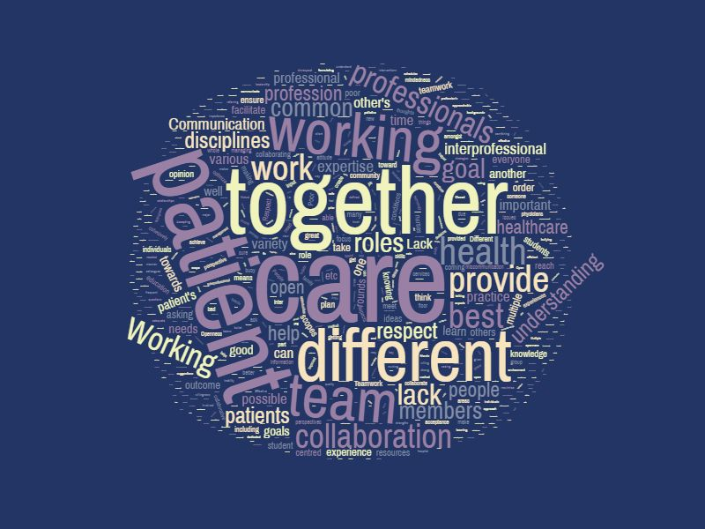
2018 Educating for the Future: Learning Outcomes and Experiential Learning Symposium
Notes:
Post data only
Care as central (best care)
Different word occurrence/frequency from pre: disciplines, being, collaboration, open; Greater freq. of respect, roles, TEAM.
All data (pre and post)
-Care always central in all data (most common word)
66 care
56 patient
50 together
43 professions
42 communication
39 different
33 working
32 team
Pre:
33 care
28 professions
27 together
25 patient
21 communication
21 working
19 different
18 health
Post:
33 care
31 patient
23 together
21 communication
21 team
20 different
15 professions
12 working

Slide 25
Key Findings – Impact? (n=24)
1) Change in Approach to Care Planning? (Uni-professional to Collaborative perspective)
No significant change (20%)(n=5)
2) Change in Collaborative Language? (Identifying with IP National Competencies)
Change (>70%)(n=17)
3) Change in Knowledge re: IPC? (Specifically the 3 critical components of IPC)
1) Working together
2) Multiple professionals
3) To deliver best/most effective/holistic/optimal care
Change (>90%)(n=22)
2018 Educating for the Future: Learning Outcomes and Experiential Learning Symposium
Notes:
1) Majority of students still approaching a client care scenario via a uni-professional approach vs. as a professional within an IP team of varied expertise. {2 RN, 2MD, 1PN}
2) {RN - 12; RPN - 4; MD - 1} - Greatest change in RN group (which makes sense considering this is their first exposure to IPE)
3) Unmatched Data: (primarily Pre-IPE CTU – 75%) Defn of IPC: For some reason, not one student in this group identified all 3 elements in the IPC defn
a) multiple professionals with different skill sets – 2
b) providing optimal patient care – 1; providing adequate care – 1; achieving a common goal - 2
c) working together – 2

Slide 26
Key Findings – Perceptions, Experiences (n=42)
Importance of Communication & Respect
Importance of Dedicated Time/Opportunities
Importance of Mentors & Role Modelling
Professional Stereotypes
2018 Educating for the Future: Learning Outcomes and Experiential Learning Symposium

Slide 27
Key Findings – Importance of Communication & Respect
“An open environment where everyone can contribute ideas without judgement” (facilitator)
“Professional hierarchy can get in the way of an idea or suggestion being considered” (barrier)
“Not having an open-mind to different professional viewpoints”
- RN students
“Acknowledgement of each other’s contributions…scopes of practice and limitations” (facilitator)
“Poor communication styles; nondisclosure of important details” (barrier)
- MD students
“Lack of respect,
acceptance”
- PA student
“Lack of respect”
- OTA student
Notes:
- (1) Communication – cited the most as a facilitator and as a barrier
- (2) Second most frequently cited Facilitator for IPC – Appreciation/Respect for other’s roles/knowledge/skills
(2) Second most frequently cited Barrier to IPC - Lack of respect/appreciation for others’ knowledge/skills; (ego; close-minded)
*Largest bubble – largest amt of comments from RNs

Slide 28
Key Findings – Importance of Dedicated Time & Opportunities
“being physically on the ward…daily”
“dedicated time for collaboration (ie. interdisciplinary rounds)”
“morning bullet rounds” (facilitators)
“too busy to work with other disciplines” (barrier)
- MD students
“no time”
- RN, RPN
Notes:
(3) Third most cited Facilitator: Dedicated time & opportunities to learn and work together
6/7 MD; 1 RPN (Barrier & Facilitator)

Slide 29
Key Findings – Importance of Mentors & Role Modelling
“Lack of desire to teach/preceptor students”
(Barrier to IPC)
“Enthusiasm to teach students”
(Facilitates IPC) -RN student
“As a student, I believe we care about IPC the most, yet, are excluded from IP endeavours the most”
-RN student
”Collaboration that exists on the IPE floor is useful for students of all professions
to observe and take part in”
- RN student
Notes:
All nurses (RNs)

Slide 30
Key Findings – Stereotypes:
Hanging onto Historical? Or Hidden Curriculum?
“Intimidation”
“Ego”
“Power differentials” “Bullying”
“Devaluation of the importance of healthcare being a team effort”
“One sided perspective”
- RN students
“Hierarchy of professions – medical professions – potentially seeing their work as more important than their IP colleagues”
“Elitist attitude … Previous experiences working with others in that profession, and then generalizing that to the whole profession”
“Patriarchy” “Trying to dominate the group process”
- MD students
“Lack of professional understanding & courtesy”
- PA student
“Collaboration with members of the team results in a synergistic effect where we’re able to do more for a patient,
although in my opinion it seems less efficient.”
- MD student
Notes:
(3) Third most cited Barrier: Lack of Role Clarity; Misconceptions, Bias/”stereotypes” about Professions
Hanging onto Historical (perspectives)? Or Hidden Curriculum (affecting current perspectives)?
Historical Stereotypes:
Physician & Nursing professions:
Majority of MD students appeared to be “aware” of historical stereotypes … which has been a cited benefit of IPE and the importance of IP Collaboration.
Is there a shift in MD/RN relations?
But then there was a comment by one MD student ….
(Hidden curriculum?)
As for the RN comments: Are these perceptions based on current experiences or historical perspectives on the MD profession? (Historical Or Hidden Curriculum?)
Although all the comments were similar in terms of perspective …
And the PA: Since the profession came to Canada, there has been some confusion re: this role, and the overlap with medicine and nursing –
Hanging onto Historical? Or Hidden Curriculum?

Slide 31
One Final Finding:
“Remember that it is all about the patient”
Notes:
All nurses – RN and RPN students.
The majority of the comments that spoke about patients –
“patient-centred care”; “keeping patient’s concerns at the focus of care” … were from the nursing students.
So that was a bit interesting … since all professions should be viewing the “patient” as central to all care.

Slide 32
So is the IPE CTU Working?
There is some evidence that the IPE CTU might have had an impact on …
student knowledge of the IP National Competencies (aeb increased use of collaborative language/specific terms)
student knowledge re: IPC (in general) (aeb increased ability to identify all 3 critical components of IPC)
2018 Educating for the Future: Learning Outcomes and Experiential Learning Symposium
Notes:
So is the IPE CTU Working? Are students learning to become more collaborative professionals?

Slide 33
So is the IPE CTU Working?
There is some evidence that the IPE CTU might have enhanced awareness of …
the importance of communication & respect for others’ roles as a facilitator for effective collaboration
professional stereotypes – that have existed in past, and how they may pose as a barrier to effective interprofessional collaboration
2018 Educating for the Future: Learning Outcomes and Experiential Learning Symposium
Notes:
So I would say that the IPE CTU was somewhat successful in that it did allow for the dedicated time and IP opportunities to observe and engage in IPC that the students identified as a facilitator for interprofessional learning and practice.

Slide 34
So is the IPE CTU Working?
There is not enough evidence that the …
IPE CTU has had a positive impact on students’ attitudes & approach to care (students still approaching “care” from a uni-professional (siloed) perspective)
IPE CTU has had a positive impact on confronting misconceptions & stereotypes, and rivalry between professionals (++responses indicating this as a barrier to IPC)
2018 Educating for the Future: Learning Outcomes and Experiential Learning Symposium
Notes:
*** attitudes/behaviours take time to develop. This IPE experience (on its own) is perhaps not enough to change uni-professional behaviours.

Slide 35
This evaluation was still helpful …
  in that it reminds us to be realistic in our expectations with this type of experiential learning experience - where there are so many “other” contextual factors to consider
  in that it informs next steps in improving this very unique learning experience for students (and professionals)
2018 Educating for the Future: Learning Outcomes and Experiential Learning Symposium
Notes:
Although it was hoped that the IPE CTU would have had more of a positive impact on students’ collaborative behaviours, especially considering this unit was planned & designed with that in mind, I still think that this evaluation has been helpful in that it :
-reminds us to be realistic in our expectations with this type of experiential learning experience - where there are so many “other” contextual factors to consider – different schools, different professional programs with different curriculums and different priorities; the everchanging hospital environment and complex culture; historical professional perspectives and hidden curriculum; and a decreasing level of interest/investment in IPE (no longer a “hot” topic in healthcare & therefore no more funding).

Slide 36
Going Forward …
  we need to continue to set aside dedicated time for IP opportunities with other students/professionals, so that they can observe & engage in collaborative practices;
  set aside time for ongoing staff development sessions - as these are the students’ role models/mentors;
  begin to/continue to - incorporate a variety of mandatory, well-executed, relevant IPE experiences, scaffolded across all levels of all programs – to complement the learning in this clinical experience
2018 Educating for the Future: Learning Outcomes and Experiential Learning Symposium
Notes:
**** the students identified these items (in red) as facilitators for interprofessional learning and practice
Kerri 36-38

Slide 37
And finally …
  we need to continue to assess the learning outcomes of the IPE CTU to ensure that we are maximizing this learning experience for our students & preparing them for effective interprofessional collaborative practice.
2018 Educating for the Future: Learning Outcomes and Experiential Learning Symposium
Notes:
***this is the conference theme (assessing learning outcomes) ….

Slide 38
Thank You …
  Questions ???
2018 Educating for the Future: Learning Outcomes and Experiential Learning Symposium

