Slide 1
Assessing Critical Competencies in Higher Education: The HEIghten® Approach
Lydia Liu, PhD
Senior Research Director
Educational Testing Service, U.S.
Educating for the Future: learning outcomes and experiential learning symposium
Toronto, 2018

Slide 2
The U.S. Economic Recovery: Trajectory by Degree Level
Source: Georgetown University Center on Education and the Workforce, America’s Divided Recovery: College Haves and Have-Nots, 2016
Data source: Georgetown University Center on Education and the Workforce analysis of Current Population Survey (CPS) data, 1989-2016.
Note: Employment includes all workers age 18 and older. The monthly employment numbers are seasonally adjusted using the U.S. Census Bureau X-12 procedure and smoothed using a four-month moving average.
Notes:
Figure I. Workers with a Bachelor’s degree have added 8.4 million jobs in the recovery, but workers with a high school diploma or less added only 80,000 jobs after losing 5.6 million jobs in the recession.

Slide 3
College Degree a Necessity, but College Education a Luxury

Slide 4
Skills Gap
National Association of Colleges and Employers (2018). Job Outlook Survey.

Slide 5
Hart Research Associates. (2018). Fulfilling the American Dream: Liberal Education and the Future of Work.

Slide 6
Why Assessing Learning Outcomes
Accountability
Internal improvement
Workforce readiness
Value proposition (Parthenon, 2016)

Slide 7

International Trends in Assessing Competencies in Higher Education
HEQCO
Learning Outcomes Assessment Consortium
Learning Gain-United Kingdom
KoKoHs-Germany
CALOHEE-European Commission
Measuring College Learning -SSRC
Large Research Centers-China

Slide 8
The ETS HEIghten Assessments
Research Synthesis
Input from HEIs and organizations
Core
Competencies
Leverage existing R&D capabilities
Critical thinking
Written communication
Quantitative literacy
Civic competency and engagement
Intercultural competency and diversity
Qualitative and quantitative market research
Copyright © 2016 by Educational Testing Service. All rights reserved. ETS, the ETS logo and MEASURING THE POWER OF LEARNING are registered trademarks of Educational Testing Service (ETS).

Slide 9
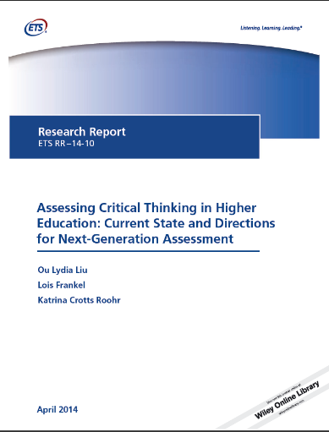
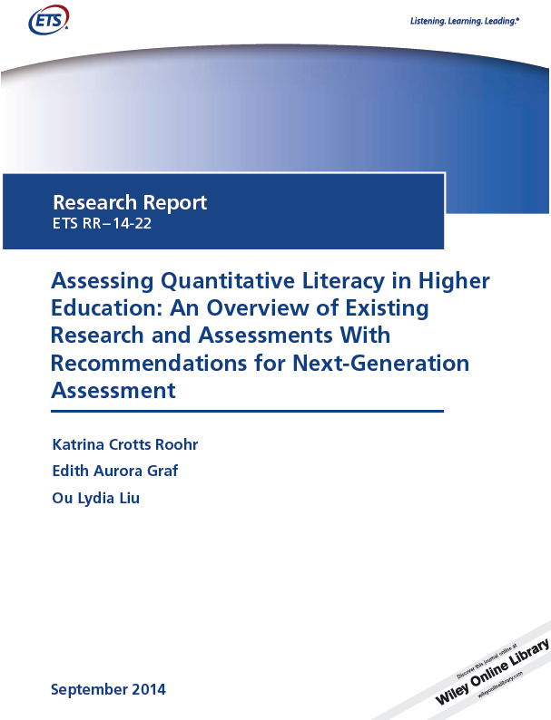
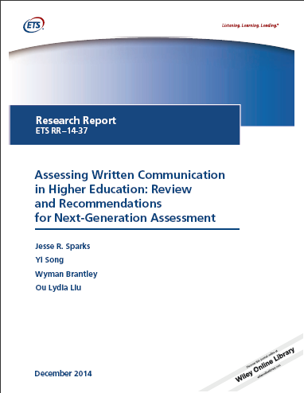
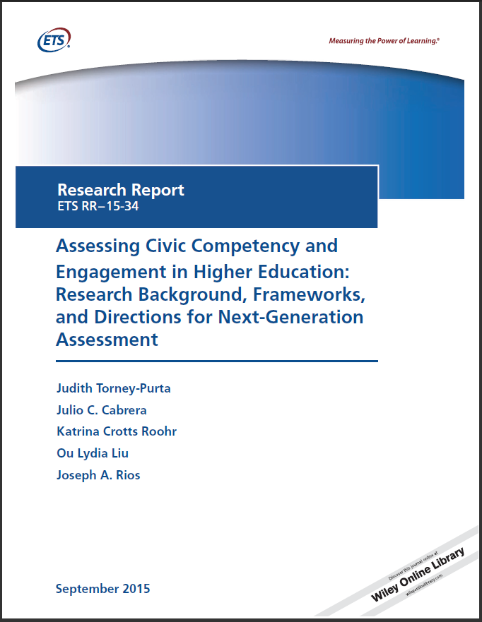
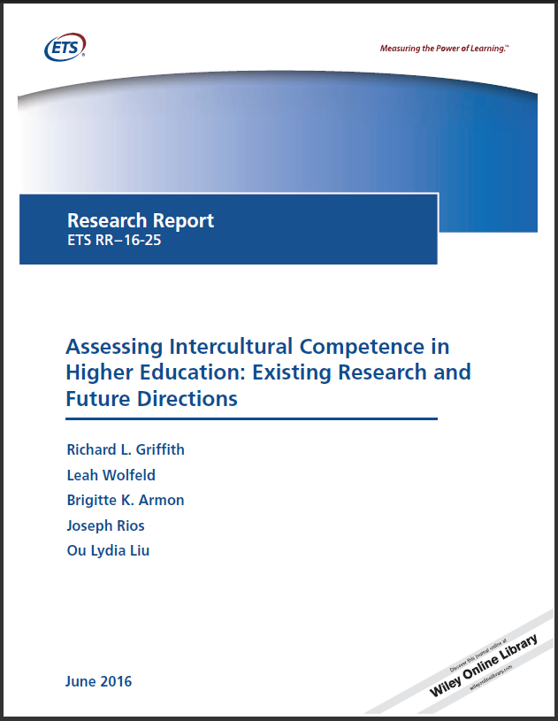
A Research-Driven Approach to Assessment Design
Review of influential frameworks
Review of existing assessments
Operational definition
Assessment considerations
Copyright © 2016 by Educational Testing Service. All rights reserved. ETS, the ETS logo and MEASURING THE POWER OF LEARNING are registered trademarks of Educational Testing Service (ETS). 34728

Slide 10
Framework | Author | Critical Thinking (or equivalent) Definition
Assessment & Teaching of 21st Century Skills (ATC21S) | Collaboration among Cisco, Intel, and Microsoft | Reason effectively, use systems thinking and evaluate evidence: understand systems and strategies for tackling unfamiliar problems; understand the importance of evidence in belief formation; reevaluate beliefs when presented with conflicting evidence (Binkley et al., 2009)
Degree Qualifications Profile (DQP) | The Lumina Foundation | Analytic Inquiry – identifies, categorizes and distinguishes among ideas, concepts, theories and practical approaches to problems; differentiates and evaluates theories and approaches to complex standard and non-standard problems within his/her major field; disaggregates, adapts, reformulates and employs in an essay or project principal ideas, techniques or methods at the forefront of the field (Adelman, Ewell, Gaston, & Scheinder, 2011)
The Employment and Training Administration (ETA) Industry Competency Model Clearinghouse | U.S. Department of Labor (USDOL) | One who possesses sufficient inductive and deductive reasoning ability to perform job successfully; critically reviews, analyzes, synthesizes, compares and interprets information; draws conclusions from relevant and/or missing; understands the principles underlying the relationship among facts and applies the information in understanding when solving problems (USDOL, 2013)
European Higher Education Area Competencies (Bologna Framework) | European Commission: European Higher Education Area | Critical analysis, evaluation and synthesis of new and complex ideas (EACEA, 2012)
Framework for Higher Education Qualifications (QAA-FHEQ) | Quality Assurance Agency for Higher Education | Ability to evaluate the appropriateness of different approaches to solving problems related to area(s) of study and/or work; use a range of techniques to initiate and undertake critical analysis of information, and to propose solutions to problems arising from that analysis; critically evaluate arguments, assumptions, abstract concepts and data (that may be incomplete), to make judgments, and to frame appropriate questions to achieve a solution – or identify a range of solutions – to a problem (QAA, 2008)
Framework for Learning and Development Outcomes (CAS Standards) | The Council for the Advancement of Standards in Education | Identifies important problems, questions, and issues; analyzes, interprets, and makes judgments of the relevance and quality of information; assesses assumptions and considers alternative perspectives and solutions (CAS Board of Directors, 2008)
Liberal Education and America’s Promise (LEAP) | Association of American Colleges and Universities | A habit of mind (思维的方式）characterized by the comprehensive exploration of issues, ideas, artifacts, and events before accepting or formulating an opinion or conclusion (Rhodes, 2010)

Slide 11
Operational Definition—Critical Thinking
Analytical Dimensions
Evaluate evidence and its use Evaluate the evidence itself, including its larger context, its relevance to the argument, appropriateness of sources, and possibilities of bias.
Analyze and evaluate arguments Understand/assess the structure of the argument, independent of the evidence offered. Identify stated and unstated premises, conclusions, intermediate steps. Understand the language of argumentation, recognizing linguistic cues. Distinguish valid from invalid arguments, including recognizing structural flaws that may be present in an invalid argument, e.g., “holes” in reasoning.
Synthetic Dimensions
Understand implications and consequences Identify unstated conclusions or implications and consequences that go beyond the original argument.
Develop sound and valid arguments Students should be able not only to understand and evaluate arguments made by others, but to develop their own arguments which are valid (based on good reasoning) and sound (valid and based on good evidence).
Causation / Explanation
Generate or Evaluate causal claims / Generate or Evaluate explanations Applicable to and works with all of the analytical and synthetic dimensions: it can involve considerations of evidence, implications, argument structure, as well as either evaluation or argument production.
Copyright © 2016 by Educational Testing Service. All rights reserved. ETS, the ETS logo and MEASURING THE POWER OF LEARNING are registered trademarks of Educational Testing Service (ETS).

Slide 12
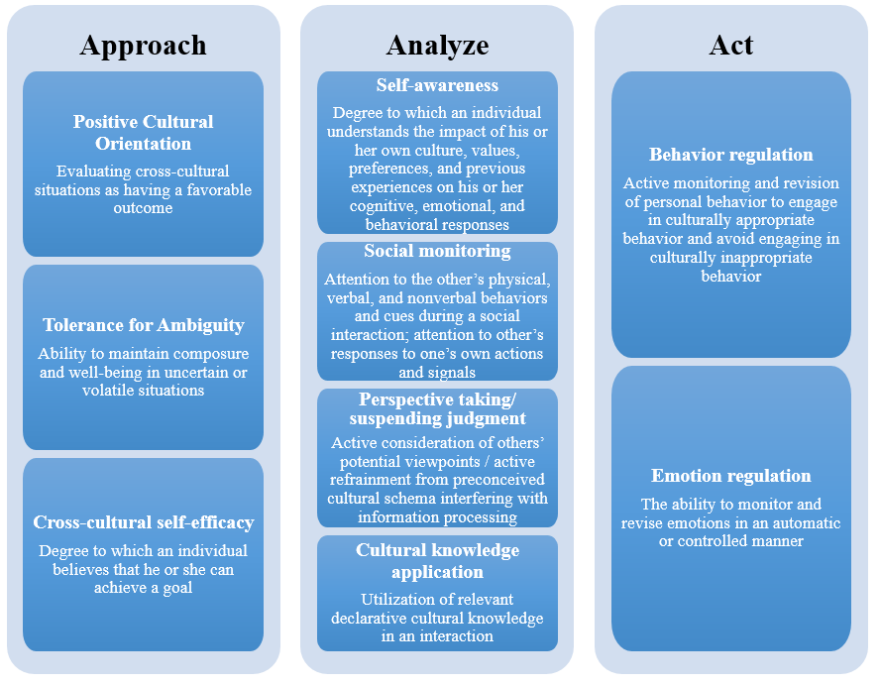
HEIghten Intercultural Competency
Notes:
Given the internationalization of higher ed and workforce.

Slide 13
Notes:
Four of the five HEIghten papers made to the top 7. 70 Research reports.

Slide 14
HEIghten Test Development
A variety of item types
Contextualized in higher ed, workforce, and everyday life settings
Iterative item development process
prototype tests
pilot tests
field tests
Score reports
Total score and subscale scores
Proficiency levels
Others
No more than 45 mins
Modular
Online
Notes:
让学生做的时候感到真实性； 采取了很高的工业标准；
Maximize the number of subscores allowed by psychometric standards

Slide 15







International Partnerships
China
Canada
Russia
HEIghten Critical Thinking
India
Colombia
Ireland
South Korea

Slide 16

Translation and Adaptation
Double translation and reconciliation
Review
Verification

Slide 17
Translation and Adaptation
Localization
Linguistically correct
Psychologically appropriate
Culturally authentic
Comparability
Construct equivalence
Content equivalence
TD-1 (4): Ensure that the translation and adaptation processes consider linguistic, psychological, and cultural differences in the intended populations through the choice of experts with relevant expertise. (ITC, 2017)
Copyright © 2016 by Educational Testing Service. All rights reserved. ETS, the ETS logo and MEASURING THE POWER OF LEARNING are registered trademarks of Educational Testing Service (ETS).

Slide 18


An Example
English Version
Three individuals contributed $800 each toward the purchase of a computer that costs $1,950.
Chinese Version
一台电脑价格为 19,500 元，三人共同出资购买，每人出 8000 元。
Copyright © 2016 by Educational Testing Service. All rights reserved. ETS, the ETS logo and MEASURING THE POWER OF LEARNING are registered trademarks of Educational Testing Service (ETS).

Slide 19
Validation
Carefully designed framework
Items mapped to construct
Test Content
Response Process
Internal Structure
Relation to other variables
Consequ-ences of testing
Validity
Intended and unintended consequences
New use cases
Cognitive interviews
Student survey
Response time
Delivery mode
Motivation
Relation to GPA, SAT, self-evaluation, similar measures, relevant experience, etc.
Item analysis
Dimensionality analysis
Reliability
International scale
Copyright © 2016 by Educational Testing Service. All rights reserved. ETS, the ETS logo and MEASURING THE POWER OF LEARNING are registered trademarks of Educational Testing Service (ETS). 34728

Slide 20
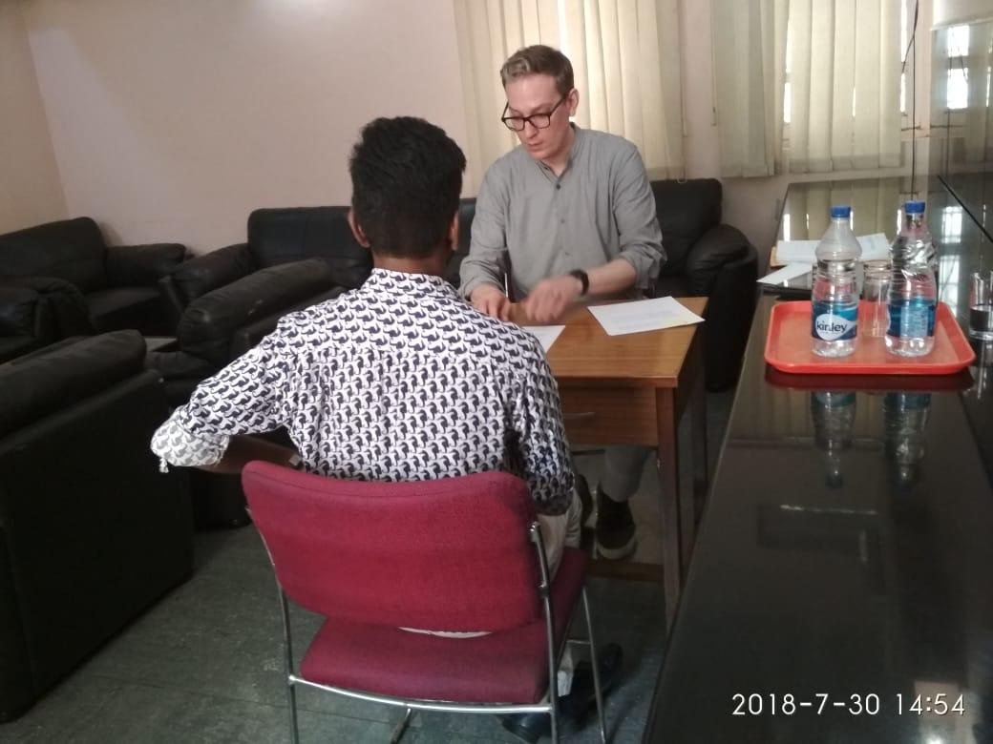
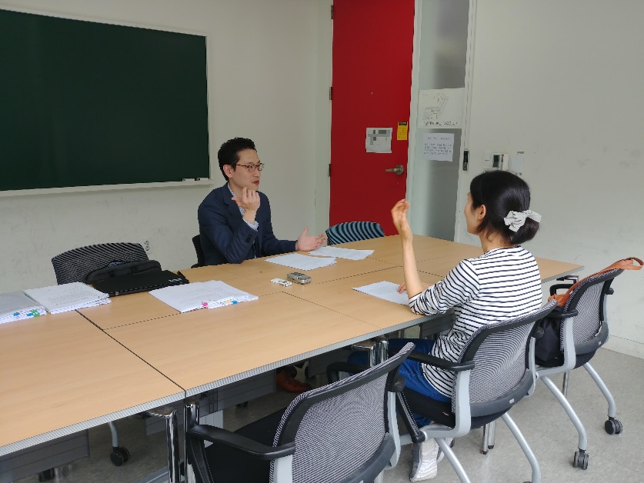
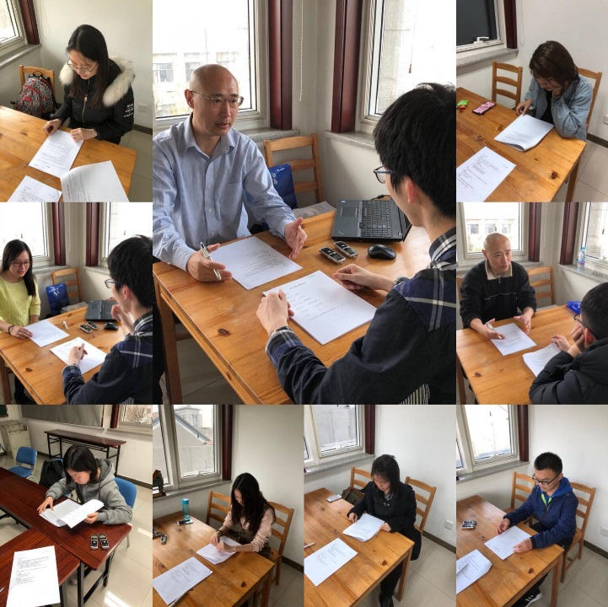
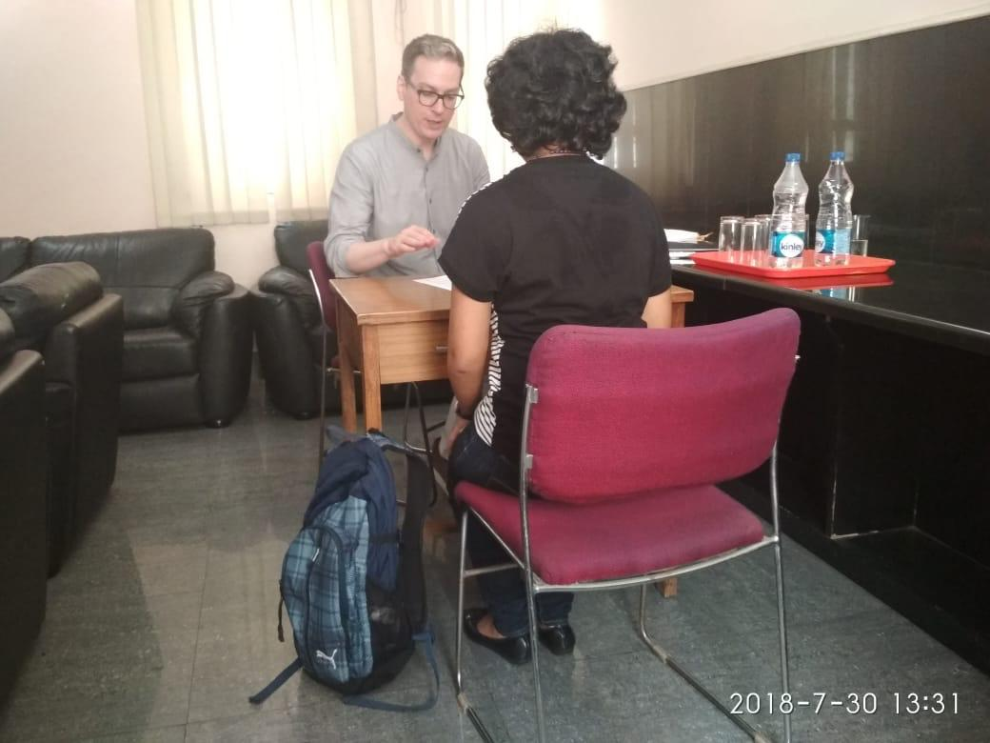
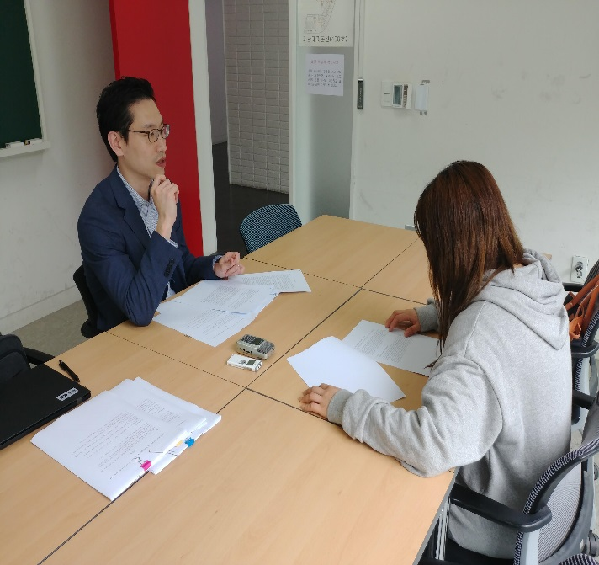

Slide 21
Impact of Motivation on Assessment Performance
Testing stakes do impact students’ test-taking motivation
Students tend to be less motivated on lower stakes tests (Barry, Horst, Finney, Brown, & Kopp 2010; Sundre & Wise, 2003; Liu, Bridgeman, & Adler, 2012; Wise & DeMars, 2005, 2010; Wise & Kong, 2005)
There is a positive relationship between motivation and performance
More motivated students tend to do better (Braun, Kirsch, & Yamamoto 2011; Duckworth, Quinn, Lynam, Loeber, & Stouthamer-Loeber, 2011; Kim & McLean 1995; Liu et al. 2012)
There are ways to boost students’ motivation through various strategies
Incentives contingent on performance (Braun et al., 2011; Duckworth et al.,2011; Gneezy, List, Livingston, Sadoff, Qin, & Xu, 2017; O’Neil et al., 1995)
Increase the stakes of the assessment results (Liu et al., 2012)
Provide feedback to students (Kong et al., 2006; O’Neil, Sugrue, & Baker, 1995/1996)

Slide 22
Gneezy et al. (2017)
Notes:
NATIONAL BUREAU OF ECONOMIC RESEARCH--Gneezy study created a PISA-like exam of just 25 questions and asked 447 sophomores at two different high schools to take it. Seconds before the test started, they surprised half the students at each school with an envelope of 25 one-dollar bills. The researchers told those students they would take away one dollar for each incorrect or unanswered question.
Scores rose for the American teens who were bribed. The economists estimated that if U.S. students had put this much effort into the real PISA test, they would have scored 22 to 24 points higher in math, moving the U.S. from 36th to 19th in the 2012 international rankings. (The U.S. ranked 39th in 2015.)

Slide 23
Self-Rated Critical Thinking Skills and HEIghten Critical Thinking Scores

Slide 24
Four Elements and One Enabler
Engage faculty and cultivate an assessment culture
Identify and define learning outcomes
Translate the learning outcomes to specific assessment goals
Holistic evaluation of assessment tools
Work with professionals for assessment implementation and interpretation
Liu, O.L. (2017). Ten years after the Spellings commission: From accountability to internal improvement. Educational Measurement: Issues and Practices, 36(2), 34-41.

Slide 25
Future Work
Partnership with local institutions
Understand the context of learning and assessment
Explore and validate new use cases
Design learning materials to help learners
Connect with workforce

Slide 26

Thank you! Lydia Liu lliu@ets.org
Copyright © 2016 by Educational Testing Service. All rights reserved. ETS, the ETS logo and MEASURING THE POWER OF LEARNING are registered trademarks of Educational Testing Service (ETS).

