Slide 1



From Learning Outcomes to Workplace Skills 2018 Educating for the Future: Learning Outcomes and Experiential Learning Symposium The Council of Ontario Universities I October 2018

Slide 2

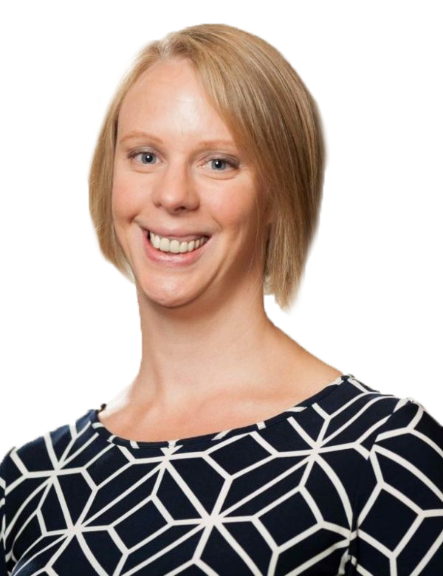
VAL WALKER
Executive Director, Business/ Higher Education Roundtable (BHER) (www.bher.ca)

Slide 3


Slide 4


Slide 5

Every two years, we ask about 100 of Canada’s biggest companies about their workforce and talent needs, in order to learn how businesses are preparing for the future.

Slide 6
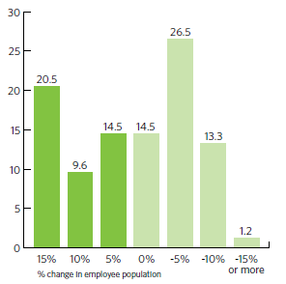
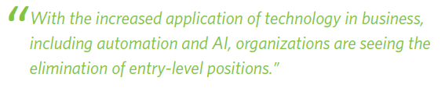
The impacts of change
Notes:
Expected change in employee population over next five years due to AI/automation.

Slide 7
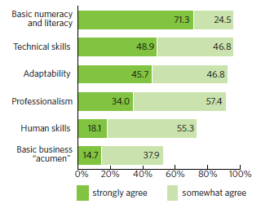
Greater expectations for new grads
70 per cent say they expect more from new grads
Skills they need to bring to the job are different
They are well-equipped with numeracy, literacy and technical skills.
Notes:
Do new grads have these skills?

Slide 8
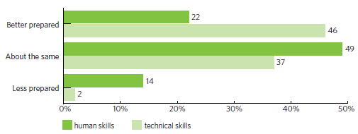

Improvements in the last five years
Notes:
Preparedness of graduates compared to five years ago.

Slide 9
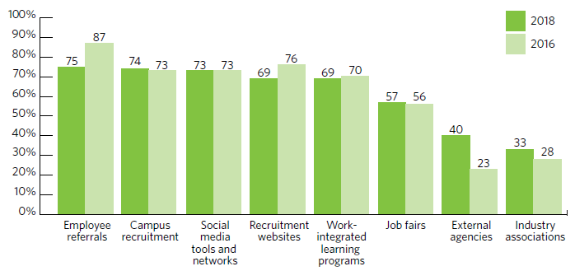
How companies find entry-level employees
Notes:
Preparedness of graduates compared to five years ago.

Slide 10
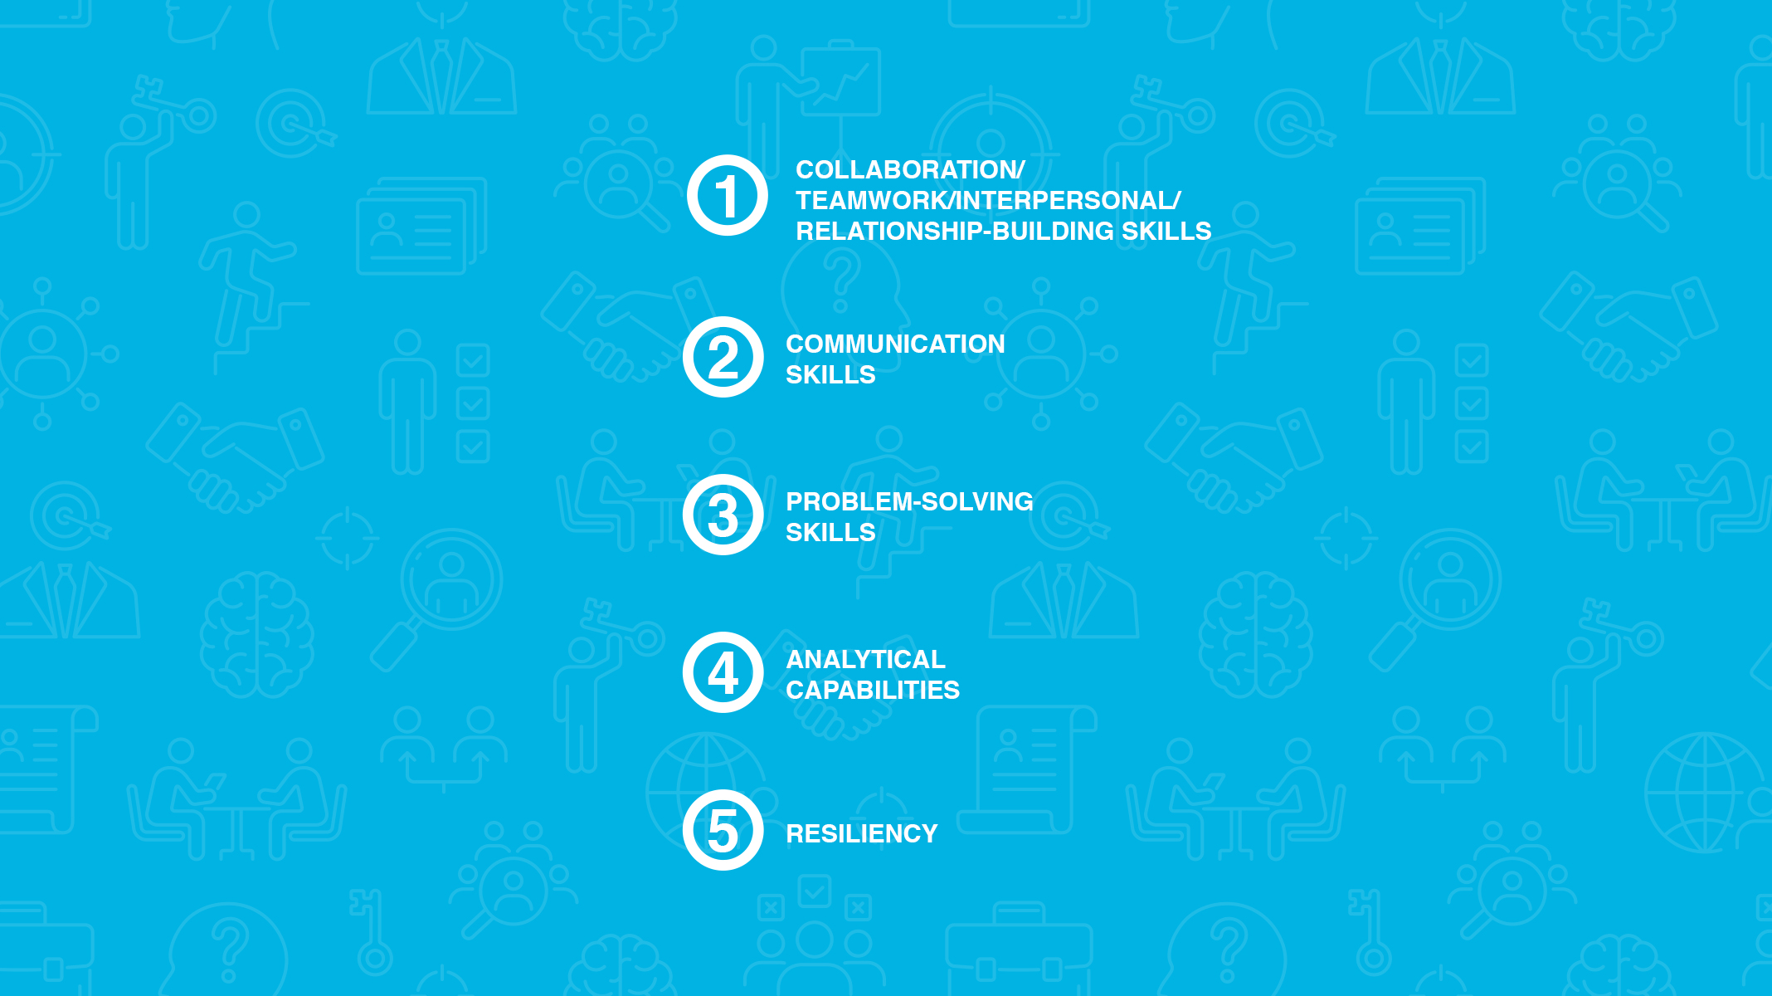

Top 5 skills for entry-level hires
Collaborative / teamwork / interpersonal skills
Communication skills
Problem-solving skills
Analytical capabilities
Resiliency
Notes:
According to the skills survey, these are the top 5 skills for entry-level hires. It should be emphasized that these are the characteristics that differentiate top candidates who already meet the required threshold for functional knowledge – but when asked, 70 per cent of businesses say that the expectations for new grads have increased dramatically. The “good enough” grads from five years ago can’t cut it anymore.
And it’s exactly these types of skills that students develop during work-integrated learning experiences.

Slide 11
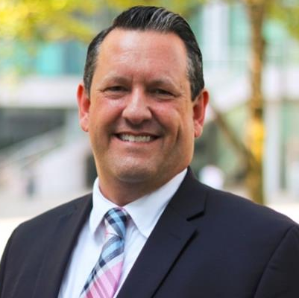
BRIEN CONVERY
Director, Early Talent Acquisition, Attraction and Engagement, RBC

Slide 12
1
Demystifying the Opportunities Together
2
Promoting an ecosystem for learning and growth
3
Embracing Diversity and removing unconscious and conscious bias
Young people are exploring. They don’t know what they don’t know. We need to educate with facts and opportunities based on today and the future of work.
Today’s youth are more diverse, educated, connected and socially engaged – how do we keep them engaged?
Diversity for Diversity sake is not enough to create change. The need to understand our biases is an important factor to take action.

Slide 13

Demystifying the Opportunities Together
1
“My daughter is in Engineering do ‘we’ hire engineering students?”
“I have a Biology Degree, can I work in Banking?”
“Do you need a cover letter with my resume?”
“Is a College Degree valued in the workplace?”
“I don’t have a 4.0 GPA should I apply?”
“Do you only hire Co-ops?”

Slide 14













Promoting an ecosystem for learning and growth
2

Slide 15


Promoting an ecosystem for learning and growth
2
RBC Café Supports Work-Integrated Learning on Scale and with Purpose for our Students

Slide 16


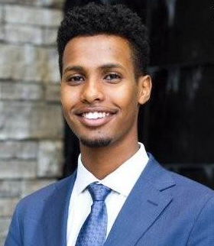
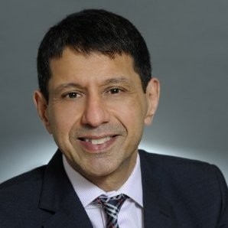





Promoting an ecosystem for learning and growth
2
From an RBC Café Coffee Chat in Toronto to NYC
Summer Internship
Summer Internship
FULL-TIME JOB!!!

Slide 17
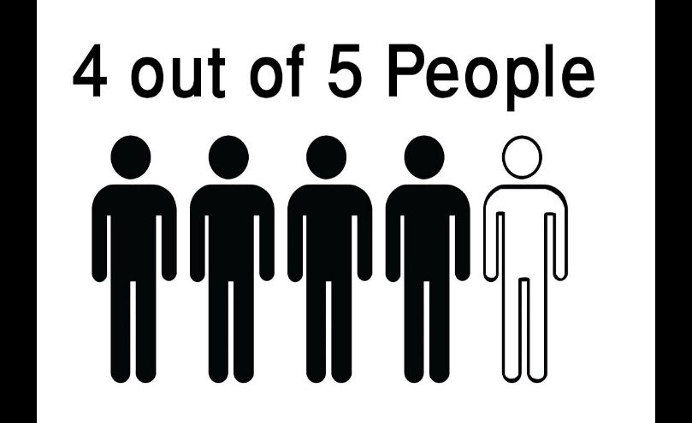

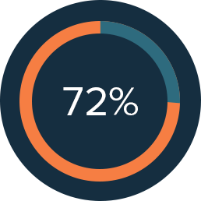
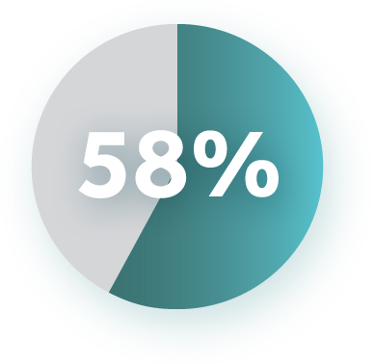
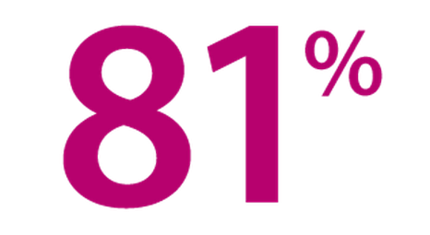
Promoting an ecosystem for learning and growth
2
RBC Café Supports Work-Integrated Learning on Scale and with Purpose for our Students
students said they feel more prepared for their career after their coffee chats
of students have a better understanding of career opportunities at RBC
of students are more confident networking
of students identified key skills that they need to develop in the next 6-12 months
of students gained career advice that will help them make the next step in their career

Slide 18
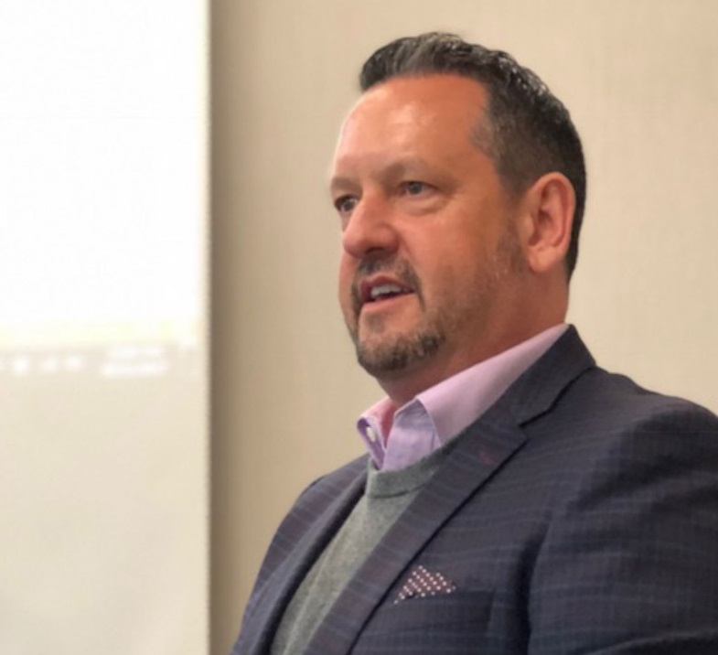
Embracing Diversity and removing unconscious and conscious bias
3
Diversity Matters, Inclusion is Us
“Diversity is understood by many as “the condition of being different” whereas inclusion is thought to be “the act of making a person part of a group.
These two concepts hinge together as a dynamic force for innovative business leaders and employees to embrace. The positive returns to individuals, business and the community are multifold.” – Brien Convery, Roll Out the Employer Welcome Mat to LGBTQ Jobseekers: Diversity Matters, Inclusion is Us, CERIC Careering Magazine, June 2018
1
Foster diversity, inclusion and empathy in the classroom
2
Encourage advocacy for individuals to self-identify and to find the right fit for them
3
Provide a supportive environment from recruitment stage, to hiring, to workplace culture that supports diversity for inclusion

Slide 19
PANEL DISCUSSION

Slide 20
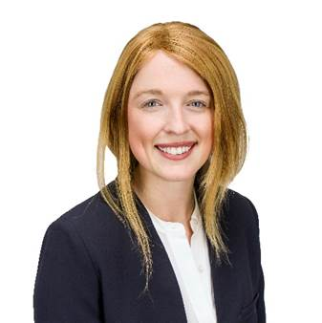


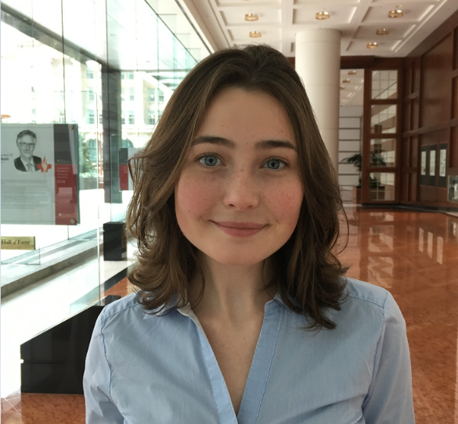
EMILY FLECK
Associate, Jacket River
Queen’s University
JOSH ROBERTS
RBC Co-op Summer Student 2018, Operations
Seneca College
SHANNON KELLY
VP Finance, Ontario Undergraduate Student Alliance
Wilfred Laurier University
HANNAH FLEMING
RBC Co-op Winter | Fall 2018, Analyst Capital Markets Supplier Management
University of Waterloo
Notes:
Emily Fleck
Josh Roberts is a 3rd-year student and varsity athlete at Seneca College enrolled in the Business Administration management program. Over the 4 months spent at RBC as an operations agent, he displayed dedication and passion for being involved with new learning experiences together with a strong interest in meeting new people and making connections he was recognized with an RBC top summer student networking award.
Shannon Kelly
Hannah Fleming

