Slide 1
And finally:
Test Time

Slide 2


Slide 3

“There are widespread concerns that the colleges are providing career education that is too narrowly focused on specific job skills…
We define generic skills to be practical life skills essential for both personal and career success.
They include language and communication skills, math skills, learning and thinking skills, interpersonal skills, and basic technological literacy.”

Slide 4
Classes of Postsecondary Skills
Disciplinary knowledge
Solve equations
Know concepts
Basic cognitive skills
Literacy
Numeracy
Higher order cognitive skills
Problem solving
Critical thinking
Communication
Behavioural (soft) skills
Persistence
Initiative
Resilience

Slide 5
THANK YOU

Slide 6

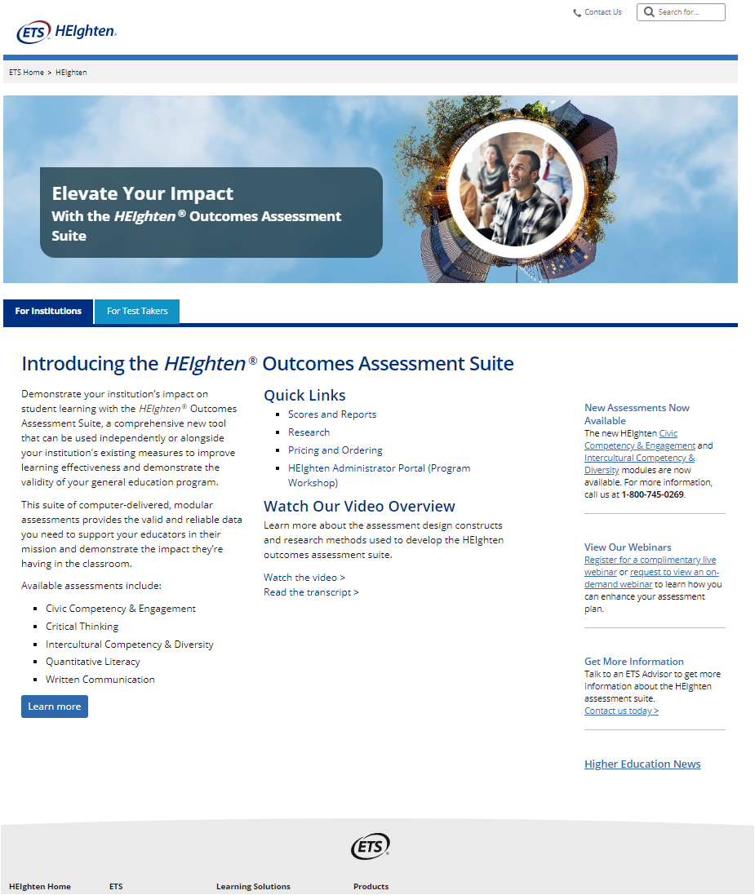
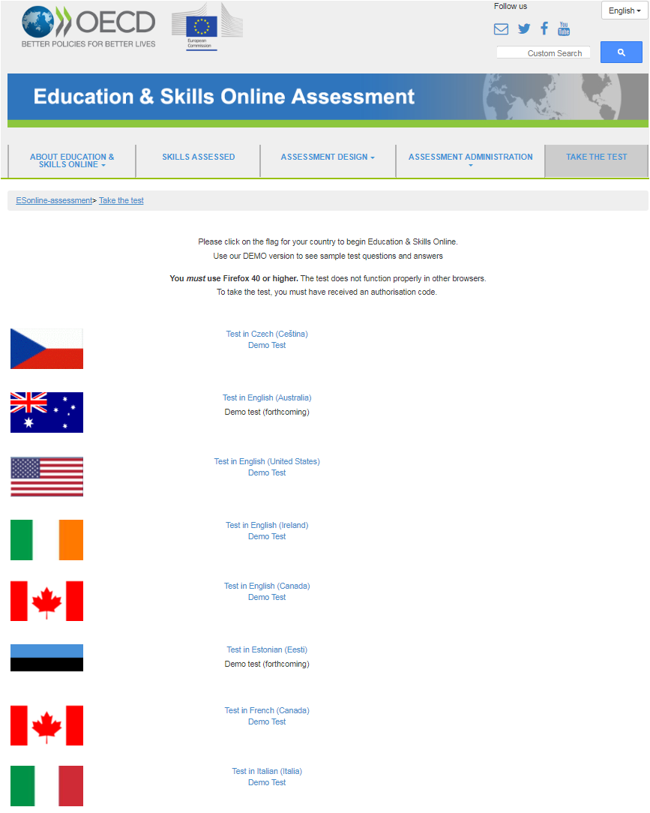
Literacy, Numeracy
Critical Thinking

Slide 7
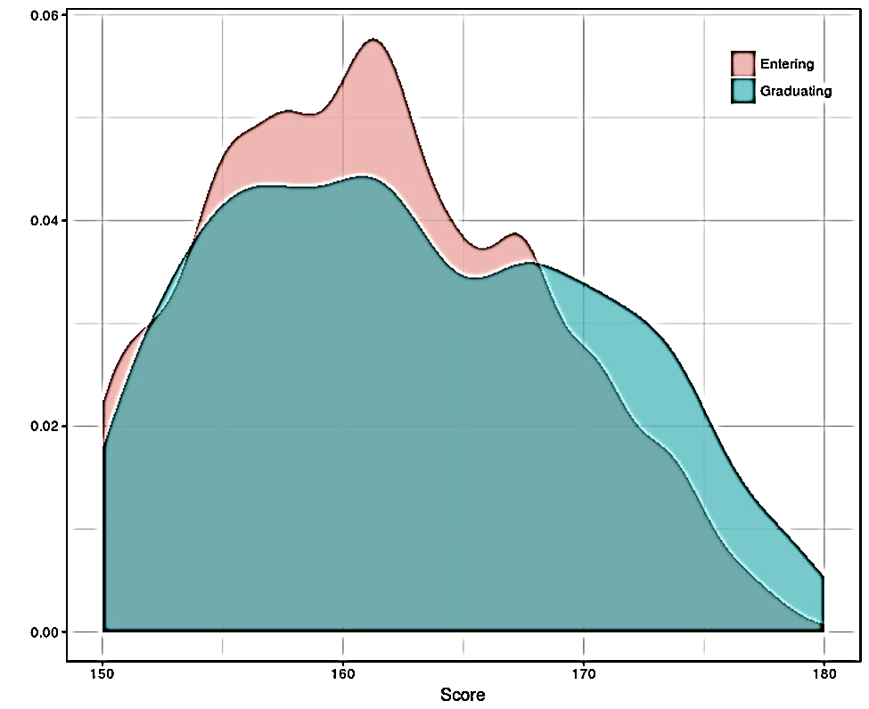
Heighten CRITICAL THINKING

Slide 8
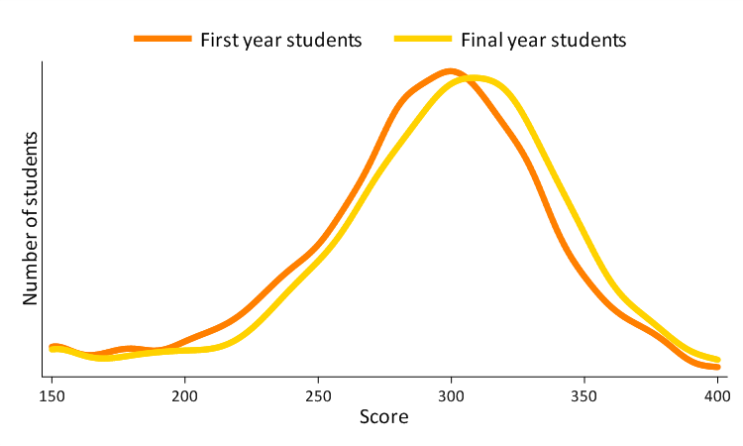
ESO NUMERACY

Slide 9
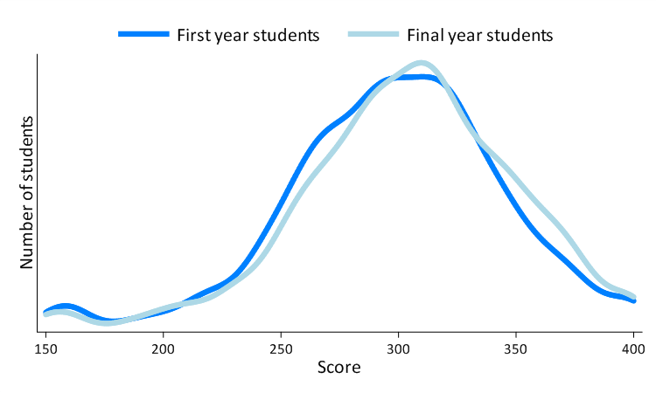
ESO LITERACY

Slide 10
ESO LITERACY

Slide 11
ESO NUMERACY

Slide 12
“When a university graduate is recruited, the employer has in their hire an exceptional communicator, an adept researcher, a problem solver and a critical thinker…”

Slide 13
GO BIG
(OR GO HOME)

Slide 14
YOU ALL PASSED

