Slide 1

Large Scale Assessment: Authentic Measures of Student Learning and the VALUE Institute Approach
Jillian Kinzie, Indiana University Center for Postsecondary Research
www.valueinstituteassessment.org

Slide 2
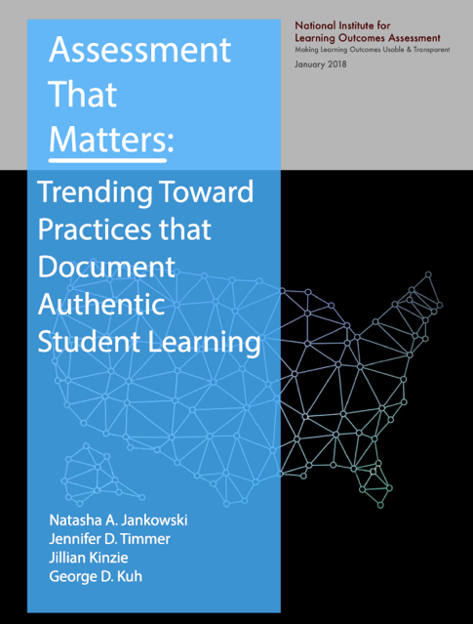
Institutions are using a variety of data collection approaches to yield actionable evidence
Trending towards greater use of authentic measures of student learning: rubrics, classroom-based performance assessments & capstones

Slide 3
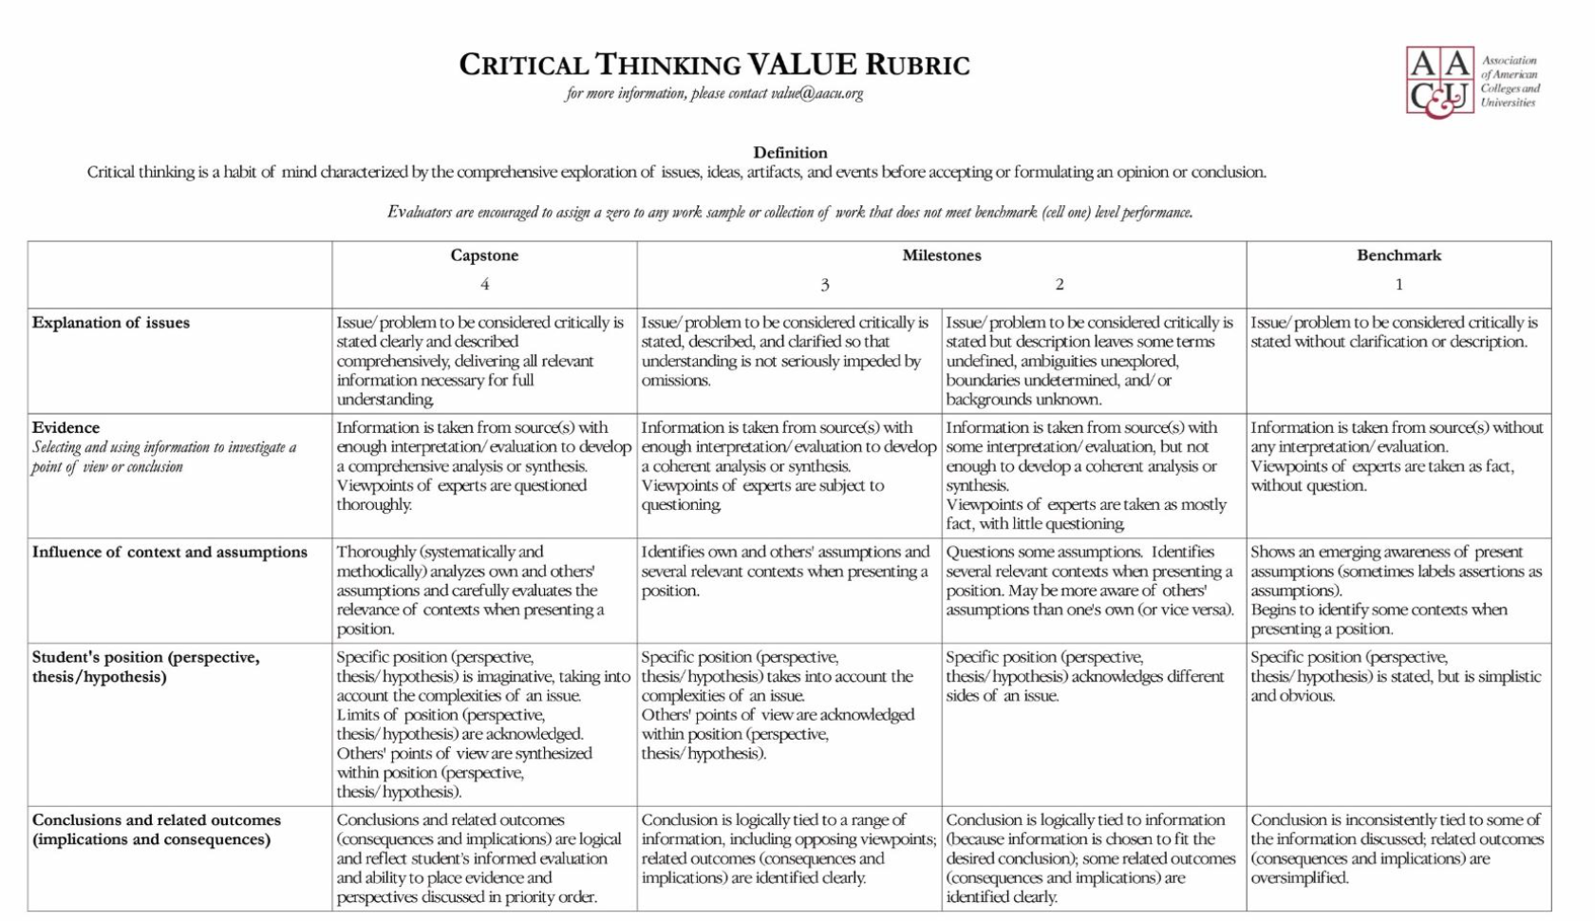
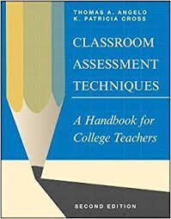

What form of assessment is most valuable for IMPROVING student learning & success?
classroom-based work

Slide 4
Purpose of Assessment using Authentic Measures of Student Learning
Use results to make changes that ACTUALLY improve student learning & success
Link assessment more closely with teaching & learning
Use sources of evidence of student learning that are already integral to teaching
Make assessment seem (and be) less like an add-on, more like regular pedagogical work
Increase faculty engagement with the assessment process

Slide 5

Authentic Measures of Student Learning: Assignments and Artifacts
Course-based assignments
  Papers, lab reports,
General education outcome measures
Writing-Intensive sequence artifacts
Program-level (Major) capstone products
Portfolios
Co-curricular learning products/artifacts

Slide 6

Origin of AAC&U VALUE Rubrics
Critical Thinking, Creative Thinking, Written Comm, Oral Comm, Quant Literacy, Info Literacy, Teamwork, Problem Solving, Civic Knowledge & Engagement, Intercultural Knowledge & Competence, Ethical Reasoning & Action, Global Learning, Lifelong Learning, Integrative Learning…
2007-2009 teams of faculty and other educational professionals developed16 VALUE rubrics for the LEAP Essential Learning Outcomes
Each rubric developed from most frequently identified characteristics or criteria of learning for each outcome
Rubrics were tested by faculty with their own students’ work

Slide 7
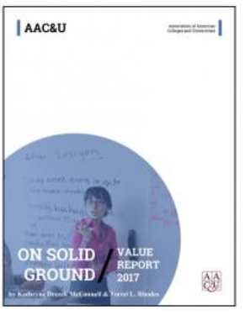
On Solid Ground shares results from first 2 years of VALUE Initiative data collection, a nationwide project to examine direct evidence of student learning.
“This project represents the first attempt to develop a large-scale model for assessing student achievement across institutions that goes beyond testing,”
-- Lynn Pasquerella, president of AAC&U

Slide 8
Large Scale Assessment Using Authentic Student Work: the VALUE Institute
NEW in 2018! VALUE Institute
2018 AAC&U partners with Indiana University’s Center for Postsecondary Research – to help document, report, and use learning outcomes evidence to improve student success in college
VALUE Institute enables higher education institutions, department, program, state, consortium or providers to utilize VALUE rubrics, collect and upload samples of student work to a digital repository; work is scored by certified VALUE Institute scorers for external validation of learning
Allows for examination of learning achievement across student groups, e.g. first generation, gender, racial and ethnic groups, year in school, etc., and reveal the larger landscape of learning outcome achievement

Slide 9

VALUE Rubric Approach - Assumptions
Student work is representation of student motivated learning
Focus on what student does in terms of key dimensions of learning outcomes
Faculty and educator expert judgment
Results are useful and actionable for
improvement of learning
Diverse sampling plan to help raise up,
not wash out, inherent diversity—
from race, ethnicity, & socioeconomic
status to the diversity of courses,
credit-levels, and disciplinary backgrounds—found on campuses.

Slide 10
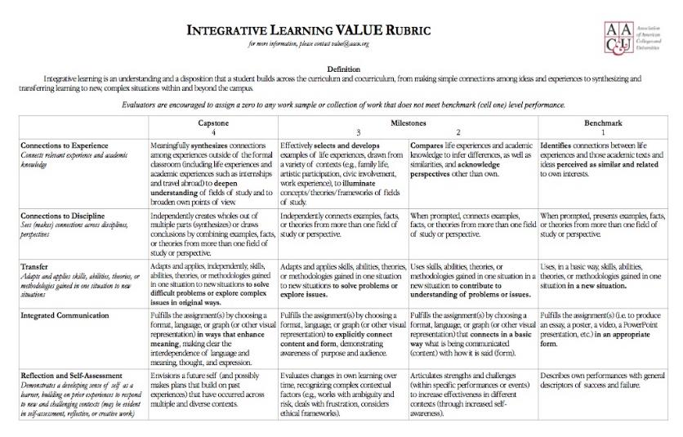
The Anatomy of a VALUE Rubric
Criteria
Levels
Performance
Descriptors

Slide 11
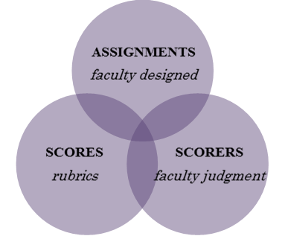
VALUE Approach to Assessment – Not Just Rubrics!

Slide 12
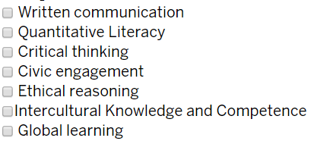
VALUE Institute: Select your Learning Outcomes (100 artifacts per outcome)

Slide 13
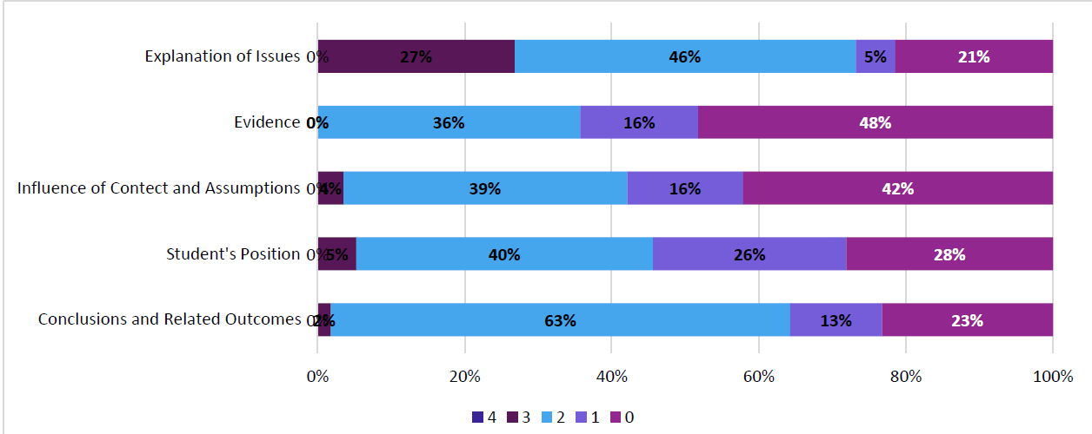
Prepared Reports - benchmarking and normative comparison to come
Critical Thinking results
SAMPLE
breakdown of student scores overall by rubric criteria and levels

Slide 14
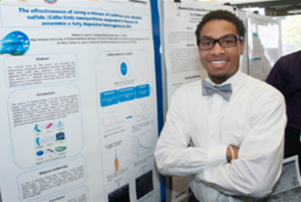
Potential to Assess Learning Outcomes in Experiential Learning via the VALUE Institute
Test VALUE Rubrics for assessing learning outcomes in High-Impact Practices/ Experiential Learning
HIP/EL artifacts: capstone projects, case study assignments, service-learning reflection tasks, internship product portfolios, simulation performance, undergraduate
research posters/papers…

Slide 15

VALUE Institute invites the higher education community writ large to engage in a nuanced, robust examination of the quality of student learning and to explore measures of success for all students
Notes:
refer

Slide 16
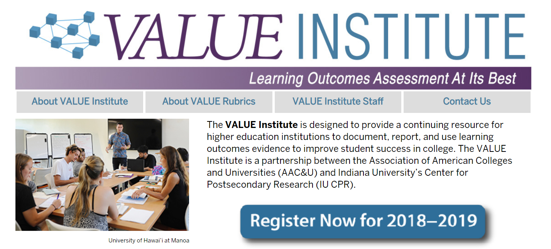
http://valueinstituteassessment.org

Slide 17
Large Scale Assessment Issues:
Context for Assessment (where does assessment occur?)
Procedure/Protocol (what must be done to implement assessment?)
Student Participation (what issues are associated with student participation?)
Faculty Involvement (how are faculty involved?)
Interpreting & Acting on Results (what are the benefits and limitations of results? how can they be used?)

Slide 18
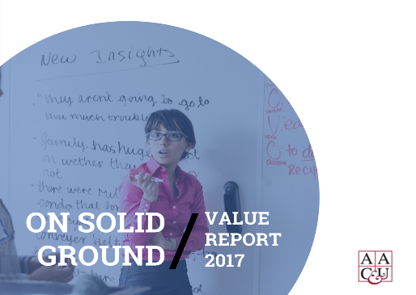
Questions & Answers
www.valueinstituteassessment.org
www.aacu.org/OnSolidGroundVALUE

