Slide 1
Learning Outcomes – Evolution of Assessment Conference Council of Ontario Universities DoubleTree by Hilton Hotel Toronto Downtown
Assessing International Graduate Students
Evolving Academic Literacies:
Master of Engineering
17th-18th October 2016
Stephen C. Armstrong

Slide 2

III The Recognized Engineer Gaps – “Soft Skills”

Slide 3

III The Recognized Gaps – Critical Thinking

Slide 4
UNIVERSITY OF TORONTO- Master of Engineering (MEng)
MEng - Professional Degree Stream…
MEng- 20% of all graduate students
MASc - 22%
PhD – 58%
9 or 10 courses, or combine fewer courses with a project.
Full-time in a year, or Extended Full-time in two years.

Slide 5
VII MEng Applications
2015/2016 (2,000 applicants) – 800 Domestic and 1,200 International

Slide 6
VII MEng Enrolment
2015/2016 – 299 International and 516 Domestic

Slide 7
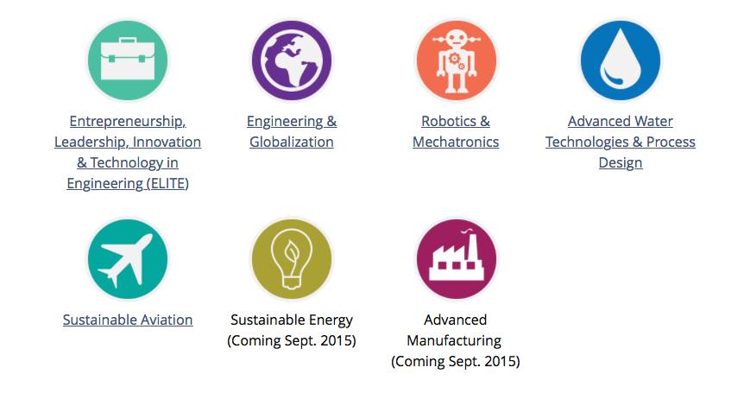
VII MEng Certificates/Specializations

Slide 8
ELITE Certificate
E - Entrepreneurship
L - Leadership
I - Innovation
T - Technology
E - Engineering

Slide 9
VII ELITE Certificates Awarded
In 2015/2016 - 125

Slide 10
APS1012 Management of Innovation - Syllabus
Part I – Innovation in Context
Week 1 Mod 1 –Orientation, overview of syllabus, & planning assignments
Week 2 –Mod 2- Dimensions of Innovation
Week 3 – Mod 3- Diffusion of Innovation
Part 2 – Developing an Innovative Enterprise
Week 4 –Mod 4- Designing an Innovative Enterprise - Business Transformation
Week 5- Mod 5- Organizational Approach to Cultural Transformation
Week 6 –Mod 6- Enterprise Integration and Process Management
Part 3 – Building the Innovation Process Methodology
Week 7 – Mod 7 - Integrating Process, Project Management & IPTs
Week 8 –Mod 8 - Integrating Process, Project & Knowledge Management
Week 9 –Mod 9 - Deploying and embedding the innovation process
Part 4 – Sustaining the Innovative Lean Enterprise
Week 10 – Mod 10 - Continuous Analyses of the “As Is” / “To Be” Business Process
Week 11 – Mod 11- Continuous Improvement through creativity & problem solving
Week 12 – Mod 12 - Engaging the people and maintaining an innovative culture
Part 5 - Final Team Innovation Projects

Slide 11
APS1012 - Learning Outcomes
Establish a context for Innovation and its dimensions
Analyze the elements of Innovation management as a key organizational capability
Explain how innovations are diffused across cultures
Identify how to develop an innovative future state vision through systems thinking
Develop and prepare an organization for an innovation transformation initiative
Explain and assess a culture of innovation for readiness to change
Identify how to overcome the barriers to innovation in organizations
Develop the key leadership roles in managing innovation at the group/department, division, and corporate levels
Develop an integrated enterprise approach to innovation
Design an Innovation delivery system for various environments
Apply process management and project management practices to product development
Organize and develop integrated Project / Product teams (IPT’s) for project execution
Deploy and Embed an innovation process through the core culture
Continuously assess the “As Is” business processes
Continuously improve the “As Is” process through structured problem solving
Apply the key strategies to engage the people to sustain an innovative culture
Identify challenges in measuring and maintaining innovation performance

Slide 12
APS1012-Assessment Approach-Online Version
Inclass Presentations – 4 Off based on module content discussion board questions – 30% OR…..
Discussion Board Contribution (10 out off 12) – provides breadth in knowledge 30%
Mid Term Critical Review (CR1) Paper (based on discussions Mods 1-6) 15%
One 4-6 minute video that critiques your mid term CR using the Rubric 10%
Final Critical Review (CR2) Paper (based on discussions in Mods 7-12) 15%
Project Team Report– (Charter - 5%) (PPT Summary – 5%) 30%

Slide 13
APS1012 Course Mechanics
Extensive use of online learning tools (Blackboard) – 60 plus Videos across all modules
12 Modules coordinated to open each week
Students watch lectures before class
Discussion board engagement
Written critical reviews
Assessment Rubric for presentation and written work
Activity based learning in class – students deliver response to questions in lecture
Inclass student response.

Slide 14
APS1012 - Assessment Approach for IFP
Simplified the Deliverables for IFP..
3 written Critical Review (CR) papers (650-1000) words based on a primer or academic paper readings and a special interest topic 30%
Individual in-class presentations (4 off) based on module questions (video and reading) 40%
Final Project Team Report – (Charter – 5% & PPT Summary 5%) 30%
Assessment rubrics – discussions, project reports, presentations, critical reviews

Slide 15
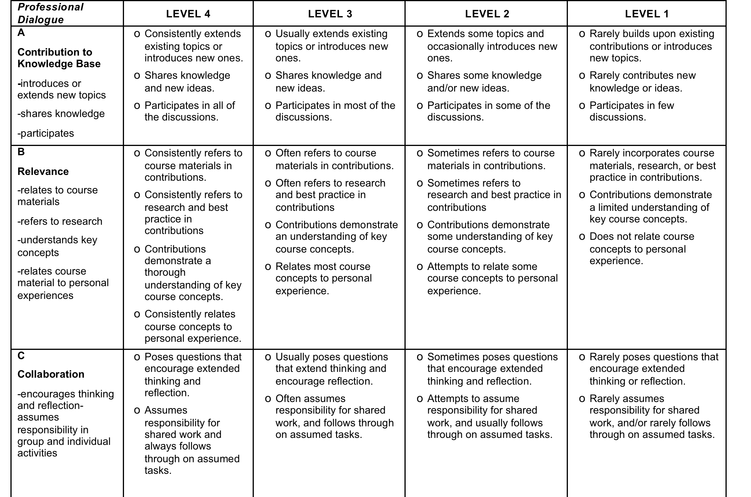
Assessment Rubric – Discussion Board

Slide 16
APS1012-IFP Reflections – Lessons Learned
Class Size 16-20
All My courses simulate the real world of practice
Week 2 – Students complain that I am not lecturing enough – not oriented for real world practice – I resist
Foreign Language students Kick in around week 7 of the 12 week course- steep learning curve – they thank me for not lecturing in the class - amazing
Practice practice practice – presenting, discussing, preparing, teamwork engagement, CR writing
Teamwork during the week with and in class – constant feedback with IFP language profs – works well
Mainly Chinese students –used to sage on the stage - first time in the West - need to instill humor in the class

